Slide 1
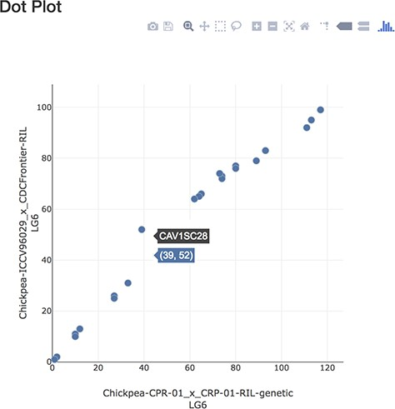
Figure 7 Dot plot page displaying markers in common between linkage groups.
Notes:
Figure 7 Dot plot page displaying markers in common between linkage groups.
Unless provided in the caption above, the following copyright applies to the content of this slide: © The Author(s) 2019. Published by Oxford University Press.This work is written by US Government employees and is in the public domain in the US.

