Slide 1
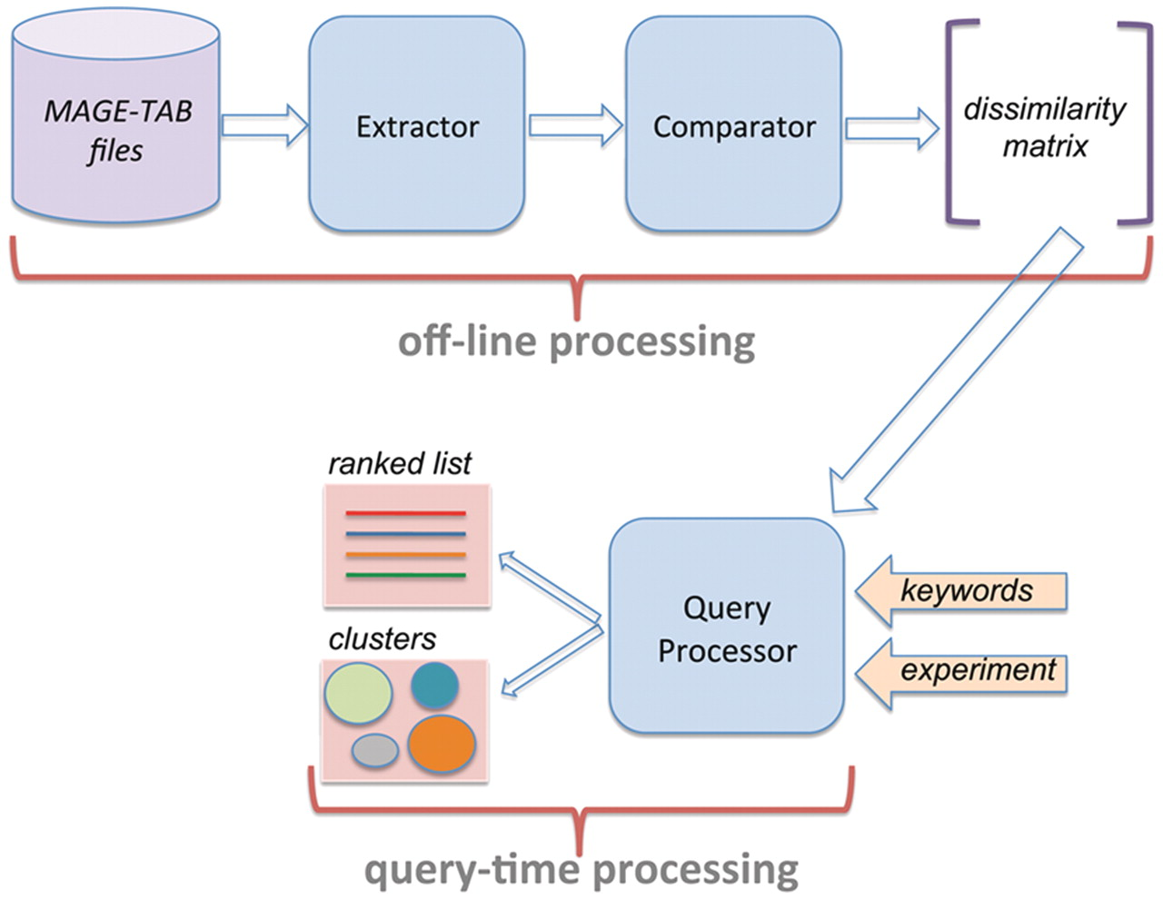
Figure 1. System architecture of AnnotCompute. Off-line processing is executed once a month, and builds a dissimilarity ...
Notes:
Figure 1. System architecture of AnnotCompute. Off-line processing is executed once a month, and builds a dissimilarity matrix of experiments. This matrix is used at query time to produce a ranked list of results in ‘query-by-example’, or to cluster results in the ‘clustering’ scenario.
Unless provided in the caption above, the following copyright applies to the content of this slide: © The Author(s) 2011. Published by Oxford University Press.This is an Open Access article distributed under the terms of the Creative Commons Attribution Non-Commercial License (http://creativecommons.org/licenses/by-nc/3.0), which permits unrestricted non-commercial use, distribution, and reproduction in any medium, provided the original work is properly cited.

