Slide 1
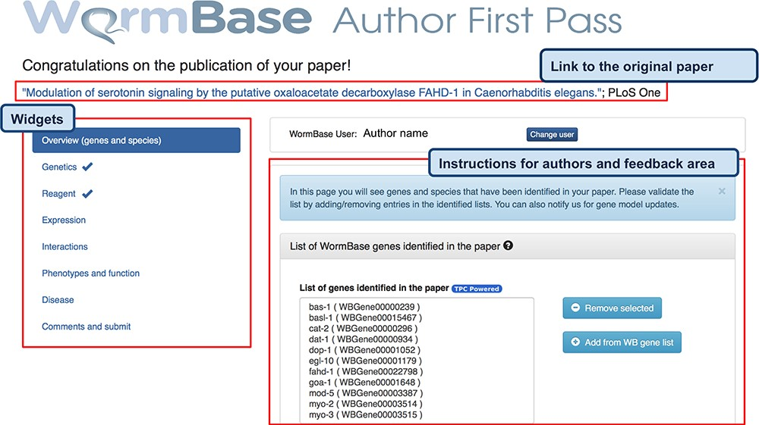
Figure 2 AFP feedback form for authors - Overview (genes and species) widget. The form is divided into widgets that ...
Notes:
Figure 2 AFP feedback form for authors - Overview (genes and species) widget. The form is divided into widgets that group the data types into different categories to simplify the work for authors—left sidebar. Between the title and the main author feedback area, there is a component that displays the WormBase person name and ID for the identified corresponding author and allows the users to select a different person using an autocomplete on WormBase database. The selected person ID is stored with the curated data in our database when the submission process is completed. Each widget shows a colored panel at the top with specific instructions on how to curate the included data types. An example of the list of genes extracted can be seen in the feedback area at the center of the page.
Unless provided in the caption above, the following copyright applies to the content of this slide: © The Author(s) 2020. Published by Oxford University Press.This is an Open Access article distributed under the terms of the Creative Commons Attribution License (http://creativecommons.org/licenses/by/4.0/), which permits unrestricted reuse, distribution, and reproduction in any medium, provided the original work is properly cited.

