Slide 1
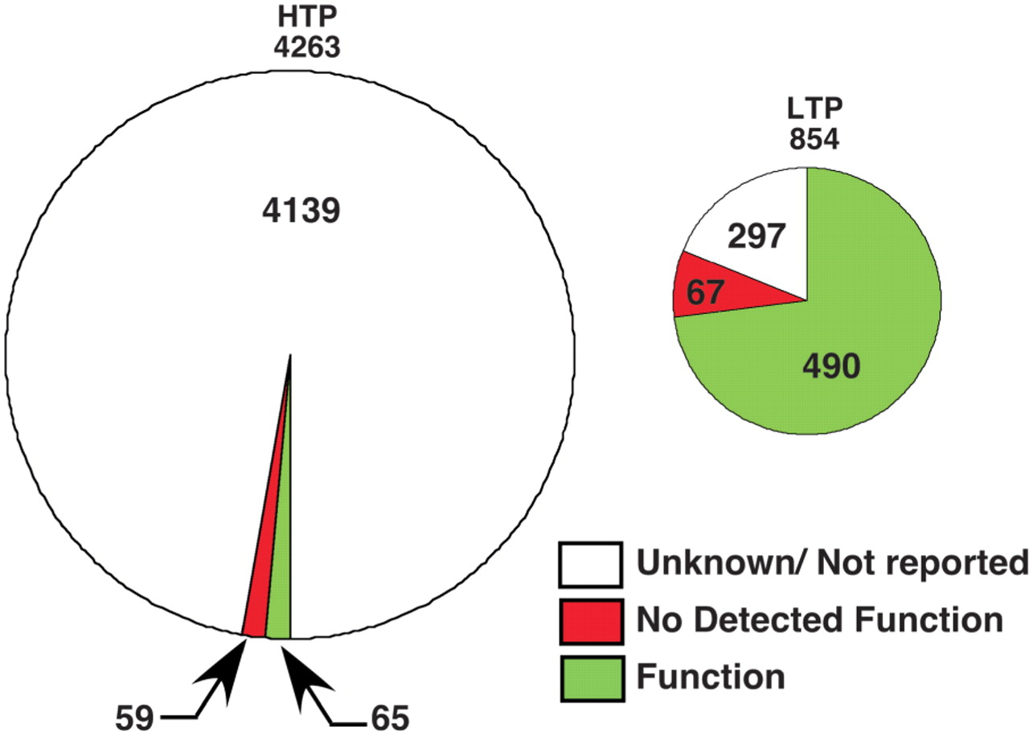
Figure 5. Proportion of phosphorylation sites in PhosphoGRID with defined functions. Summaries of phosphorylation sites ...
Notes:
Figure 5. Proportion of phosphorylation sites in PhosphoGRID with defined functions. Summaries of phosphorylation sites identified by HTP mass spectrometry-based studies (left chart) or focused LTP studies on individual proteins (right chart) are shown.
Unless provided in the caption above, the following copyright applies to the content of this slide: © The Author(s) 2010. Published by Oxford University Press.This is Open Access article distributed under the terms of the Creative Commons Attribution Non-Commercial License (http://creativecommons.org/licenses/by-nc/2.5), which permits unrestricted non-commercial use, distribution, and reproduction in any medium, provided the original work is properly cited.

