Slide 1
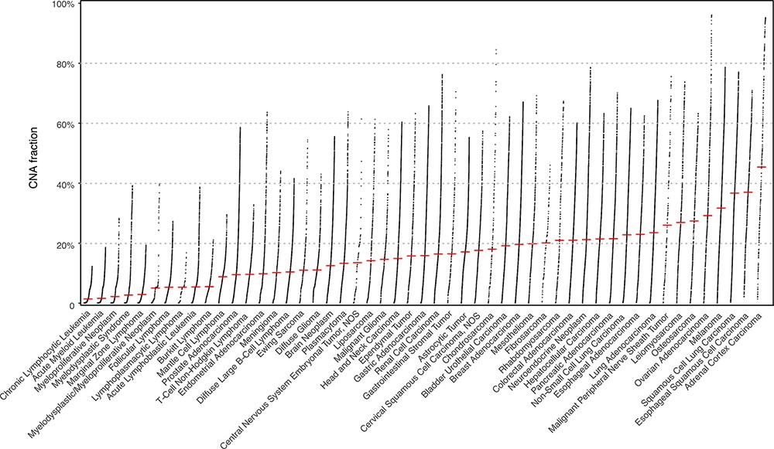
Figure 1. The currently available CNA data points in Progenetix and TCGA Progenetix database contain 115 357 cancer ...
Notes:
Figure 1. The currently available CNA data points in Progenetix and TCGA Progenetix database contain 115 357 cancer samples with 92 307 mapped to the 51 defined critical nodes in NCIt ontology tree and 23 050 samples not mapped to the tree (black), whereas TCGA repository contains 11 090 samples with 9103 samples mapped and 1987 samples not mapped to the tree (black). Colors of the stacked bar plot (left) match the branch colors on NCIt ontology tree (right).
Unless provided in the caption above, the following copyright applies to the content of this slide: © The Author(s) 2021. Published by Oxford University Press.This is an Open Access article distributed under the terms of the Creative Commons Attribution License (http://creativecommons.org/licenses/by/4.0/), which permits unrestricted reuse, distribution, and reproduction in any medium, provided the original work is properly cited.

Slide 2
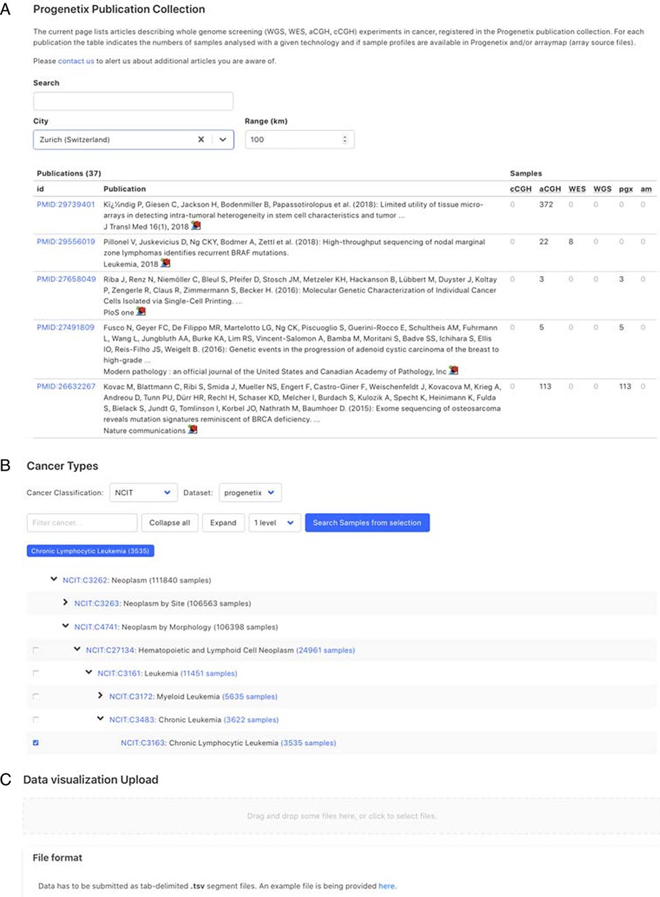
Figure 4. Demonstration of further functionality pages: A. Publication search; B. NCIt hierarchical tree navigation A: ...
Notes:
Figure 4. Demonstration of further functionality pages: A. Publication search; B. NCIt hierarchical tree navigation A: Cancer-genomics-associated publications are recorded with number of samples stratified by technology used. The publications can be filtered by keywords; B: Part of the sample subsets contained in Progenetix under the hierarchical NCIt classification tree. It allows for selection of sample subsets at different levels; C: User can upload custom segment files for data visualization.
Unless provided in the caption above, the following copyright applies to the content of this slide: © The Author(s) 2021. Published by Oxford University Press.This is an Open Access article distributed under the terms of the Creative Commons Attribution License (http://creativecommons.org/licenses/by/4.0/), which permits unrestricted reuse, distribution, and reproduction in any medium, provided the original work is properly cited.

Slide 3
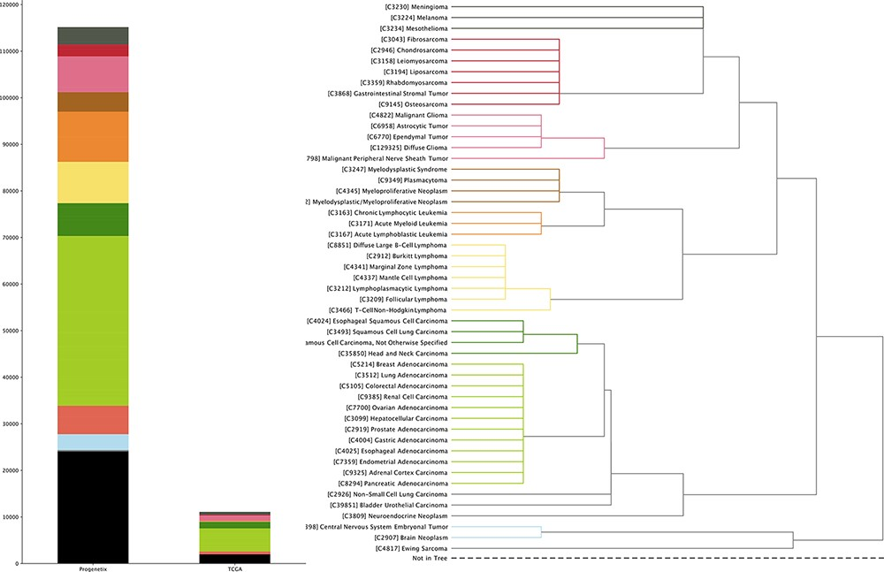
Figure 2. The genomic CNV fraction across 51 NCIt umbrella nodes Each dot represents one sample’s CNV fraction range ...
Notes:
Figure 2. The genomic CNV fraction across 51 NCIt umbrella nodes Each dot represents one sample’s CNV fraction range from 0 to 1 and the red horizontal line indicates median CNV of the respective cancer type. Each cancer type contains between 104 and 11 804 CNV profiles (median 904; See Supplementary Table S1).
Unless provided in the caption above, the following copyright applies to the content of this slide: © The Author(s) 2021. Published by Oxford University Press.This is an Open Access article distributed under the terms of the Creative Commons Attribution License (http://creativecommons.org/licenses/by/4.0/), which permits unrestricted reuse, distribution, and reproduction in any medium, provided the original work is properly cited.

Slide 4
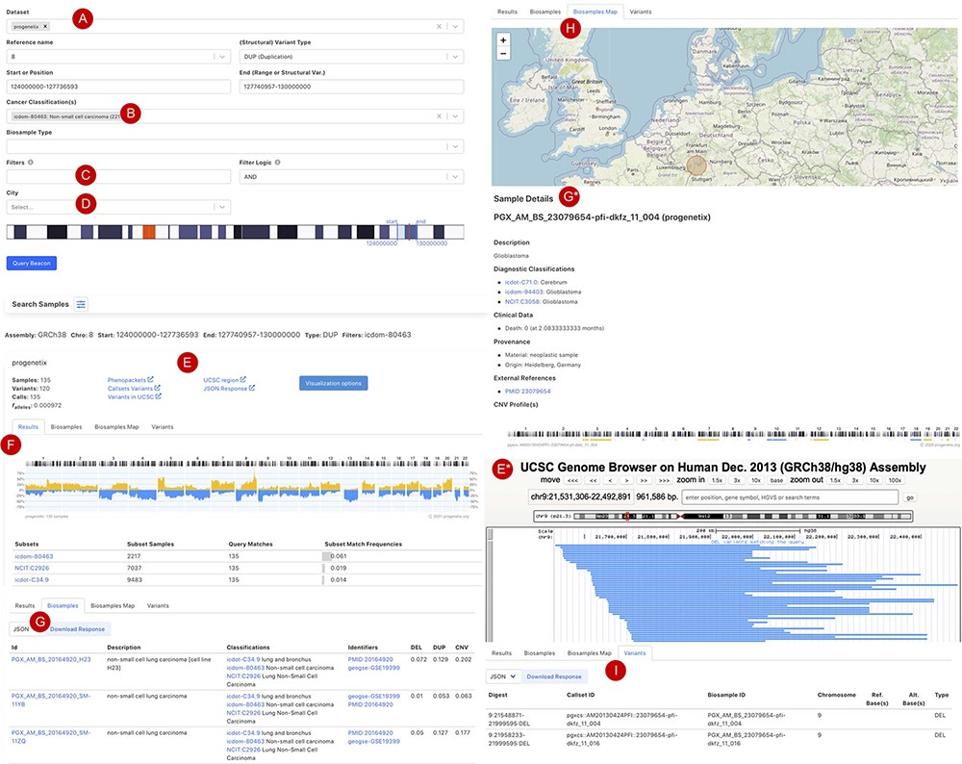
Figure 3. Beacon-style query using fuzzy ranges to identify biosamples with variants matching the CNA range This ...
Notes:
Figure 3. Beacon-style query using fuzzy ranges to identify biosamples with variants matching the CNA range This example queries for a continuous, focal duplication covering the complete MYC gene’s coding region with < = 6 Mb in size. A: Filter for dataset; B: filter for cancer classification (NCIt and ICD-O-3 ontology terms available); C: additional filter, e.g. Cellosaurus; D: additional filter for geographic location; E: external link to UCSC browser to view the alignment of matched variants; F: cancer type classification sorted by frequency of the matched biosamples present in the subset; G: list of matched biosamples with description, statistics and reference. More detailed biosample information can be viewed through ‘id’ link to the sample detail page; H: matched variants with reference to biosamples can be downloaded in json or csv format.
Unless provided in the caption above, the following copyright applies to the content of this slide: © The Author(s) 2021. Published by Oxford University Press.This is an Open Access article distributed under the terms of the Creative Commons Attribution License (http://creativecommons.org/licenses/by/4.0/), which permits unrestricted reuse, distribution, and reproduction in any medium, provided the original work is properly cited.

