Slide 1
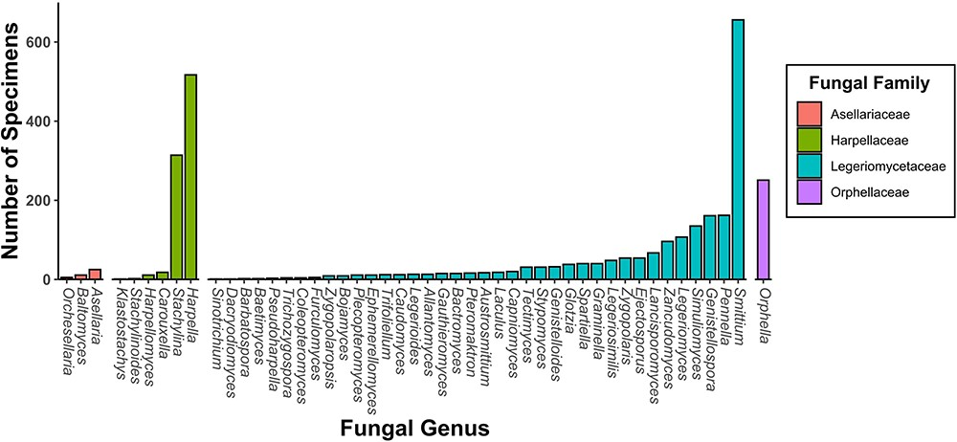
Figure 2. A bar chart of specimen records within the CIGAF database by genus. The bars are colored by fungal family and ...
Notes:
Figure 2. A bar chart of specimen records within the CIGAF database by genus. The bars are colored by fungal family and are ordered from lowest to highest prevalence within each category.
Unless provided in the caption above, the following copyright applies to the content of this slide: © The Author(s) 2023. Published by Oxford University Press.This is an Open Access article distributed under the terms of the Creative Commons Attribution License (https://creativecommons.org/licenses/by/4.0/), which permits unrestricted reuse, distribution, and reproduction in any medium, provided the original work is properly cited.

