Slide 1
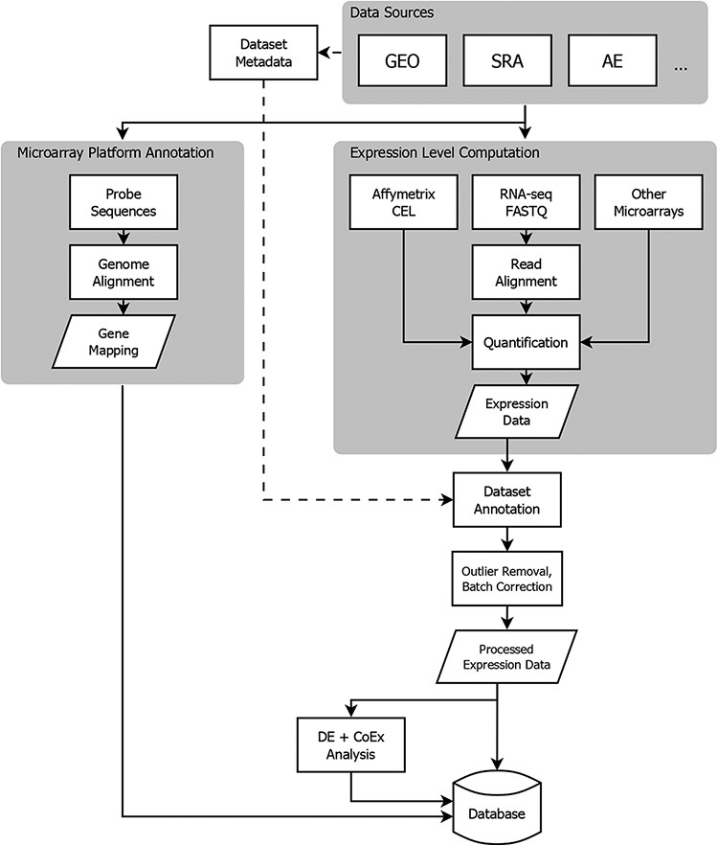
Figure 1. Flowchart showing the flow of data from NCBI GEO into the Gemma database. Three classes of information are ...
Notes:
Figure 1. Flowchart showing the flow of data from NCBI GEO into the Gemma database. Three classes of information are processed: platform metadata, gene expression data and metadata. While microarray data reside on GEO, raw RNA-sequencing (RNA-seq) data are obtained from NCBI Sequence Read Archive (SRA). AE: ArrayExpress, DE: differential expression, and CoEx: co-expression.
Unless provided in the caption above, the following copyright applies to the content of this slide: © The Author(s) 2021. Published by Oxford University Press.This is an Open Access article distributed under the terms of the Creative Commons Attribution License (http://creativecommons.org/licenses/by/4.0/), which permits unrestricted reuse, distribution, and reproduction in any medium, provided the original work is properly cited.

Slide 2
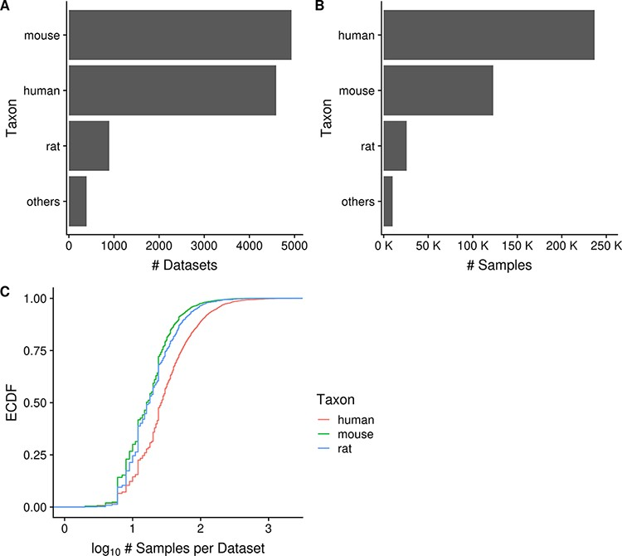
Figure 2. Horizontal bar charts displaying the number of datasets (A) and samples (B) grouped by taxon; empirical ...
Notes:
Figure 2. Horizontal bar charts displaying the number of datasets (A) and samples (B) grouped by taxon; empirical cumulative distribution function representation of the number of datasets against the number of samples per dataset grouped by taxon (C). ‘Others’ taxon group consists of D. rerio, D. melanogaster, C. elegans and S. cerevisiae. (Ndataset = 10 420 in C).
Unless provided in the caption above, the following copyright applies to the content of this slide: © The Author(s) 2021. Published by Oxford University Press.This is an Open Access article distributed under the terms of the Creative Commons Attribution License (http://creativecommons.org/licenses/by/4.0/), which permits unrestricted reuse, distribution, and reproduction in any medium, provided the original work is properly cited.

Slide 3
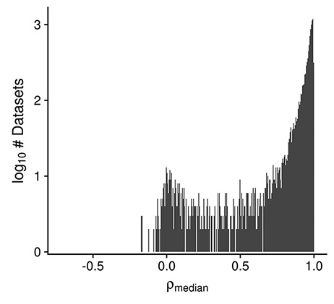
Figure 3. Histogram displaying the distribution of the median design-regressed sample–sample correlation per dataset, ...
Notes:
Figure 3. Histogram displaying the distribution of the median design-regressed sample–sample correlation per dataset, for all human, mouse and rata datasets (Ndataset = 10 420).
Unless provided in the caption above, the following copyright applies to the content of this slide: © The Author(s) 2021. Published by Oxford University Press.This is an Open Access article distributed under the terms of the Creative Commons Attribution License (http://creativecommons.org/licenses/by/4.0/), which permits unrestricted reuse, distribution, and reproduction in any medium, provided the original work is properly cited.

Slide 4
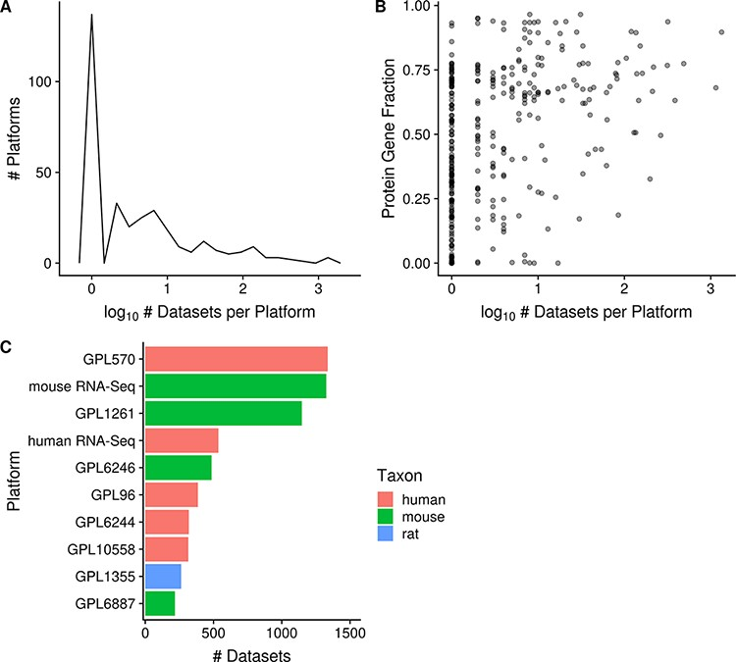
Figure 4. Distribution of platforms by the number of associated datasets for each platform (N = 357; A); scatterplot of ...
Notes:
Figure 4. Distribution of platforms by the number of associated datasets for each platform (N = 357; A); scatterplot of the fraction of protein-coding gene coverage of each microarray platform with its number of associated datasets (N = 354; B) and bar chart of the top 10 platforms with the most associated datasets for human, mouse and rat (C). The names of the listed platforms (C): Affymetrix GeneChip Human Genome U133 Plus 2.0 Array (GPL570), Affymetrix GeneChip Mouse Genome 430 2.0 Array (GPL1261), Affymetrix Mouse Gene 1.0 ST Array (GPL6246), Affymetrix GeneChip Human Genome U133 Array Set HG-U133A (GPL96), Affymetrix Human Gene 1.0 ST Array (GPL6244), Illumina HumanHT-12 v4.0 Expression Beadchip (GPL10558), Affymetrix GeneChip Rat Genome 230 2.0 Array (GPL1355) and Illumina MouseWG-6 v2.0 Expression Beadchip (GPL6887).
Unless provided in the caption above, the following copyright applies to the content of this slide: © The Author(s) 2021. Published by Oxford University Press.This is an Open Access article distributed under the terms of the Creative Commons Attribution License (http://creativecommons.org/licenses/by/4.0/), which permits unrestricted reuse, distribution, and reproduction in any medium, provided the original work is properly cited.

Slide 5
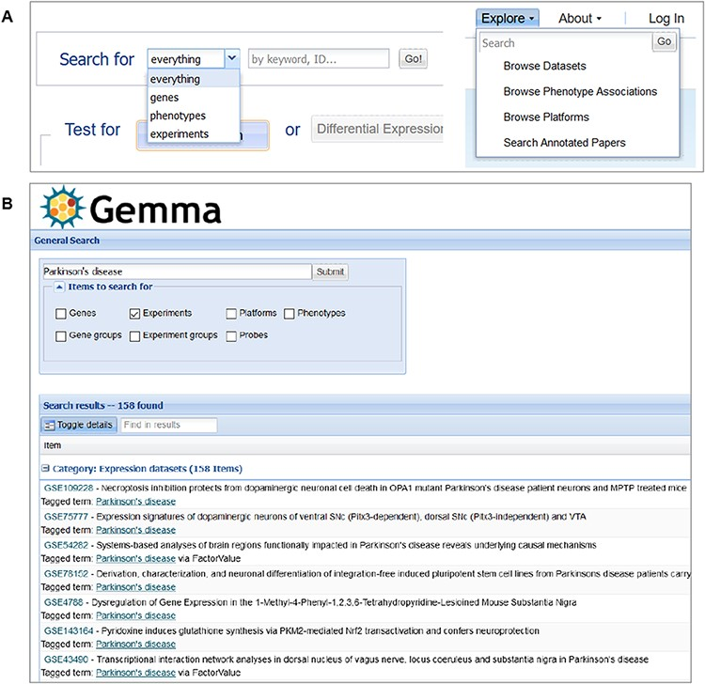
Figure 11. Snapshot of Gemma’s search tools, accessible from the main page (A-left) or upper banner (A-right); and the ...
Notes:
Figure 11. Snapshot of Gemma’s search tools, accessible from the main page (A-left) or upper banner (A-right); and the search results page (B), in which datasets (‘Experiments’) annotated with the term ‘Parkinson’s disease’ is returned.
Unless provided in the caption above, the following copyright applies to the content of this slide: © The Author(s) 2021. Published by Oxford University Press.This is an Open Access article distributed under the terms of the Creative Commons Attribution License (http://creativecommons.org/licenses/by/4.0/), which permits unrestricted reuse, distribution, and reproduction in any medium, provided the original work is properly cited.

Slide 6
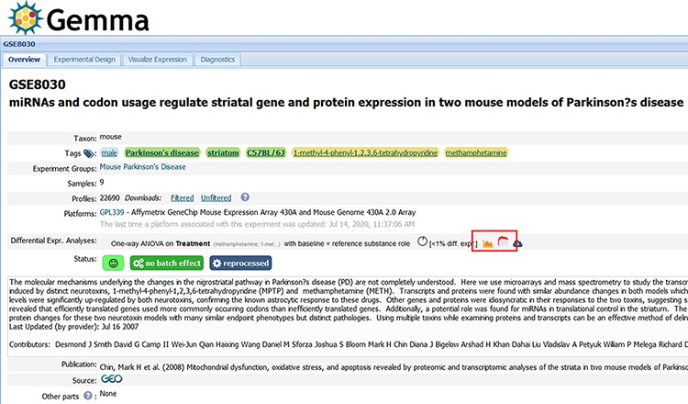
Figure 9. Snapshot of Gemma’s dataset page for GSE8030 [https://tinyurl.com/Gemma-GSE8030, (61)]; see main text for ...
Notes:
Figure 9. Snapshot of Gemma’s dataset page for GSE8030 [https://tinyurl.com/Gemma-GSE8030, (61)]; see main text for description. The red box indicates the ‘Differential Expression’ buttons for accessing the details shown in Figure 10C.
Unless provided in the caption above, the following copyright applies to the content of this slide: © The Author(s) 2021. Published by Oxford University Press.This is an Open Access article distributed under the terms of the Creative Commons Attribution License (http://creativecommons.org/licenses/by/4.0/), which permits unrestricted reuse, distribution, and reproduction in any medium, provided the original work is properly cited.

Slide 7
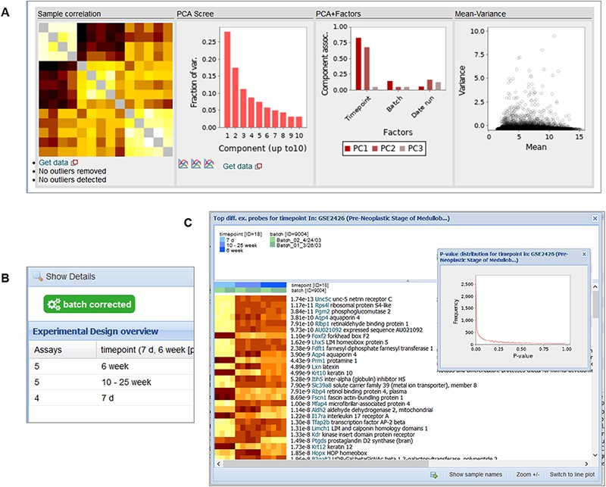
Figure 10. Snapshot of the contents in the ‘Diagnostics’ tab (A), ‘Experimental Design’ tab (B) and the ‘Differential ...
Notes:
Figure 10. Snapshot of the contents in the ‘Diagnostics’ tab (A), ‘Experimental Design’ tab (B) and the ‘Differential Expression’ buttons (C) for GSE2426 [https://tinyurl.com/Gemma-GSE2426, (62)]. Within the diagnostics tab, a sample–sample gene expression correlation heatmap, PCA scree plot, PCA–Factor association plot and mean–variance scatterplot are displayed. For the differential expression details, a heatmap of the top differentially expressed platform elements and histogram of P-value distribution of the platform elements (inset) are provided.
Unless provided in the caption above, the following copyright applies to the content of this slide: © The Author(s) 2021. Published by Oxford University Press.This is an Open Access article distributed under the terms of the Creative Commons Attribution License (http://creativecommons.org/licenses/by/4.0/), which permits unrestricted reuse, distribution, and reproduction in any medium, provided the original work is properly cited.

Slide 8
Figure 5. Numbers of datasets grouped by body system (A), organ/tissue (B) and cell type (C). The values are further ...
Notes:
Figure 5. Numbers of datasets grouped by body system (A), organ/tissue (B) and cell type (C). The values are further grouped by taxon and are represented using different colors (Ndataset = 8292).
Unless provided in the caption above, the following copyright applies to the content of this slide: © The Author(s) 2021. Published by Oxford University Press.This is an Open Access article distributed under the terms of the Creative Commons Attribution License (http://creativecommons.org/licenses/by/4.0/), which permits unrestricted reuse, distribution, and reproduction in any medium, provided the original work is properly cited.

Slide 9
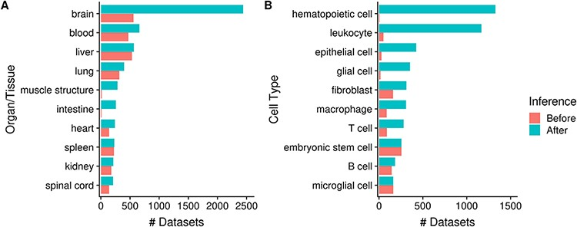
Figure 6. Numbers of datasets grouped by organ/tissue (A) and cell type (B); the colors indicate the number of ...
Notes:
Figure 6. Numbers of datasets grouped by organ/tissue (A) and cell type (B); the colors indicate the number of associated datasets before (red) and after (blue) ontology inference (Ndataset = 8292).
Unless provided in the caption above, the following copyright applies to the content of this slide: © The Author(s) 2021. Published by Oxford University Press.This is an Open Access article distributed under the terms of the Creative Commons Attribution License (http://creativecommons.org/licenses/by/4.0/), which permits unrestricted reuse, distribution, and reproduction in any medium, provided the original work is properly cited.

Slide 10
Figure 7. Numbers of datasets grouped by system-level classification of disorders (A), various cancers (B) and neuronal ...
Notes:
Figure 7. Numbers of datasets grouped by system-level classification of disorders (A), various cancers (B) and neuronal disorders (C); the values are further grouped by taxon and are represented using different colors (Ndataset = 3602). Abbreviations: amyotrophic lateral sclerosis (ALS), multiple sclerosis (MS), autism spectrum disorder (ASD), bipolar disorder (BD) and major depressive disorder (MDD).
Unless provided in the caption above, the following copyright applies to the content of this slide: © The Author(s) 2021. Published by Oxford University Press.This is an Open Access article distributed under the terms of the Creative Commons Attribution License (http://creativecommons.org/licenses/by/4.0/), which permits unrestricted reuse, distribution, and reproduction in any medium, provided the original work is properly cited.

Slide 11
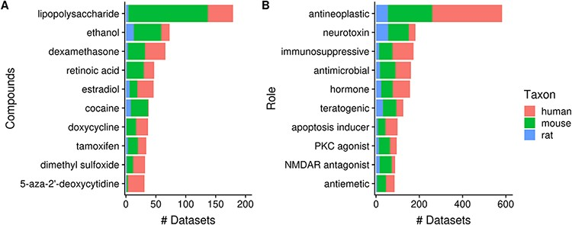
Figure 8. Numbers of datasets grouped by chemical compounds (A) and biological role/application of compounds (B); the ...
Notes:
Figure 8. Numbers of datasets grouped by chemical compounds (A) and biological role/application of compounds (B); the values are further grouped by taxon and are represented using different colors (Ndataset = 2362).
Unless provided in the caption above, the following copyright applies to the content of this slide: © The Author(s) 2021. Published by Oxford University Press.This is an Open Access article distributed under the terms of the Creative Commons Attribution License (http://creativecommons.org/licenses/by/4.0/), which permits unrestricted reuse, distribution, and reproduction in any medium, provided the original work is properly cited.

Slide 12
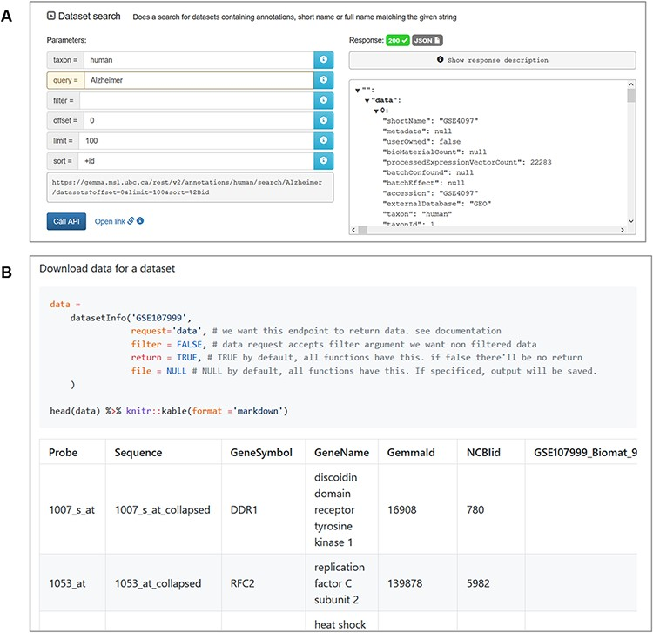
Figure 12. Snapshot of JSON output from searching for ‘Alzheimer’ datasets using the interactive documentation website ...
Notes:
Figure 12. Snapshot of JSON output from searching for ‘Alzheimer’ datasets using the interactive documentation website of the Gemma REST Application Programming Interface (API) (A) and tabulated output of GSE107999’s (63) metadata and expression data using the GemmaAPI.R package (B).
Unless provided in the caption above, the following copyright applies to the content of this slide: © The Author(s) 2021. Published by Oxford University Press.This is an Open Access article distributed under the terms of the Creative Commons Attribution License (http://creativecommons.org/licenses/by/4.0/), which permits unrestricted reuse, distribution, and reproduction in any medium, provided the original work is properly cited.

