Slide 1
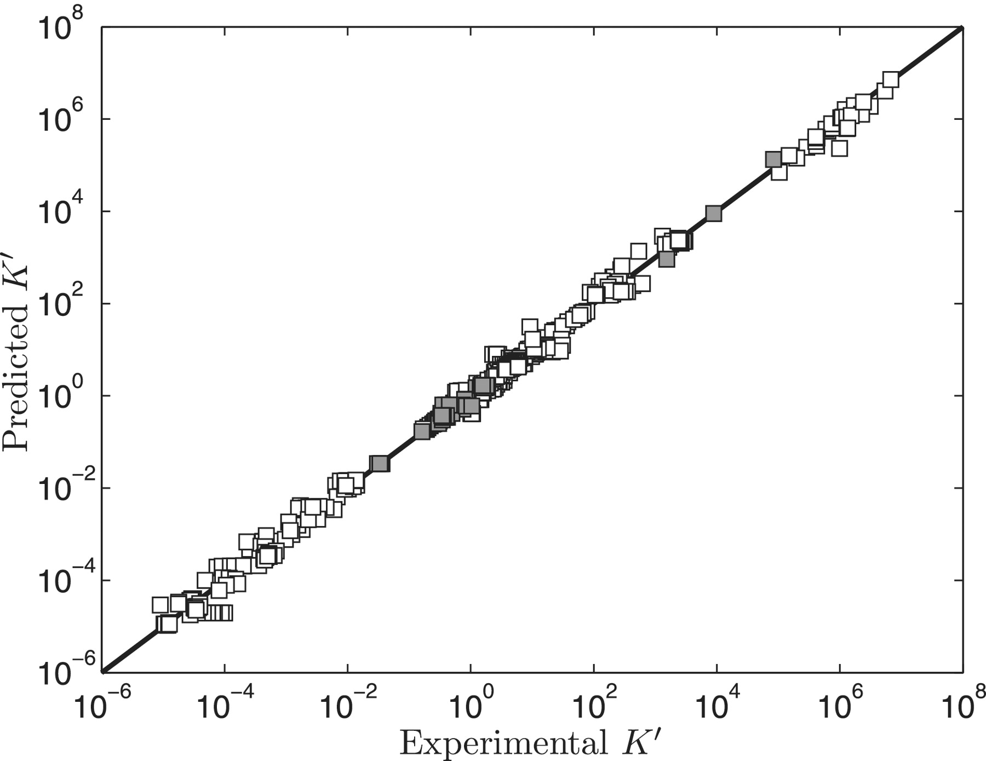
Figure 1. Model-predicted versus experimental . Model predicted apparent equilibrium constants under defined ...
Notes:
Figure 1. Model-predicted versus experimental . Model predicted apparent equilibrium constants under defined experimental conditions (T, I, [Mg2+], [Ca2+], [Na+], [K+] and pH) are plotted versus experimental measurements for all data used in the analysis. Data points in the pentose phosphate pathway are shown as filled squares.
Unless provided in the caption above, the following copyright applies to the content of this slide: © The Author(s) 2011. Published by Oxford University Press.This is Open Access article distributed under the terms of the Creative Commons Attribution Non-Commercial License (http://creativecommons.org/licenses/by-nc/2.5), which permits unrestricted non-commercial use, distribution, and reproduction in any medium, provided the original work is properly cited.

