Slide 1
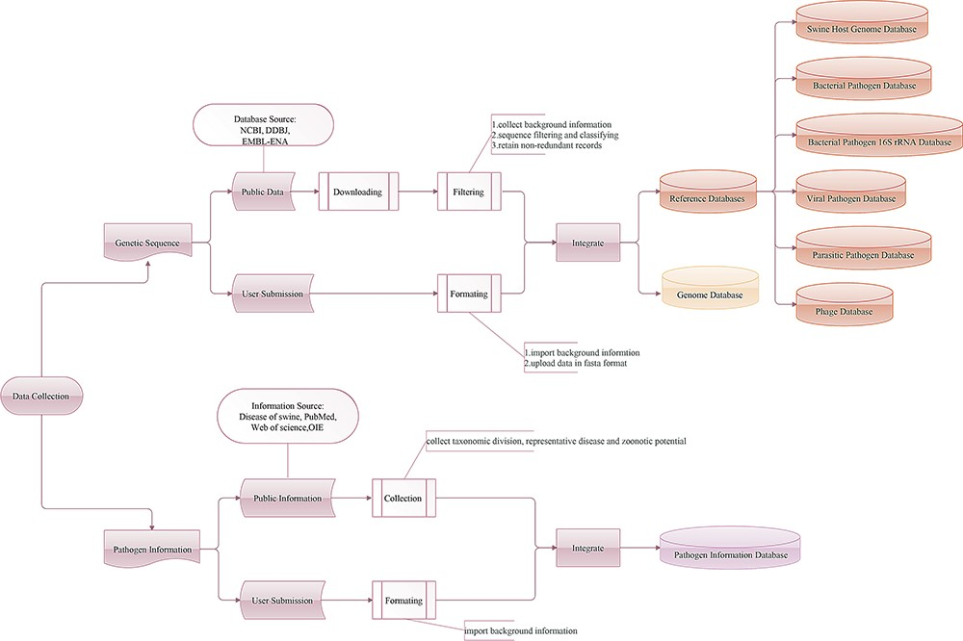
Figure 1 Workflow of the data integration processes. Genetic sequence and pathogen information are imported from two ...
Notes:
Figure 1 Workflow of the data integration processes. Genetic sequence and pathogen information are imported from two main sources: public resources and users.
Unless provided in the caption above, the following copyright applies to the content of this slide: © The Author(s) 2020. Published by Oxford University Press.This is an Open Access article distributed under the terms of the Creative Commons Attribution License (http://creativecommons.org/licenses/by/4.0/), which permits unrestricted reuse, distribution, and reproduction in any medium, provided the original work is properly cited.

Slide 2
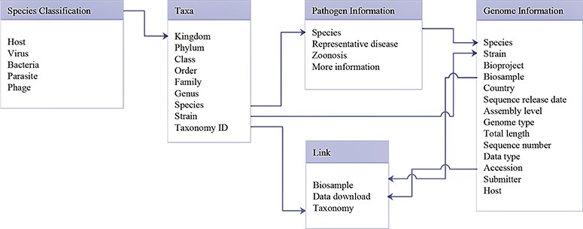
Figure 2 Database schema of data search and download system. Main data structure and relationships between different ...
Notes:
Figure 2 Database schema of data search and download system. Main data structure and relationships between different tables are illustrated.
Unless provided in the caption above, the following copyright applies to the content of this slide: © The Author(s) 2020. Published by Oxford University Press.This is an Open Access article distributed under the terms of the Creative Commons Attribution License (http://creativecommons.org/licenses/by/4.0/), which permits unrestricted reuse, distribution, and reproduction in any medium, provided the original work is properly cited.

Slide 3
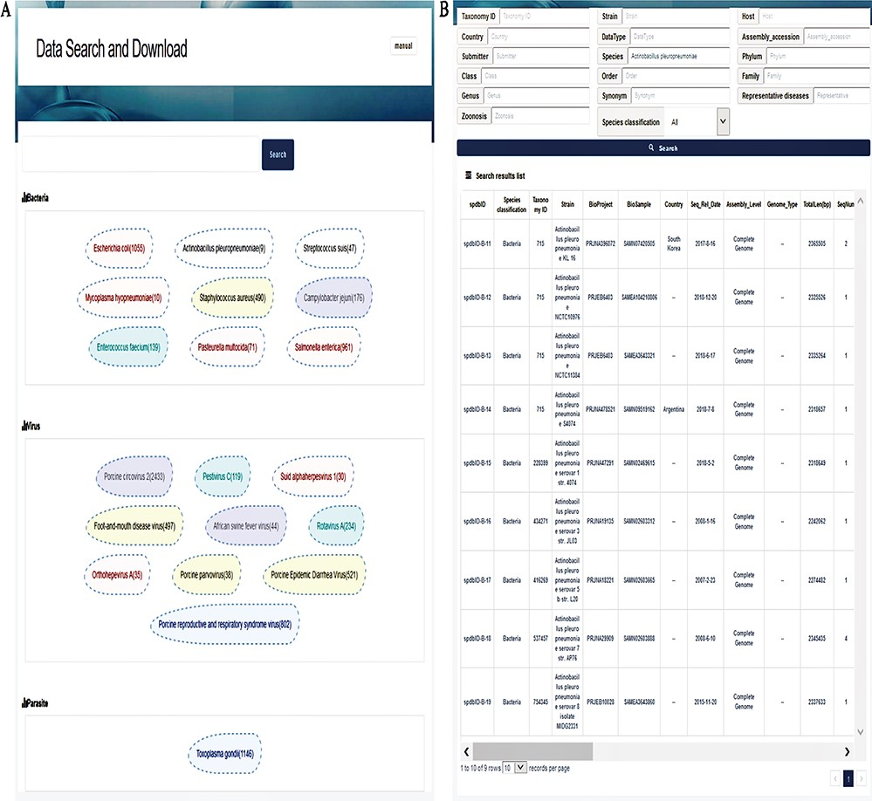
Figure 3 Interfaces of data search and download system. (A) Search page. A search box on the top is for a ...
Notes:
Figure 3 Interfaces of data search and download system. (A) Search page. A search box on the top is for a keyword-based search for quick and focused searches; clicking on the search without character input in the search box will allow the user to enter accurate and customized searches; the next section displays the top 20 hot words for each category, which can be directly linked to the corresponding data. (B) Search result page. The top of this page shows an option for advanced search, allowing the user to search the target using 17 fields to find the appropriate information more accurately. The bottom section represents the search result list, with 30 fields listed in total.
Unless provided in the caption above, the following copyright applies to the content of this slide: © The Author(s) 2020. Published by Oxford University Press.This is an Open Access article distributed under the terms of the Creative Commons Attribution License (http://creativecommons.org/licenses/by/4.0/), which permits unrestricted reuse, distribution, and reproduction in any medium, provided the original work is properly cited.

Slide 4
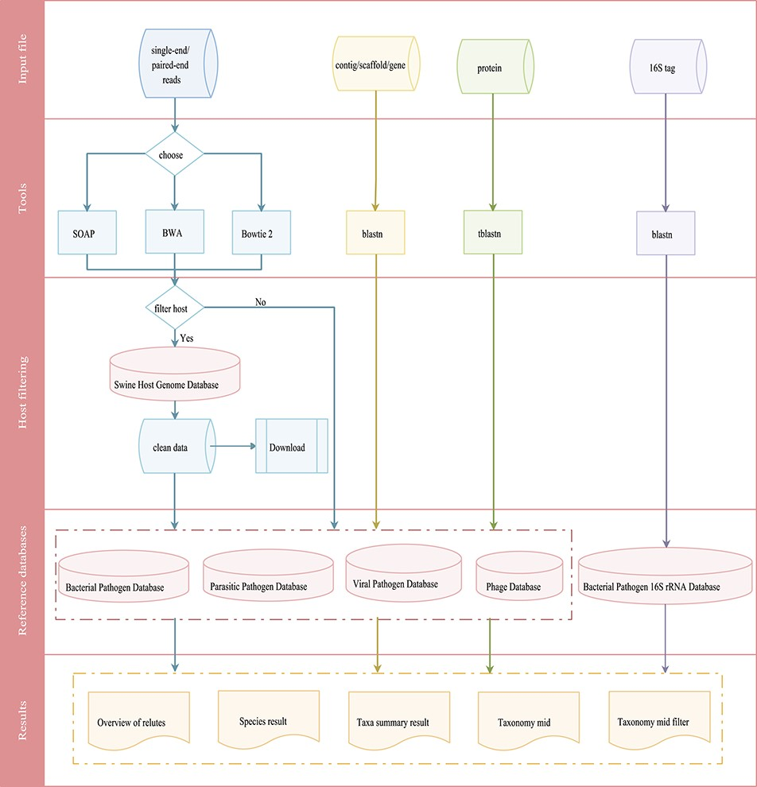
Figure 4 Integrated workflows for a pathogen screening tool. The workflows are shown in different colors based on ...
Notes:
Figure 4 Integrated workflows for a pathogen screening tool. The workflows are shown in different colors based on input data (reads in blue, contig/scaffold/gene in yellow, protein in green and 16S tag in purple).
Unless provided in the caption above, the following copyright applies to the content of this slide: © The Author(s) 2020. Published by Oxford University Press.This is an Open Access article distributed under the terms of the Creative Commons Attribution License (http://creativecommons.org/licenses/by/4.0/), which permits unrestricted reuse, distribution, and reproduction in any medium, provided the original work is properly cited.

Slide 5
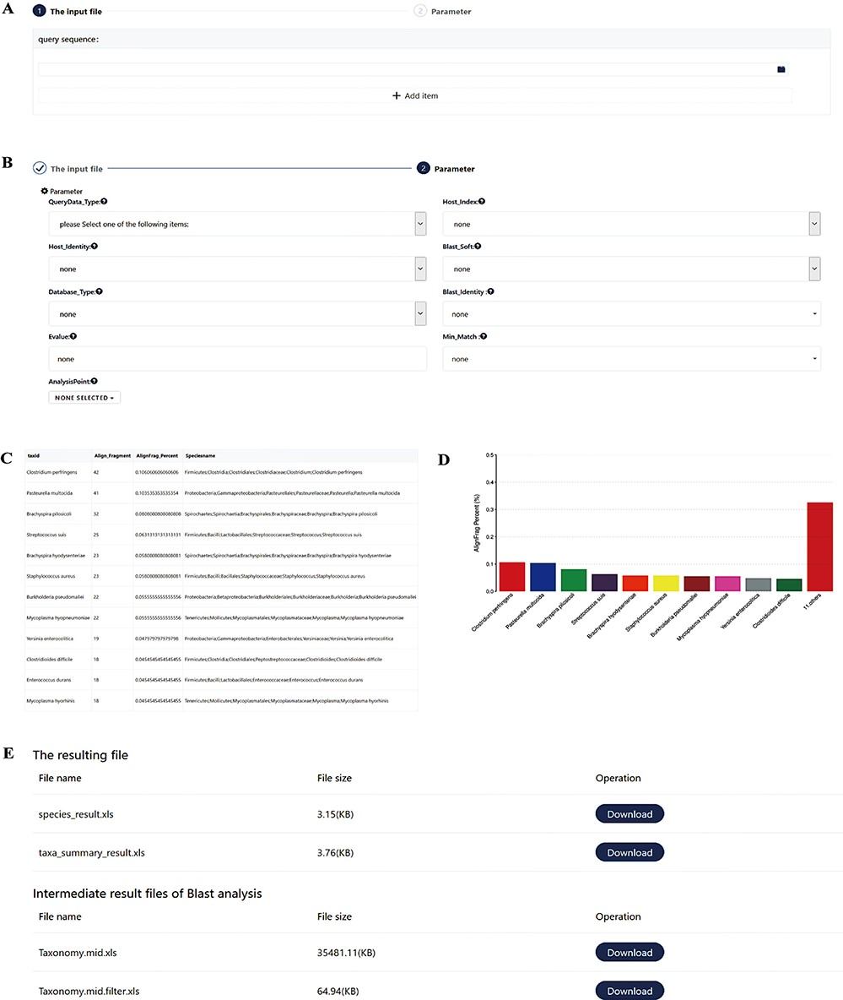
Figure 5 Screenshots of the pathogen screening tool. (A) File upload module. (B) Necessary arguments setting. (C–D) ...
Notes:
Figure 5 Screenshots of the pathogen screening tool. (A) File upload module. (B) Necessary arguments setting. (C–D) Overview of results. The top 10 species are shown in both a table and a histogram format. (E) The resulting files. The generated files can be downloaded. Species_result.xls is the result of species level. Taxa_summary_result.xls shows the result at the genus to phylum levels. Taxonomy.mid.xls contains all analysis records. Taxonomy.mid.filter.xls is the filtered result based on the set parameters and is the source file of Species_result.xls and Taxa_summary_result.xls.
Unless provided in the caption above, the following copyright applies to the content of this slide: © The Author(s) 2020. Published by Oxford University Press.This is an Open Access article distributed under the terms of the Creative Commons Attribution License (http://creativecommons.org/licenses/by/4.0/), which permits unrestricted reuse, distribution, and reproduction in any medium, provided the original work is properly cited.

