Slide 1
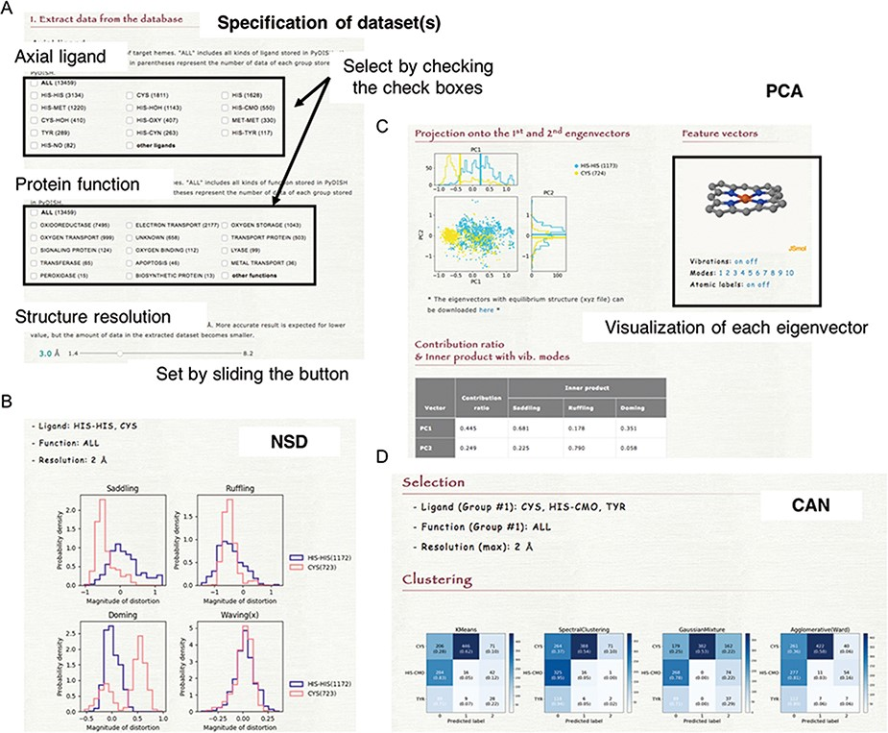
Figure 6. (A) How to specify the dataset(s). Select the axial ligand and the protein function according to the check ...
Notes:
Figure 6. (A) How to specify the dataset(s). Select the axial ligand and the protein function according to the check boxes, and set the threshold of structure resolution by sliding the button (1.4 ~ 8.2 Å). (B) Example of the NSD result page. (C) Example of the PCA result page. The motions of the first to 10th eigenvectors can be visualized by clicking the number of modes. The contribution ratio and inner product with the saddling, ruffling and doming modes of each eigenvector are listed as a table. (D) Example of the CAN result page.
Unless provided in the caption above, the following copyright applies to the content of this slide: © The Author(s) 2020. Published by Oxford University Press.This is an Open Access article distributed under the terms of the Creative Commons Attribution License (http://creativecommons.org/licenses/by/4.0/), which permits unrestricted reuse, distribution, and reproduction in any medium, provided the original work is properly cited.

