Slide 1
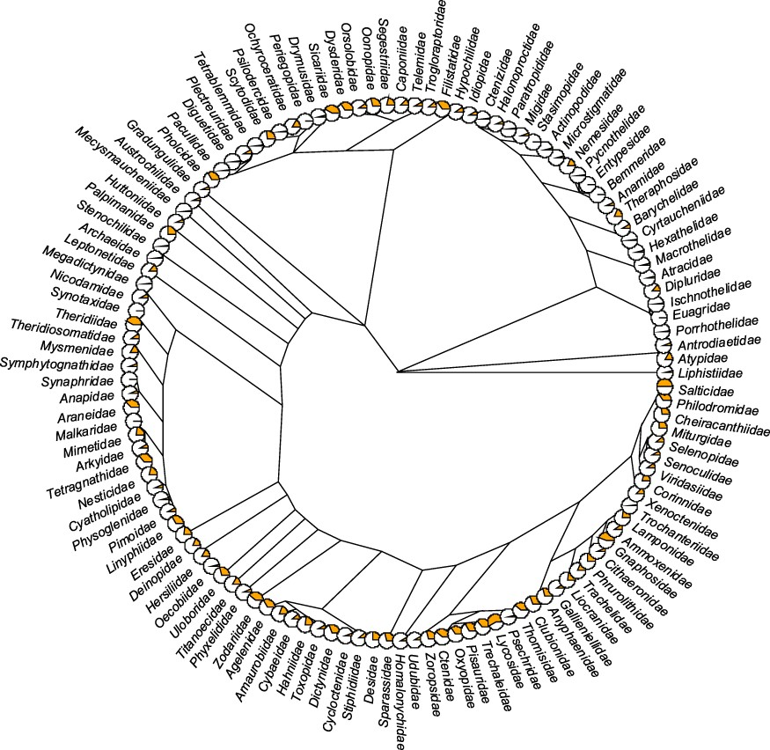
Figure 4. Trait coverage mapped on the tree. The tree is on the family level (composed of 121 families) with the ...
Notes:
Figure 4. Trait coverage mapped on the tree. The tree is on the family level (composed of 121 families) with the proportion of the total number of traits (orange) displayed as pie charts (the fuller the pie, the more the traits). The tree was constructed based on the recent phylogeny of spiders (42). Five families (Hexurellidae, Mecicobothriidae, Megahexuridae, Microhexuridae and Myrmecicultoridae) were omitted because their position in the tree is not known.
Unless provided in the caption above, the following copyright applies to the content of this slide: © The Author(s) 2021. Published by Oxford University Press.This is an Open Access article distributed under the terms of the Creative Commons Attribution License (https://creativecommons.org/licenses/by/4.0/), which permits unrestricted reuse, distribution, and reproduction in any medium, provided the original work is properly cited.

