Slide 1
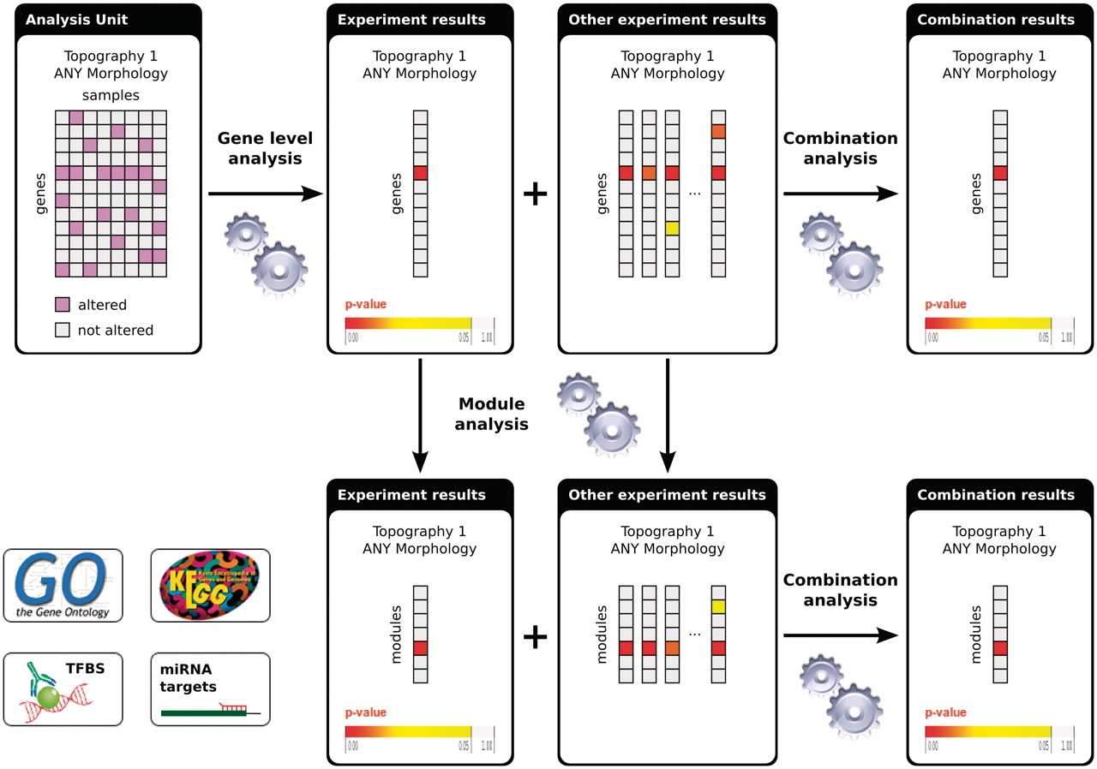
Figure 2. Flowchart of the analyses in IntOGen. Each analysis unit (set of assays from the same study using the same ...
Notes:
Figure 2. Flowchart of the analyses in IntOGen. Each analysis unit (set of assays from the same study using the same platform and annotated with the same ICD-O terms) is analysed to detect the significantly altered genes. The gene-level experiment results are analyzed further to detect significantly altered modules. The experiment results with the same ICD-O terms are combined both at the gene level and at the module level. For methods details see (1).
Unless provided in the caption above, the following copyright applies to the content of this slide: © The Author(s) 2011. Published by Oxford University Press.This is Open Access article distributed under the terms of the Creative Commons Attribution Non-Commercial License (http://creativecommons.org/licenses/by-nc/2.5), which permits unrestricted non-commercial use, distribution, and reproduction in any medium, provided the original work is properly cited.

