Slide 1
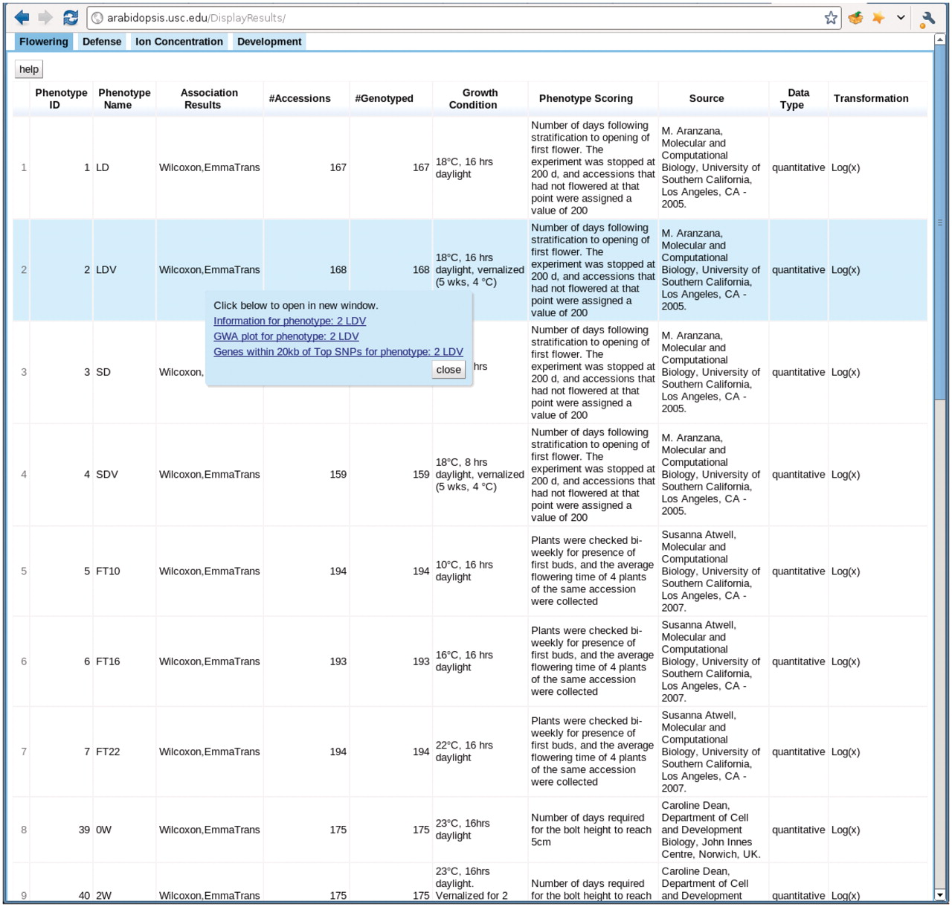
Figure 8. http://arabidopsis.usc.edu/DisplayResults/ One tab for each category of phenotypes. Under each tab is a ...
Notes:
Figure 8. http://arabidopsis.usc.edu/DisplayResults/ One tab for each category of phenotypes. Under each tab is a dynamic table filled with phenotypes. Clicking on each phenotype shows a popup with links to detailed phenotype information, GWAS plots (Figure 7) and genes adjacent to top associations.
Unless provided in the caption above, the following copyright applies to the content of this slide: © The Author(s) 2011. Published by Oxford University Press.This is Open Access article distributed under the terms of the Creative Commons Attribution Non-Commercial License (http://creativecommons.org/licenses/by-nc/2.5), which permits unrestricted non-commercial use, distribution, and reproduction in any medium, provided the original work is properly cited.

