Slide 1
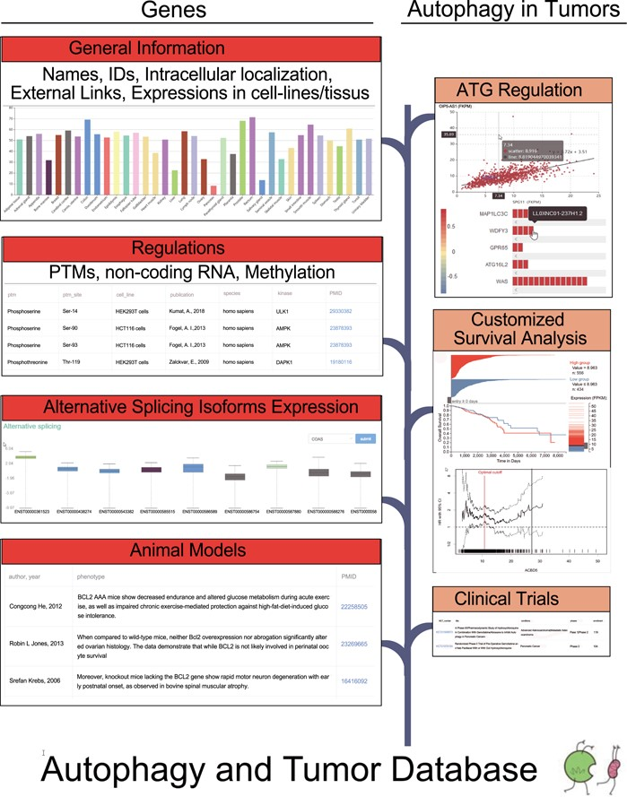
Figure 1 The flow diagram of the database construction. Gene-specific information was collected from Human Protein ...
Notes:
Figure 1 The flow diagram of the database construction. Gene-specific information was collected from Human Protein Atlas, HGNC, UniProt and Ensembl. Experiments identified regulators was searched in the PubMed. RNA sequencing data from TCGA were used to carry out correlation analysis and differential expression analysis. TCGA survival data and phenotype data were used to customize survival analysis.
Unless provided in the caption above, the following copyright applies to the content of this slide: © The Author(s) 2020. Published by Oxford University Press.This is an Open Access article distributed under the terms of the Creative Commons Attribution License (http://creativecommons.org/licenses/by/4.0/), which permits unrestricted reuse, distribution, and reproduction in any medium, provided the original work is properly cited.

Slide 2
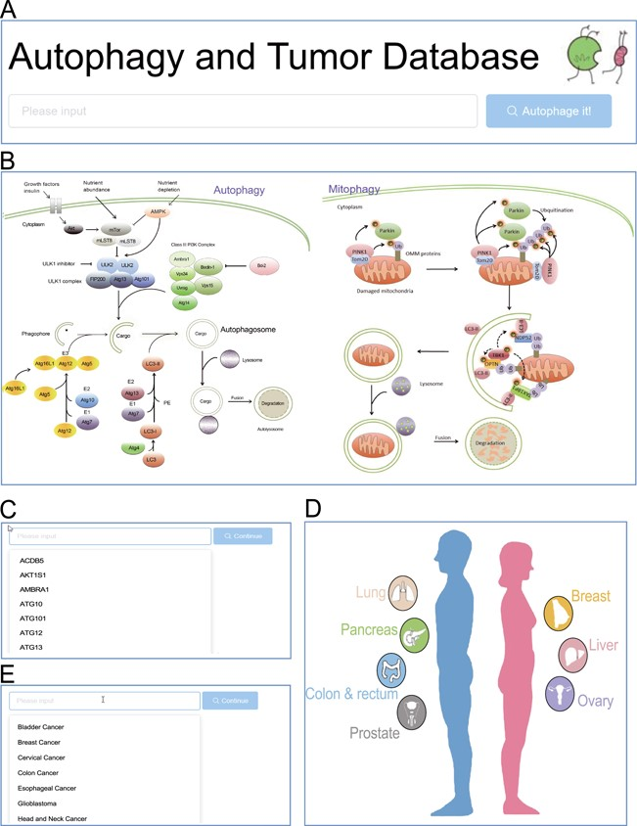
Figure 2 Browse entrance. (A) Search in the homepage; (B) click on the autophagy pathway illustration; (C) select from ...
Notes:
Figure 2 Browse entrance. (A) Search in the homepage; (B) click on the autophagy pathway illustration; (C) select from the dropdown list of genes; (D) click on the anatomy illustration; (E) select from the dropdown list of tumors.
Unless provided in the caption above, the following copyright applies to the content of this slide: © The Author(s) 2020. Published by Oxford University Press.This is an Open Access article distributed under the terms of the Creative Commons Attribution License (http://creativecommons.org/licenses/by/4.0/), which permits unrestricted reuse, distribution, and reproduction in any medium, provided the original work is properly cited.

Slide 3
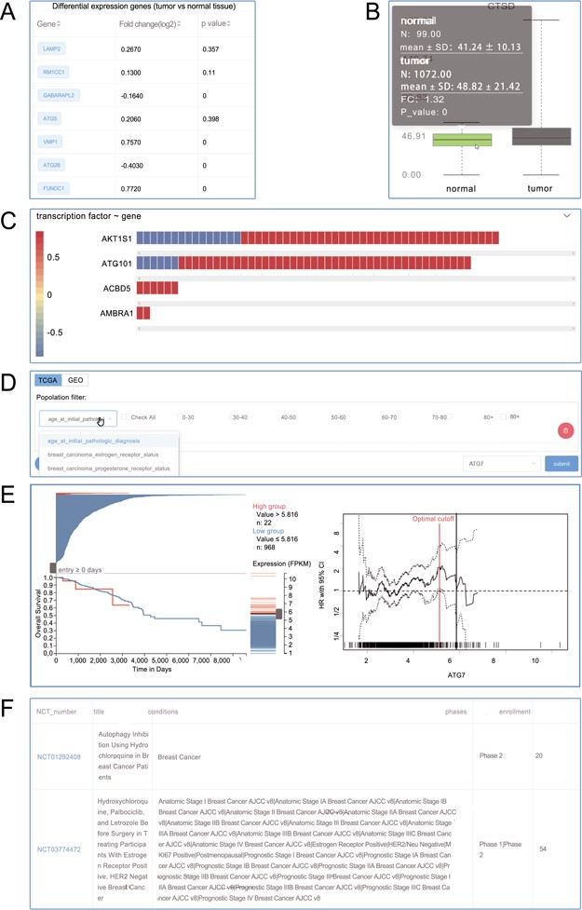
Figure 3 Screenshots from the Autophagy in Tumors. (A) Differential expression analysis; (B) box plot; (C) heat plot; ...
Notes:
Figure 3 Screenshots from the Autophagy in Tumors. (A) Differential expression analysis; (B) box plot; (C) heat plot; (D) population filter for customized survival analysis; (E) interactive Kaplan–Meier plotter interface; (F) clinical trials.
Unless provided in the caption above, the following copyright applies to the content of this slide: © The Author(s) 2020. Published by Oxford University Press.This is an Open Access article distributed under the terms of the Creative Commons Attribution License (http://creativecommons.org/licenses/by/4.0/), which permits unrestricted reuse, distribution, and reproduction in any medium, provided the original work is properly cited.

Slide 4
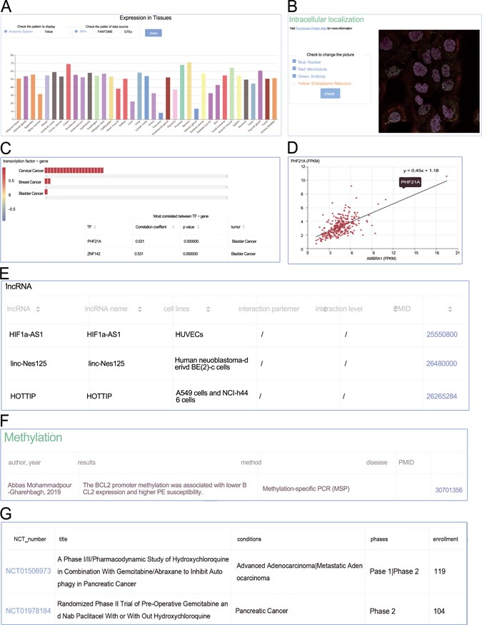
Figure 4 Screenshots from the genes section. (A) Expression profiles; (B) intracellular location; (C) heat plot; (D) ...
Notes:
Figure 4 Screenshots from the genes section. (A) Expression profiles; (B) intracellular location; (C) heat plot; (D) scatter plot; (E) manual curated regulators; (F) DNA methylation; (G) animal models.
Unless provided in the caption above, the following copyright applies to the content of this slide: © The Author(s) 2020. Published by Oxford University Press.This is an Open Access article distributed under the terms of the Creative Commons Attribution License (http://creativecommons.org/licenses/by/4.0/), which permits unrestricted reuse, distribution, and reproduction in any medium, provided the original work is properly cited.

Slide 5
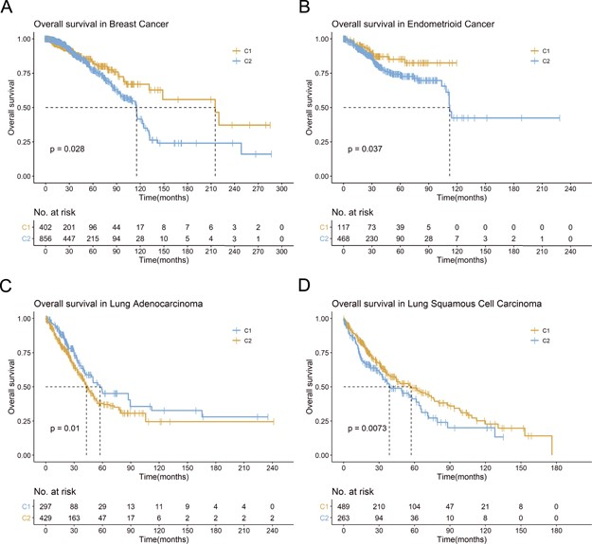
Figure 5 Example for ATdb application. Kaplan–Meier plot for (A) breast cancer (TCGA-BRCA); (B) endometrioid cancer ...
Notes:
Figure 5 Example for ATdb application. Kaplan–Meier plot for (A) breast cancer (TCGA-BRCA); (B) endometrioid cancer (TCGA-UCEC); (C) lung adenocarcinoma (TCGA-LUAD); (D) lung squamous cell carcinoma (TCGA-LUSC).
Unless provided in the caption above, the following copyright applies to the content of this slide: © The Author(s) 2020. Published by Oxford University Press.This is an Open Access article distributed under the terms of the Creative Commons Attribution License (http://creativecommons.org/licenses/by/4.0/), which permits unrestricted reuse, distribution, and reproduction in any medium, provided the original work is properly cited.

Slide 6
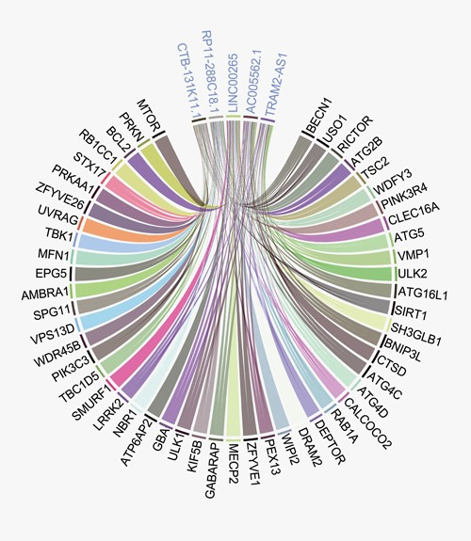
Figure 6 Circus plot between the most connected lncRNAs and genes. The top five most connected lncRNAs are connected ...
Notes:
Figure 6 Circus plot between the most connected lncRNAs and genes. The top five most connected lncRNAs are connected with a wide range of genes.
Unless provided in the caption above, the following copyright applies to the content of this slide: © The Author(s) 2020. Published by Oxford University Press.This is an Open Access article distributed under the terms of the Creative Commons Attribution License (http://creativecommons.org/licenses/by/4.0/), which permits unrestricted reuse, distribution, and reproduction in any medium, provided the original work is properly cited.

