Slide 1
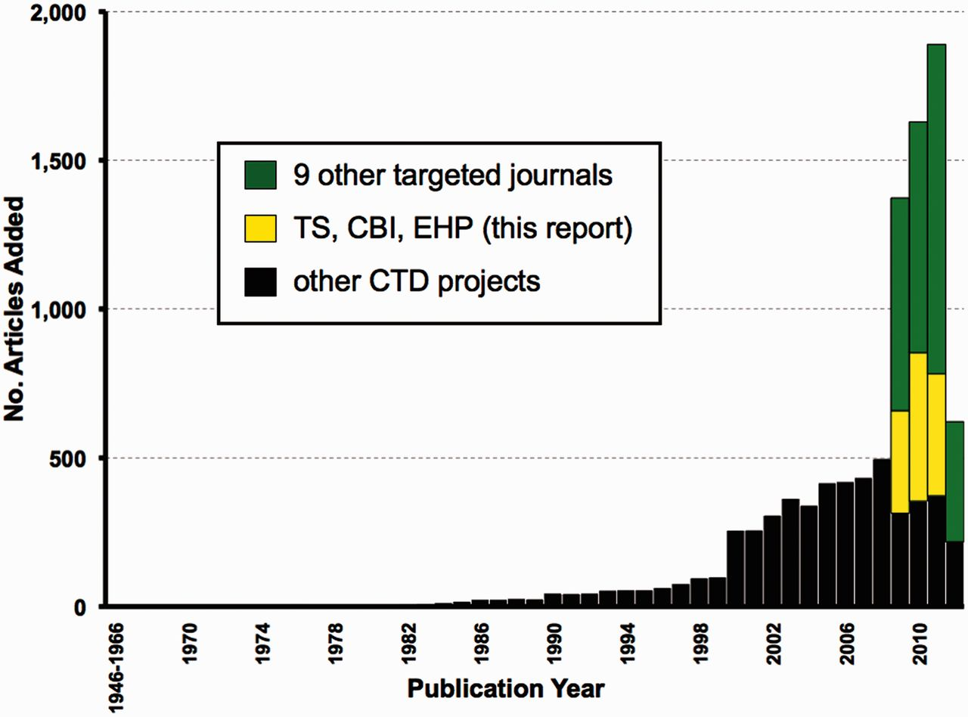
Figure 7 Expanding targeted journal curation at CTD. From March to August 2012, 9631 new articles were added to CTD. ...
Notes:
Figure 7 Expanding targeted journal curation at CTD. From March to August 2012, 9631 new articles were added to CTD. Of these, 4254 are from targeted journal curation, including 1252 from the three journals (TS, CBI and EHP) reported here (yellow bars) plus 3002 articles from nine additional journals (green bars) for publication years from 2009 to the first half of 2012. The remaining 5377 articles (black bars) are from other CTD projects and span publication years 1962–2012.
Unless provided in the caption above, the following copyright applies to the content of this slide: © The Author(s) 2012. Published by Oxford University Press.This is an Open Access article distributed under the terms of the Creative Commons Attribution License (http://creativecommons.org/licenses/by-nc/3.0/), which permits non-commercial reuse, distribution, and reproduction in any medium, provided the original work is properly cited. For commercial re-use, please contact journals.permissions@oup.com.

