Slide 1
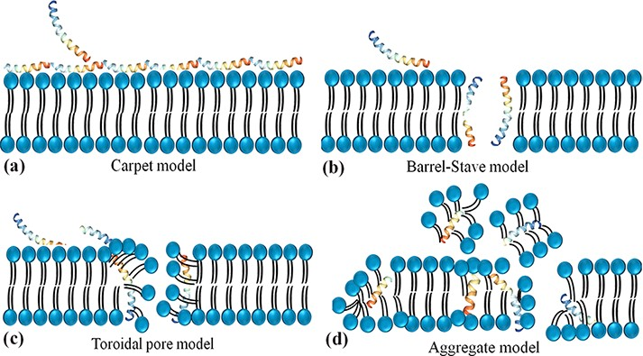
Figure 2. Schematic representation of the potential mechanism of membrane disruption and/or translocation by ...
Notes:
Figure 2. Schematic representation of the potential mechanism of membrane disruption and/or translocation by antimicrobial peptides. (a) Carpet model: Another face of the membrane is covered by AMPs to form a ‘carpet’ and the membrane undergoes some perturbation and deformation. (b) Barrel-Stave model: AMPs interact laterally and form transmembrane pores. (c) Toroidal pore model: AMPs penetrate the bilayer membrane and form a toroid of high curvature. (d) Aggregate model.
Unless provided in the caption above, the following copyright applies to the content of this slide: © The Author(s) 2022. Published by Oxford University Press.This is an Open Access article distributed under the terms of the Creative Commons Attribution License (https://creativecommons.org/licenses/by/4.0/), which permits unrestricted reuse, distribution, and reproduction in any medium, provided the original work is properly cited.

