Slide 1
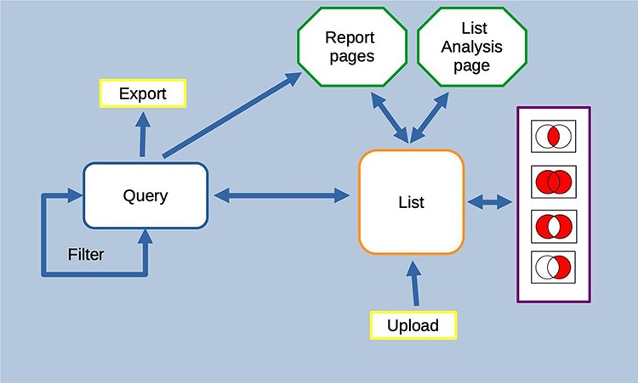
Figure 13. Features of the InterMine interface can be combined to create iterative workflows. For instance, the entities ...
Notes:
Figure 13. Features of the InterMine interface can be combined to create iterative workflows. For instance, the entities from the results of a query generated either using the query builder or through a template search can be saved as a list. The list can be fed into further queries or combined with other lists using set operations to create further lists. At any stage, individual entities or lists can be examined in more detail through the list analysis and report pages.
Unless provided in the caption above, the following copyright applies to the content of this slide: © The Author(s) 2022. Published by Oxford University Press.This is an Open Access article distributed under the terms of the Creative Commons Attribution-NonCommercial License (https://creativecommons.org/licenses/by-nc/4.0/), which permits non-commercial re-use, distribution, and reproduction in any medium, provided the original work is properly cited. For commercial re-use, please contact journals.permissions@oup.com

