Slide 1
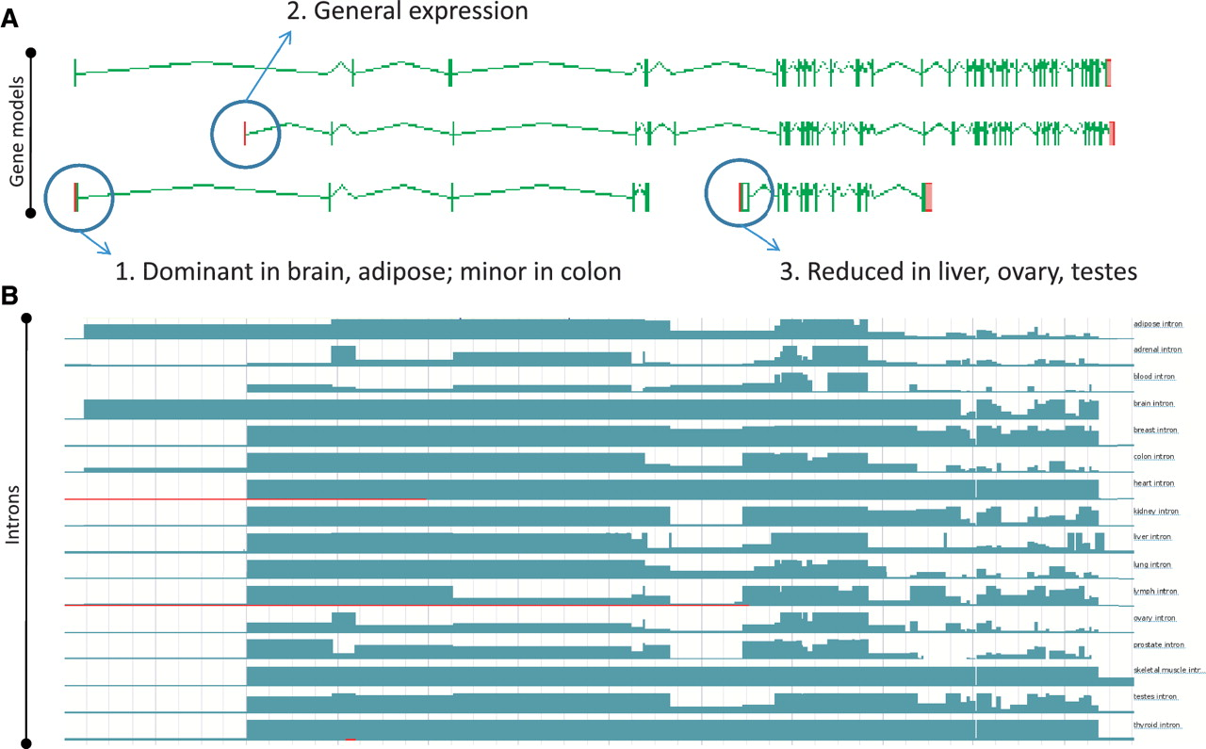
Figure 5 Zmap screenshot of four representative full-length transcripts at the human PDE4DIP locus encoding ...
Notes:
Figure 5 Zmap screenshot of four representative full-length transcripts at the human PDE4DIP locus encoding phosphodiesterase 4D interacting protein (A) and screenshot of the Ensembl display of introns built using the Illumia Bodymap2 RNA-Seq dataset (B). The three main transcription start sites (TSS) associated with the locus are circled and the primary tissue types in which the TSSs are up or downregulated are indicated.
Unless provided in the caption above, the following copyright applies to the content of this slide: © The Author(s) 2012. Published by Oxford University Press.This is an Open Access article distributed under the terms of the Creative Commons Attribution Non-Commercial License (http://creativecommons.org/licenses/by-nc/3.0), which permits unrestricted non-commercial use, distribution, and reproduction in any medium, provided the original work is properly cited.

