Slide 1
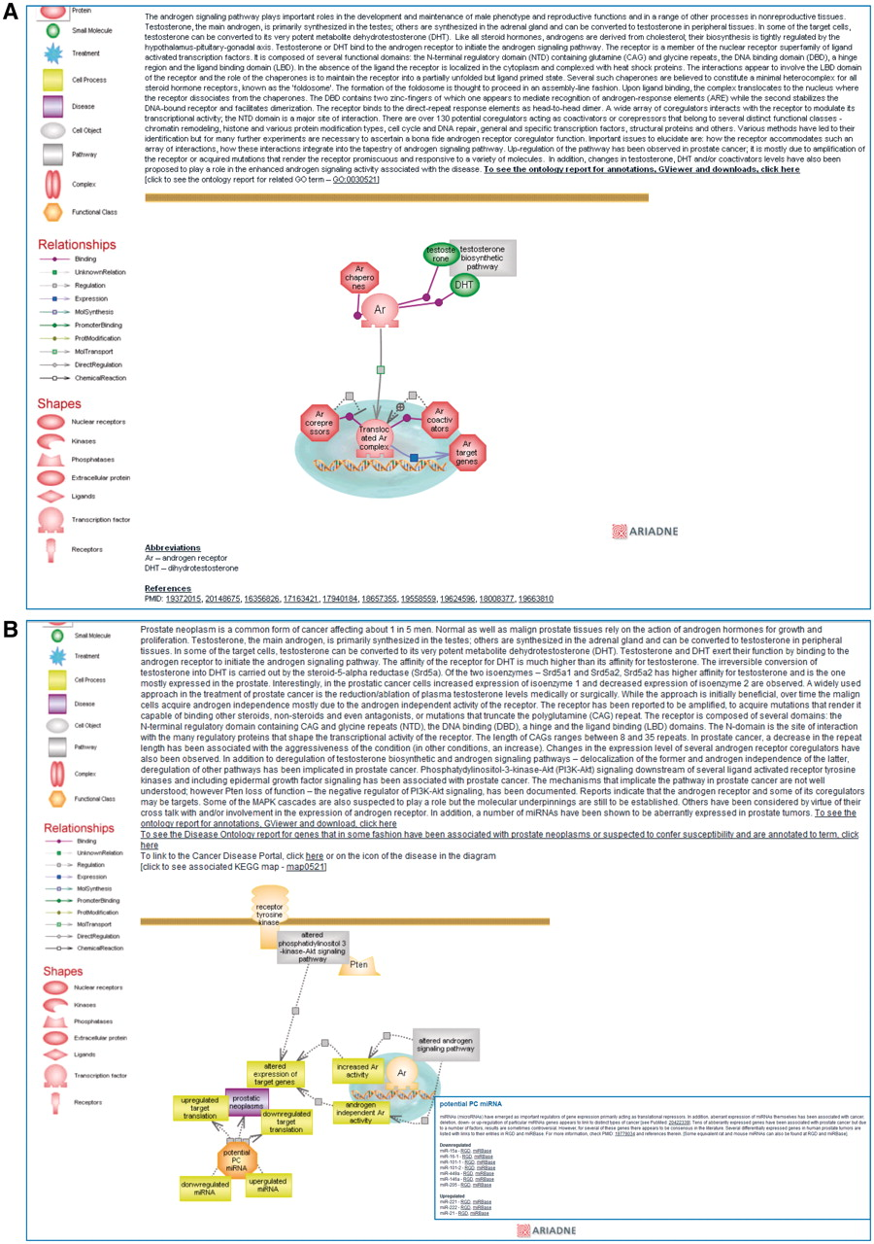
Figure 2. Shows a partial view of the interactive diagram page for the ‘androgen signaling pathway’ (A) and for the ...
Notes:
Figure 2. Shows a partial view of the interactive diagram page for the ‘androgen signaling pathway’ (A) and for the ‘prostate cancer pathway’ with the inset showing the list of miRNAs of potential interest in prostate cancer which can be accessed by clicking on the functional class icon (B).
Unless provided in the caption above, the following copyright applies to the content of this slide: © The Author(s) 2011. Published by Oxford University Press.This is Open Access article distributed under the terms of the Creative Commons Attribution Non-Commercial License (http://creativecommons.org/licenses/by-nc/2.5), which permits unrestricted non-commercial use, distribution, and reproduction in any medium, provided the original work is properly cited.

