Slide 1
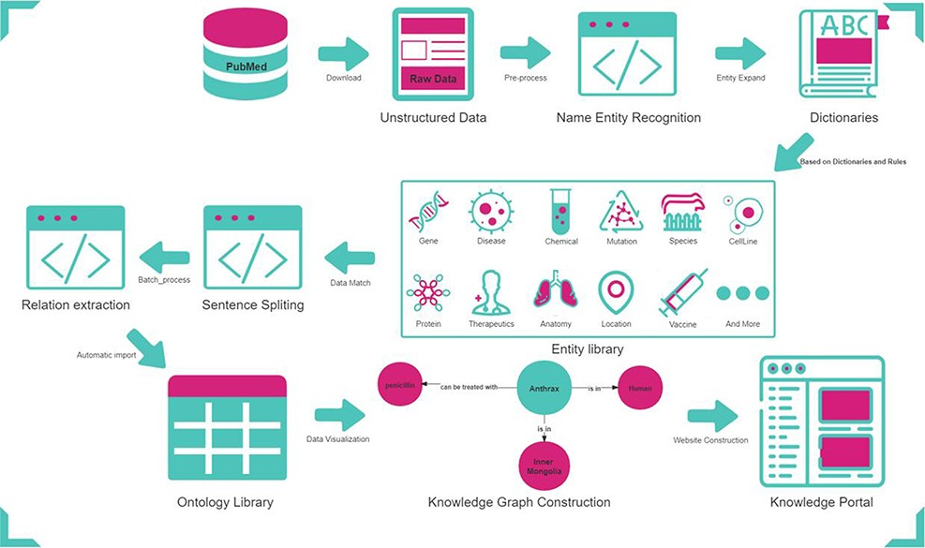
Figure 1. Workflow for constructing AnthraxKP.
Notes:
Figure 1. Workflow for constructing AnthraxKP.
Unless provided in the caption above, the following copyright applies to the content of this slide: © The Author(s) 2022. Published by Oxford University Press.This is an Open Access article distributed under the terms of the Creative Commons Attribution-NonCommercial License (https://creativecommons.org/licenses/by-nc/4.0/), which permits non-commercial re-use, distribution, and reproduction in any medium, provided the original work is properly cited. For commercial re-use, please contact journals.permissions@oup.com

Slide 2
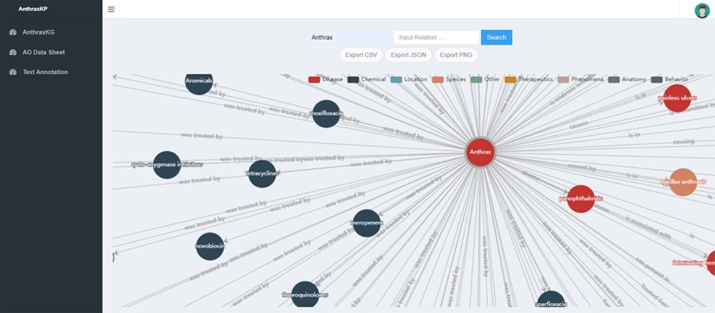
Figure 2. AnthraxKG visualization module.
Notes:
Figure 2. AnthraxKG visualization module.
Unless provided in the caption above, the following copyright applies to the content of this slide: © The Author(s) 2022. Published by Oxford University Press.This is an Open Access article distributed under the terms of the Creative Commons Attribution-NonCommercial License (https://creativecommons.org/licenses/by-nc/4.0/), which permits non-commercial re-use, distribution, and reproduction in any medium, provided the original work is properly cited. For commercial re-use, please contact journals.permissions@oup.com

Slide 3
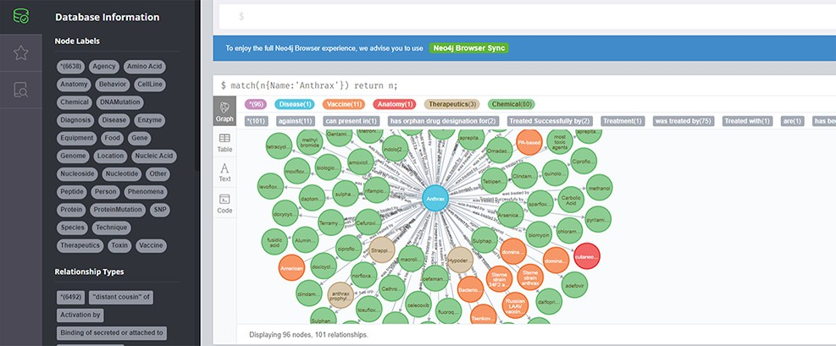
Figure 3. AntrhaxKG Neo4j Browser.
Notes:
Figure 3. AntrhaxKG Neo4j Browser.
Unless provided in the caption above, the following copyright applies to the content of this slide: © The Author(s) 2022. Published by Oxford University Press.This is an Open Access article distributed under the terms of the Creative Commons Attribution-NonCommercial License (https://creativecommons.org/licenses/by-nc/4.0/), which permits non-commercial re-use, distribution, and reproduction in any medium, provided the original work is properly cited. For commercial re-use, please contact journals.permissions@oup.com

Slide 4
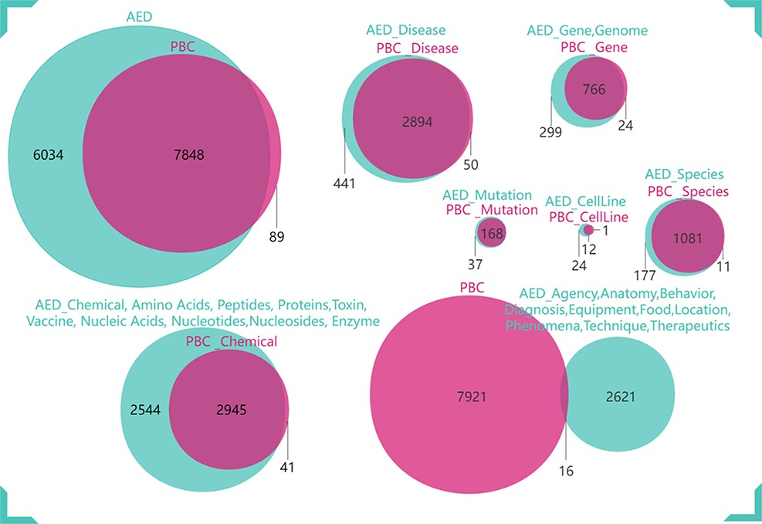
Figure 4. Comparison of AED with PBC.
Notes:
Figure 4. Comparison of AED with PBC.
Unless provided in the caption above, the following copyright applies to the content of this slide: © The Author(s) 2022. Published by Oxford University Press.This is an Open Access article distributed under the terms of the Creative Commons Attribution-NonCommercial License (https://creativecommons.org/licenses/by-nc/4.0/), which permits non-commercial re-use, distribution, and reproduction in any medium, provided the original work is properly cited. For commercial re-use, please contact journals.permissions@oup.com

Slide 5
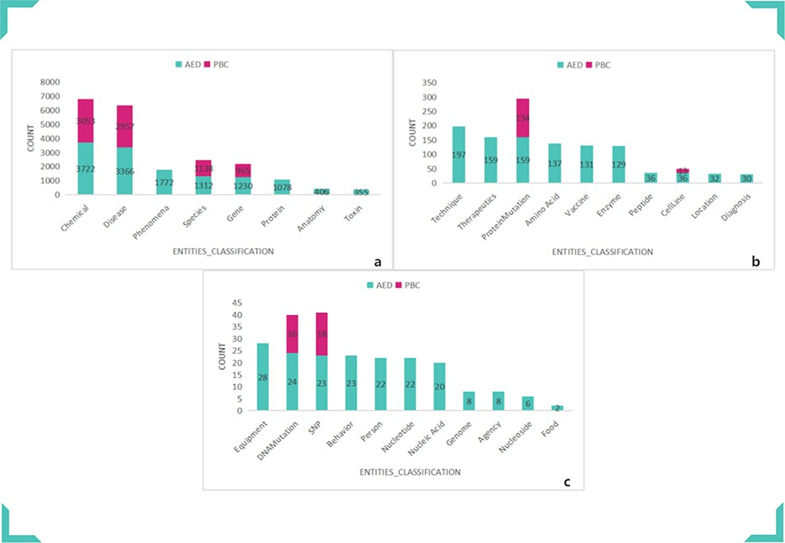
Figure 5. Comparison of AED and PBC entity categories and numbers. (a) Comparison of Chemical, Disease, Phenomena, ...
Notes:
Figure 5. Comparison of AED and PBC entity categories and numbers. (a) Comparison of Chemical, Disease, Phenomena, Species, Gene, Protein, Anatomy and Toxin. (b) Comparison of Technique, Therapeutics, ProteinMutation, Amino Acid, Vaccine, Enzyme, Peptide, CellLine, Location and Diagnosis. (c) Comparison of Equipment, DNAMutation, SNP, Behavior, Person, Nucleotide, Nucleic Acid, Genome, Agency, Nucleoside and Food.
Unless provided in the caption above, the following copyright applies to the content of this slide: © The Author(s) 2022. Published by Oxford University Press.This is an Open Access article distributed under the terms of the Creative Commons Attribution-NonCommercial License (https://creativecommons.org/licenses/by-nc/4.0/), which permits non-commercial re-use, distribution, and reproduction in any medium, provided the original work is properly cited. For commercial re-use, please contact journals.permissions@oup.com

Slide 6
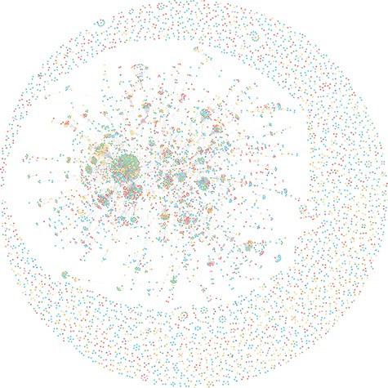
Figure 6. Full view of AnthraxKG.
Notes:
Figure 6. Full view of AnthraxKG.
Unless provided in the caption above, the following copyright applies to the content of this slide: © The Author(s) 2022. Published by Oxford University Press.This is an Open Access article distributed under the terms of the Creative Commons Attribution-NonCommercial License (https://creativecommons.org/licenses/by-nc/4.0/), which permits non-commercial re-use, distribution, and reproduction in any medium, provided the original work is properly cited. For commercial re-use, please contact journals.permissions@oup.com

Slide 7
Figure 7. Example of triples extracted by OpenIE.
Notes:
Figure 7. Example of triples extracted by OpenIE.
Unless provided in the caption above, the following copyright applies to the content of this slide: © The Author(s) 2022. Published by Oxford University Press.This is an Open Access article distributed under the terms of the Creative Commons Attribution-NonCommercial License (https://creativecommons.org/licenses/by-nc/4.0/), which permits non-commercial re-use, distribution, and reproduction in any medium, provided the original work is properly cited. For commercial re-use, please contact journals.permissions@oup.com

