Slide 1
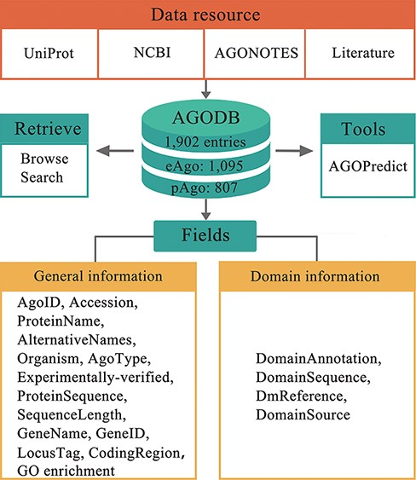
Figure 1. Architecture of AGODB. AGODB consists of 1902 entries, including 1095 eAgo proteins and 807 pAgo proteins. ...
Notes:
Figure 1. Architecture of AGODB. AGODB consists of 1902 entries, including 1095 eAgo proteins and 807 pAgo proteins. The relevant information of each entry in AGODB was collected from UniProt, NCBI, AGONOTES and published articles. The development of AGODB includes the design of fields, the development of the retrieval system and the integration of tool(s).
Unless provided in the caption above, the following copyright applies to the content of this slide: © The Author(s) 2022. Published by Oxford University Press.This is an Open Access article distributed under the terms of the Creative Commons Attribution-NonCommercial License (https://creativecommons.org/licenses/by-nc/4.0/), which permits non-commercial re-use, distribution, and reproduction in any medium, provided the original work is properly cited. For commercial re-use, please contact journals.permissions@oup.com

Slide 2
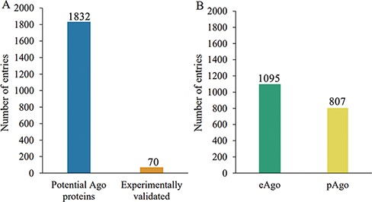
Figure 2. Schematic of Ago protein entries at various categories in the AGODB database. (A) Number of potential and ...
Notes:
Figure 2. Schematic of Ago protein entries at various categories in the AGODB database. (A) Number of potential and experimentally validated Ago proteins. (B) Number of eAgo and pAgo proteins.
Unless provided in the caption above, the following copyright applies to the content of this slide: © The Author(s) 2022. Published by Oxford University Press.This is an Open Access article distributed under the terms of the Creative Commons Attribution-NonCommercial License (https://creativecommons.org/licenses/by-nc/4.0/), which permits non-commercial re-use, distribution, and reproduction in any medium, provided the original work is properly cited. For commercial re-use, please contact journals.permissions@oup.com

Slide 3
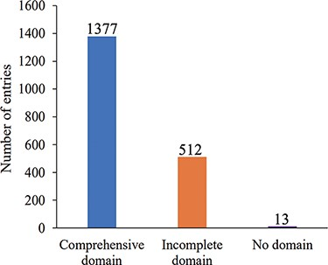
Figure 3. Number distribution of Ago protein entries according to domain annotation information integrity.
Notes:
Figure 3. Number distribution of Ago protein entries according to domain annotation information integrity.
Unless provided in the caption above, the following copyright applies to the content of this slide: © The Author(s) 2022. Published by Oxford University Press.This is an Open Access article distributed under the terms of the Creative Commons Attribution-NonCommercial License (https://creativecommons.org/licenses/by-nc/4.0/), which permits non-commercial re-use, distribution, and reproduction in any medium, provided the original work is properly cited. For commercial re-use, please contact journals.permissions@oup.com

Slide 4
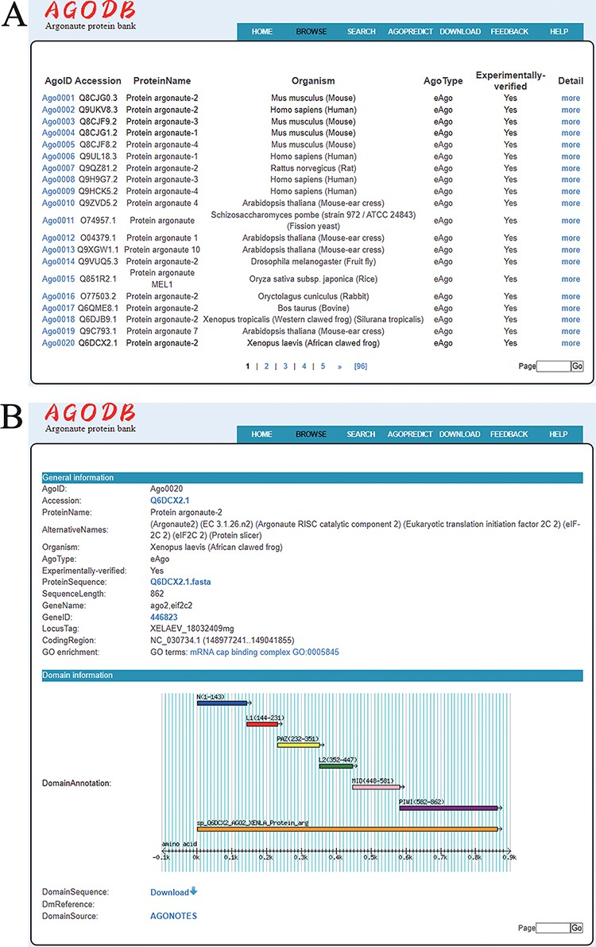
Figure 4. Browsing page of AGODB. (A) A brief browsing table displays fields, including AgoID, Accession, ProteinName, ...
Notes:
Figure 4. Browsing page of AGODB. (A) A brief browsing table displays fields, including AgoID, Accession, ProteinName, Organism, AgoType, Experimentally verified and links directing to the ‘Detail’ page. (B) The ‘Detail’ page shows detailed descriptions of each Ago protein.
Unless provided in the caption above, the following copyright applies to the content of this slide: © The Author(s) 2022. Published by Oxford University Press.This is an Open Access article distributed under the terms of the Creative Commons Attribution-NonCommercial License (https://creativecommons.org/licenses/by-nc/4.0/), which permits non-commercial re-use, distribution, and reproduction in any medium, provided the original work is properly cited. For commercial re-use, please contact journals.permissions@oup.com

Slide 5
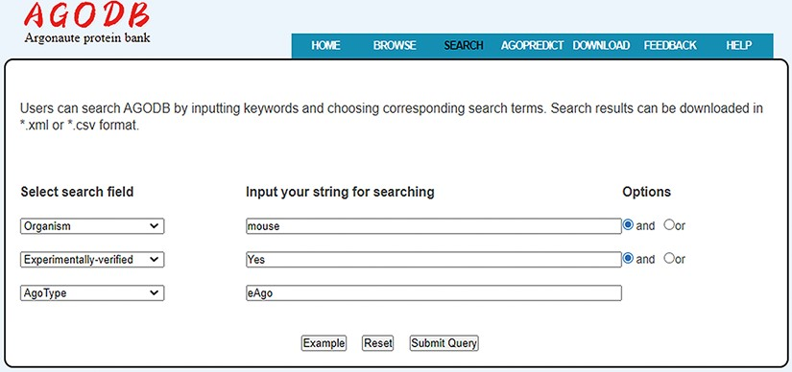
Figure 5. Search interface of AGODB. For example, if users want to retrieve all the experimentally validated eAgo ...
Notes:
Figure 5. Search interface of AGODB. For example, if users want to retrieve all the experimentally validated eAgo proteins from mouse, they should first select the search field ‘Organism’ from the pull-down list box, input ‘mouse’ into the corresponding blank text form and select the ‘and’ button. Then, users should select the ‘Experimentally-verified’ search field, input ‘Yes’ and select the ‘and’ button. Finally, they should select the ‘AgoType’ field, input ‘eAgo’ and press the ‘Submit Query’ button.
Unless provided in the caption above, the following copyright applies to the content of this slide: © The Author(s) 2022. Published by Oxford University Press.This is an Open Access article distributed under the terms of the Creative Commons Attribution-NonCommercial License (https://creativecommons.org/licenses/by-nc/4.0/), which permits non-commercial re-use, distribution, and reproduction in any medium, provided the original work is properly cited. For commercial re-use, please contact journals.permissions@oup.com

Slide 6
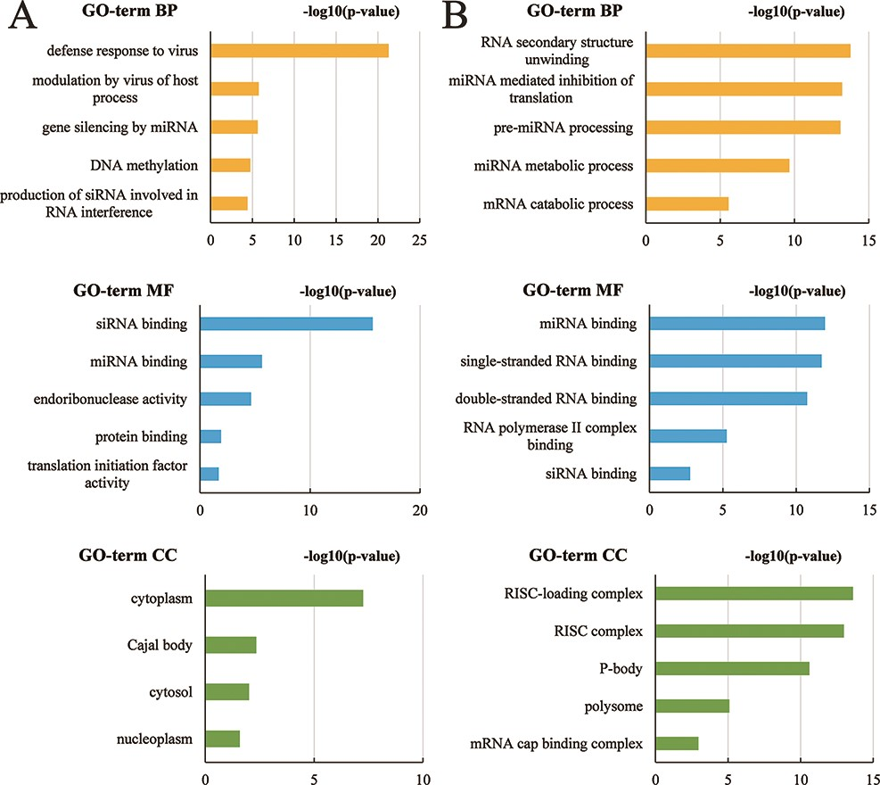
Figure 6. The top five subclasses of GO enrichment terms. (A) Arabidopsis thaliana species. (B) Bos taurus species. BP: ...
Notes:
Figure 6. The top five subclasses of GO enrichment terms. (A) Arabidopsis thaliana species. (B) Bos taurus species. BP: biological processes; MF: molecular function; CC: cellular component.
Unless provided in the caption above, the following copyright applies to the content of this slide: © The Author(s) 2022. Published by Oxford University Press.This is an Open Access article distributed under the terms of the Creative Commons Attribution-NonCommercial License (https://creativecommons.org/licenses/by-nc/4.0/), which permits non-commercial re-use, distribution, and reproduction in any medium, provided the original work is properly cited. For commercial re-use, please contact journals.permissions@oup.com

