Slide 1
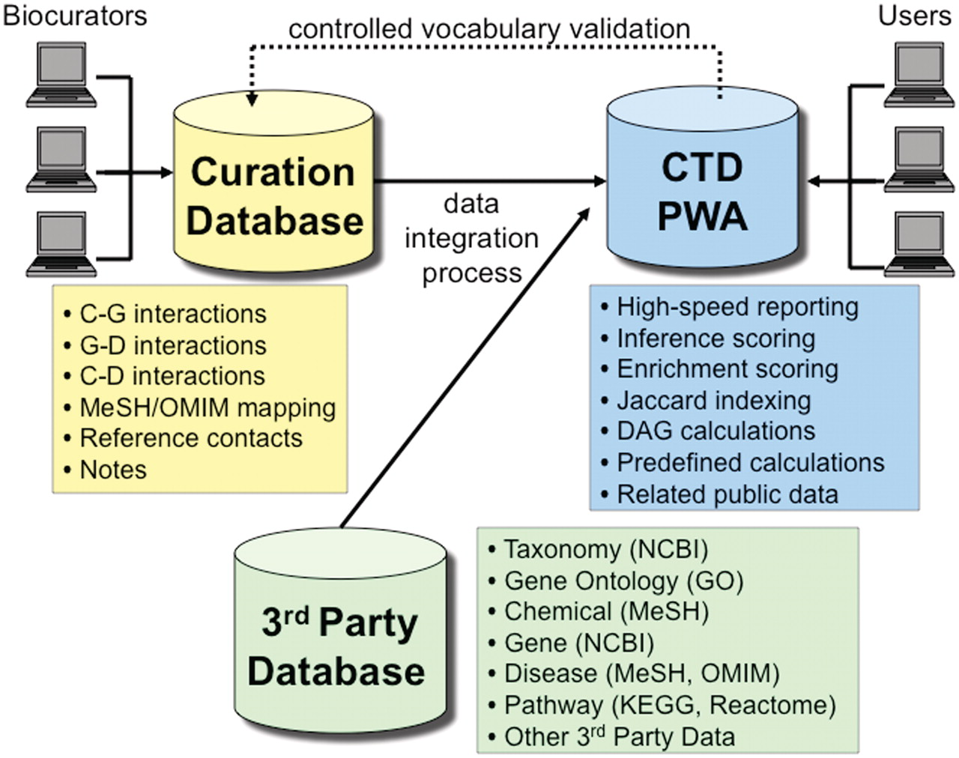
Figure 7. CTD/PostgreSQL logical database architecture. CTD is logically comprised of three major databases: Curation ...
Notes:
Figure 7. CTD/PostgreSQL logical database architecture. CTD is logically comprised of three major databases: Curation Database (yellow), 3rd Party Database (green) and Public Web Application (PWA) Database (blue). Biocurators, via the web, submit manually curated interactions and information that end up in the Curation Database. The 3rd Party Database contains data extracted from external sources (e.g., NCBI, GO, MeSH, OMIM, etc.). The PWA Database is loaded on a monthly basis and represents an integration of the Curation Database and the 3rd Party Database and is designed as a high-speed reporting database with selective denormalizations and data rollups. The PWA Database also contains novel, associative data (e.g. calculations for inference scores, enrichment scores, and Jaccard indexing, etc.). Users access CTD via the PWA.
Unless provided in the caption above, the following copyright applies to the content of this slide: © The Author(s) 2011. Published by Oxford University Press.This is Open Access article distributed under the terms of the Creative Commons Attribution Non-Commercial License (http://creativecommons.org/licenses/by-nc/2.5), which permits unrestricted non-commercial use, distribution, and reproduction in any medium, provided the original work is properly cited.

