Slide 1
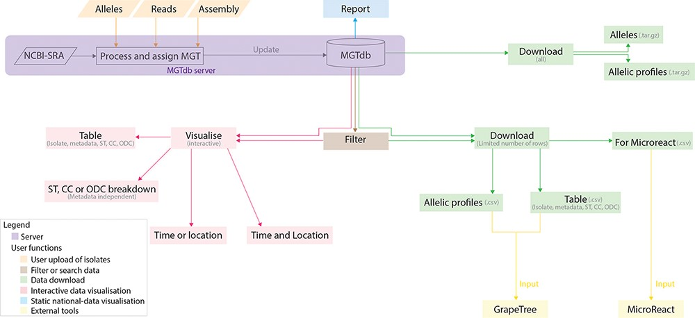
Figure 1. Data visualizations and downloads in MGTdb. The MGTdb database consists of isolates—user-uploaded or those ...
Notes:
Figure 1. Data visualizations and downloads in MGTdb. The MGTdb database consists of isolates—user-uploaded or those retrieved from NCBI-SRA—assigned the MGT identifiers. In particular, isolates submitted as reads or extracted alleles can be used for typing or querying the database for existing types, whereas isolates submitted as assemblies can only be used for querying the database for existing types. Queried isolates are only visible and downloadable by their uploading user. The MGTdb web service contains features to filter (indicated by brown), visualize (pink and blue) or download (green) these isolates. Indicated by pink: isolates are displayed in a table, either as a complete set or filtered with by metadata, ST, CC and ODC assignments. These data can also be explored via three interactive graphs. The first enables exploring the set of isolates and their MGT assignments in the context of either time or location, the second, in the context of both and the third interactive graph does not use metadata, and enables exploration of isolates and their MGT assignments. Indicated by blue: a report of country-wise or project-wise static summaries of isolates for the last 10 years, at each MGT level, can be generated. Indicated by green: the first 2000 isolates in the displayed table can be exported for use with Microreact—a web-tool which enables phylogeographical and temporal exploration of isolates. The data displayed in the initial table and the allelic profiles for the largest MGT-level STs can also be downloaded. For these two files, the current limits are set to 1 000 000 rows (essentially the entire database) for the tabular data and 10 000 for allelic profiles. The complete set of publicly available isolates, their allelic profiles and allele sequences can be downloaded separately from the organism main page.
Unless provided in the caption above, the following copyright applies to the content of this slide: © The Author(s) 2022. Published by Oxford University Press.This is an Open Access article distributed under the terms of the Creative Commons Attribution-NonCommercial License (https://creativecommons.org/licenses/by-nc/4.0/), which permits non-commercial re-use, distribution, and reproduction in any medium, provided the original work is properly cited. For commercial re-use, please contact journals.permissions@oup.com

Slide 2
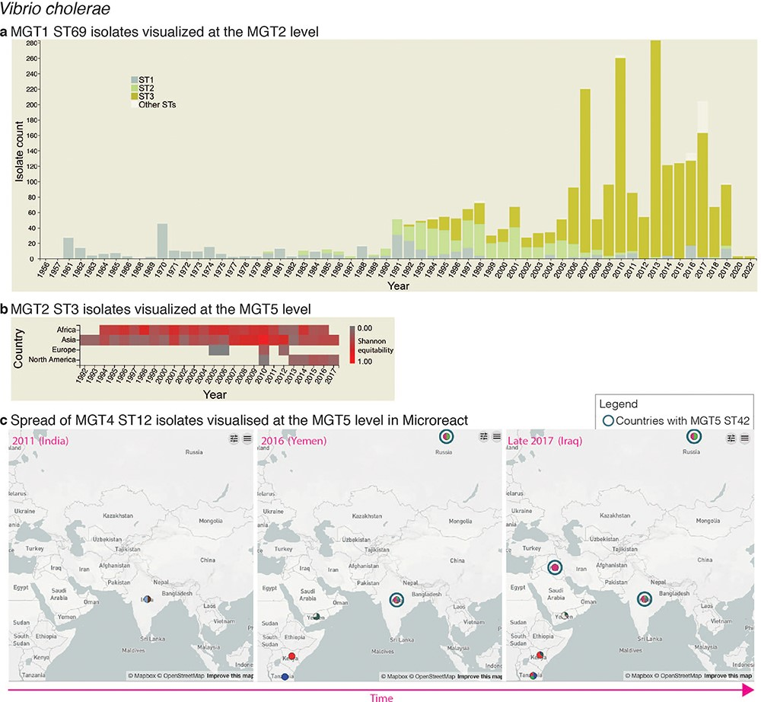
Figure 2. Interactive charts and streamlined integration with Microreact enabled in MGTdb. (a) An interactive chart in ...
Notes:
Figure 2. Interactive charts and streamlined integration with Microreact enabled in MGTdb. (a) An interactive chart in MGTdb that enables summarizing all or filtered isolates at any MGT level using either the locational or the temporal metadata. The chart shows the current cholera pandemic isolates (i.e. MGT1 ST69 or seven-gene MLST ST69) at the MGT2 level. This data can be explored on MGTdb at https://mgtdb.unsw.edu.au/vibrio/isolate-list?mgt1=69&searchType=and (data view level MGT2 ST, with ‘Only highlight top’ set to ‘3ʹ). (b) An interactive chart in MGTdb that enables summarizing all initially loaded or filtered isolates using both locational and temporal metadata. The chart shows the current cholera wave isolates (i.e. MGT2 ST3) at the MGT5 level. These data can be explored on MGTdb at https://mgtdb.unsw.edu.au/vibrio/isolate-list?ap2_0_st=3&searchType=and (data view level MGT5 ST). (c) Microreact visualization of MGT4 ST12 isolates exported from MGTdb. A data file—wherein the latitude and longitude are appended, along with unique colours for STs—can be exported from MGTdb for use with Microreact. Microreact enables visualization of isolates at any chosen MGT level, both geographically and temporally. Shown here is the temporal step-through (as enabled on Microreact) of MGT4 ST12 isolates, visualized at the MGT5 level. The data shown in this figure can be explored in Microreact using the link https://microreact.org/project/bjdgCuWdVowtJHwq2npYxi-mgt5-st12-vibrio-cholerae and selecting ‘Colour Column’ as MGT5. Alternatively, the original data can be viewed in MGTdb using the link https://mgtdb.unsw.edu.au/vibrio/isolate-list?ap4_0_st=12&searchType=and.
Unless provided in the caption above, the following copyright applies to the content of this slide: © The Author(s) 2022. Published by Oxford University Press.This is an Open Access article distributed under the terms of the Creative Commons Attribution-NonCommercial License (https://creativecommons.org/licenses/by-nc/4.0/), which permits non-commercial re-use, distribution, and reproduction in any medium, provided the original work is properly cited. For commercial re-use, please contact journals.permissions@oup.com

Slide 3
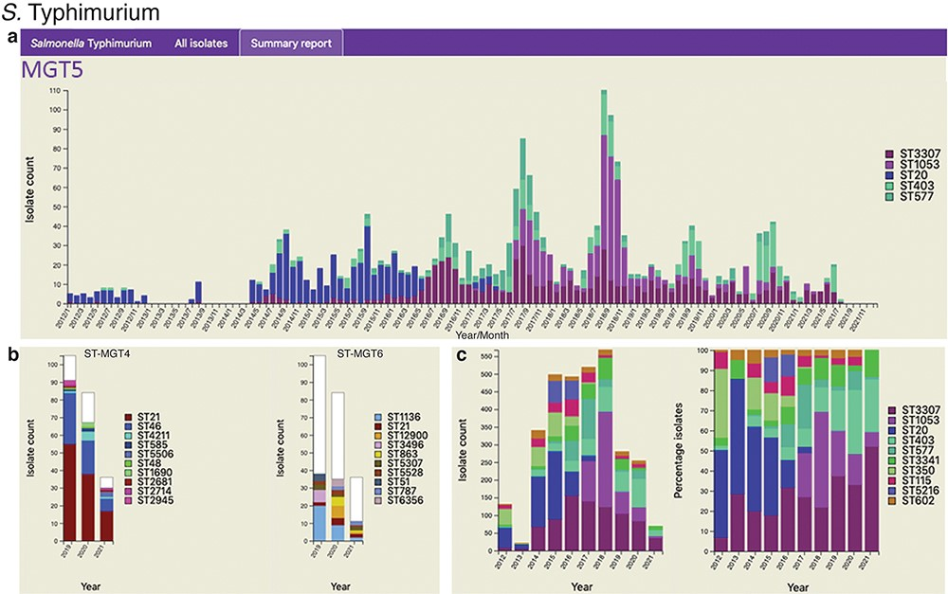
Figure 3. Static charts from the report feature on MGTdb which enables national surveillance. For any country, or any ...
Notes:
Figure 3. Static charts from the report feature on MGTdb which enables national surveillance. For any country, or any user’s project (which houses a set of isolates), a report can be generated. The report presents isolates (and MGT assignments), within a specified country or project for a specified range of years, as general summaries, as well as, summarizes the isolates at each individual MGT level as a series of graphs. Shown here are graphs from the report generated for S. Typhimurium MGT5 STs in the UK over the past 10 years (2012–21). In particular, (a) summary of top five MGT5 STs by month, (b) summary of MGT5 ST3307 isolates at the MGT4 and MGT6 levels, and (c) summary of top 10 MGT5 STs by year, where the first graph shows isolate counts, and in the second, the counts have been scaled by the maximal ST distribution observed that year. These data can be explored on MGTdb at https://mgtdb.unsw.edu.au/salmonella/summaryReport by choosing the country ‘UK, setting the ‘Year start’ as 2012, ‘Year end’ as 2021, and then generating the report.
Unless provided in the caption above, the following copyright applies to the content of this slide: © The Author(s) 2022. Published by Oxford University Press.This is an Open Access article distributed under the terms of the Creative Commons Attribution-NonCommercial License (https://creativecommons.org/licenses/by-nc/4.0/), which permits non-commercial re-use, distribution, and reproduction in any medium, provided the original work is properly cited. For commercial re-use, please contact journals.permissions@oup.com

Slide 4
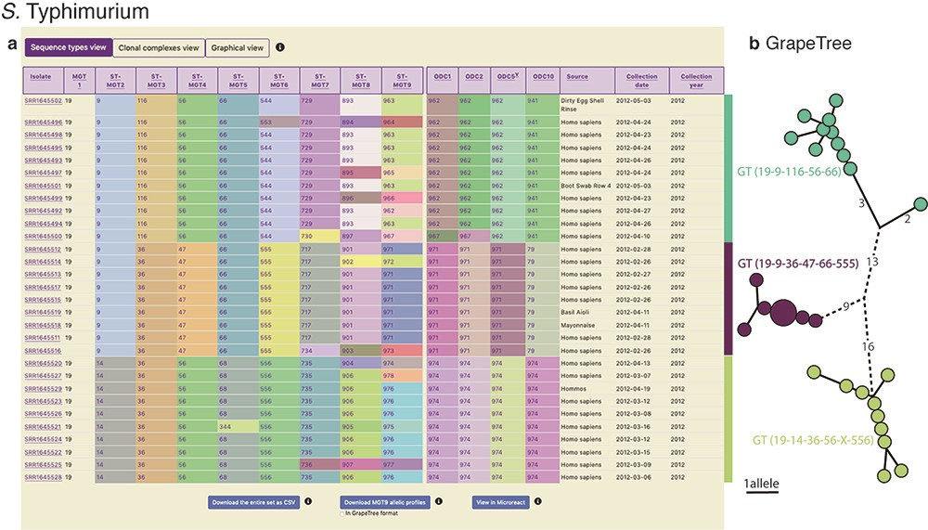
Figure 4. Display of all data in MGTdb and exported data enabling streamlined integration with GrapeTree. (a) All ...
Notes:
Figure 4. Display of all data in MGTdb and exported data enabling streamlined integration with GrapeTree. (a) All isolates—initially loaded or filtered—are shown in an interactive table. Shown in the table are also the STs assigned to the isolates at all MGT levels and ODCs. This view can be switched to visualize CCs, instead of STs, for all MGT levels, using buttons above the table. The CCs group STs by single linkage clustering with a one allele difference cut-off, and ODCs group the largest MGT-level STs, with 1, 2, 5 and 10 allele difference cut-offs. The table shows a maximum of 100 isolates per page. To summarize all the initially loaded or filtered data, a user can switch to graphical view (button displayed above the table), or download the data (using buttons below the table). The user can download the data displayed in the table (MGT-associated assignments), allelic profiles for the largest MGT level, or export the data to Microreact. (b) GrapeTree visualization of isolates exported from MGTdb. The allelic profiles and the MGT assignments can be imported into GrapeTree to build and visualize a neighbour joining graph (as shown here), or a minimal-spanning tree. The data shown in the table and the GrapeTree network graph are from three outbreaks of S. Typhimurium that occurred in NSW, Australia, in 2012 and can be explored on MGTdb at: https://mgtdb.unsw.edu.au/salmonella/isolate-list?year=2012&state=NSW&searchType=and.
Unless provided in the caption above, the following copyright applies to the content of this slide: © The Author(s) 2022. Published by Oxford University Press.This is an Open Access article distributed under the terms of the Creative Commons Attribution-NonCommercial License (https://creativecommons.org/licenses/by-nc/4.0/), which permits non-commercial re-use, distribution, and reproduction in any medium, provided the original work is properly cited. For commercial re-use, please contact journals.permissions@oup.com

