Slide 1
Figure 1. Sampling sites with spider assemblage data available in ARAapp, with data from 26 October 2023.
Notes:
Figure 1. Sampling sites with spider assemblage data available in ARAapp, with data from 26 October 2023.
Unless provided in the caption above, the following copyright applies to the content of this slide: © The Author(s) 2024. Published by Oxford University Press.This is an Open Access article distributed under the terms of the Creative Commons Attribution License (https://creativecommons.org/licenses/by/4.0/), which permits unrestricted reuse, distribution, and reproduction in any medium, provided the original work is properly cited.

Slide 2
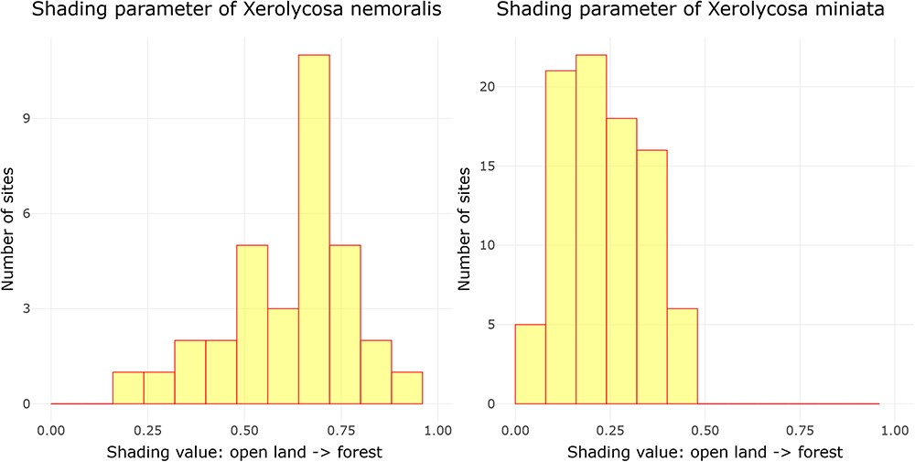
Figure 2. Distribution of the shading parameter values for X. nemoralis and X. miniata, and the graphs were downloaded ...
Notes:
Figure 2. Distribution of the shading parameter values for X. nemoralis and X. miniata, and the graphs were downloaded on 26 October 2023.
Unless provided in the caption above, the following copyright applies to the content of this slide: © The Author(s) 2024. Published by Oxford University Press.This is an Open Access article distributed under the terms of the Creative Commons Attribution License (https://creativecommons.org/licenses/by/4.0/), which permits unrestricted reuse, distribution, and reproduction in any medium, provided the original work is properly cited.

Slide 3
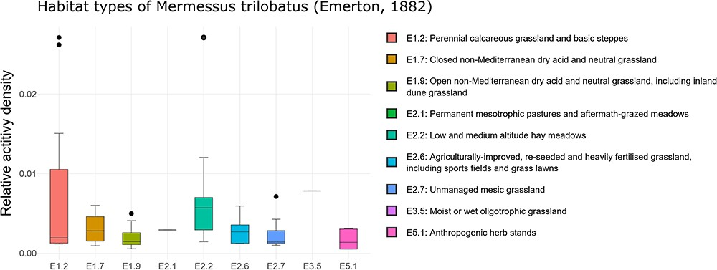
Figure 3. Habitat occurrence of M. trilobatus according to the EUNIS habitat classification at the third level within ...
Notes:
Figure 3. Habitat occurrence of M. trilobatus according to the EUNIS habitat classification at the third level within Class E: grasslands and lands dominated by forbs, mosses or lichens. The frequency data for the individual classes are as follows (sites with the presence of M. trilobatus/total sites in ARAMOB) E1.2: 12/86, E1.7: 6/14, E1.9: 15/26, E2.1: 1/6, E2.2: 13/28, E2.6: 14/24, E2.7: 8/35, E3.5: 1/12, E4.3: 7/69, E4.5: 3/46, and E5.1: 6/16. The graph was downloaded on 26 October 2023.
Unless provided in the caption above, the following copyright applies to the content of this slide: © The Author(s) 2024. Published by Oxford University Press.This is an Open Access article distributed under the terms of the Creative Commons Attribution License (https://creativecommons.org/licenses/by/4.0/), which permits unrestricted reuse, distribution, and reproduction in any medium, provided the original work is properly cited.

