Slide 1
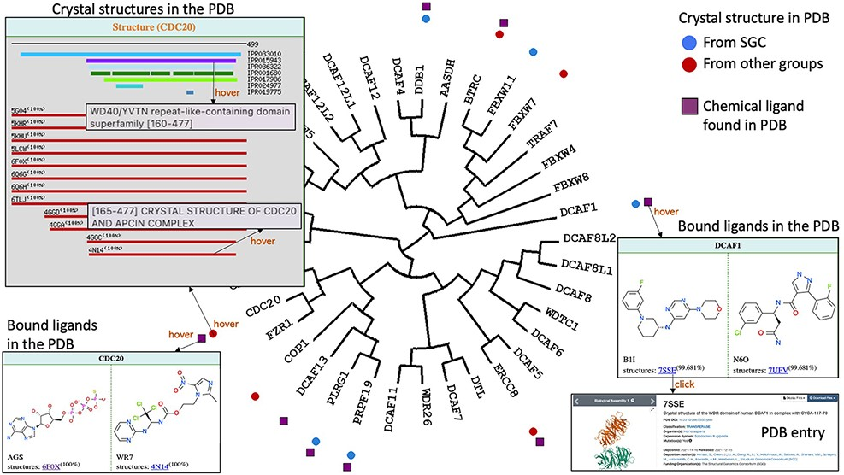
Figure 4. Structural and chemical coverage. Circular icons highlight which proteins have a crystal structure in the ...
Notes:
Figure 4. Structural and chemical coverage. Circular icons highlight which proteins have a crystal structure in the PDB. Hovering over an icon provides details on the domain architecture of the protein (including domain name and Interpro ID), the crystallized domains and their clickable PDB codes and titles linked to the associated PDB pages. Data on chemical ligands found in PDB structures were also mapped as square icons. Hovering brings image of the chemical structures and PDB codes.
Unless provided in the caption above, the following copyright applies to the content of this slide: © The Author(s) 2022. Published by Oxford University Press.This is an Open Access article distributed under the terms of the Creative Commons Attribution-NonCommercial License (https://creativecommons.org/licenses/by-nc/4.0/), which permits non-commercial re-use, distribution, and reproduction in any medium, provided the original work is properly cited. For commercial re-use, please contact journals.permissions@oup.com

