Slide 1
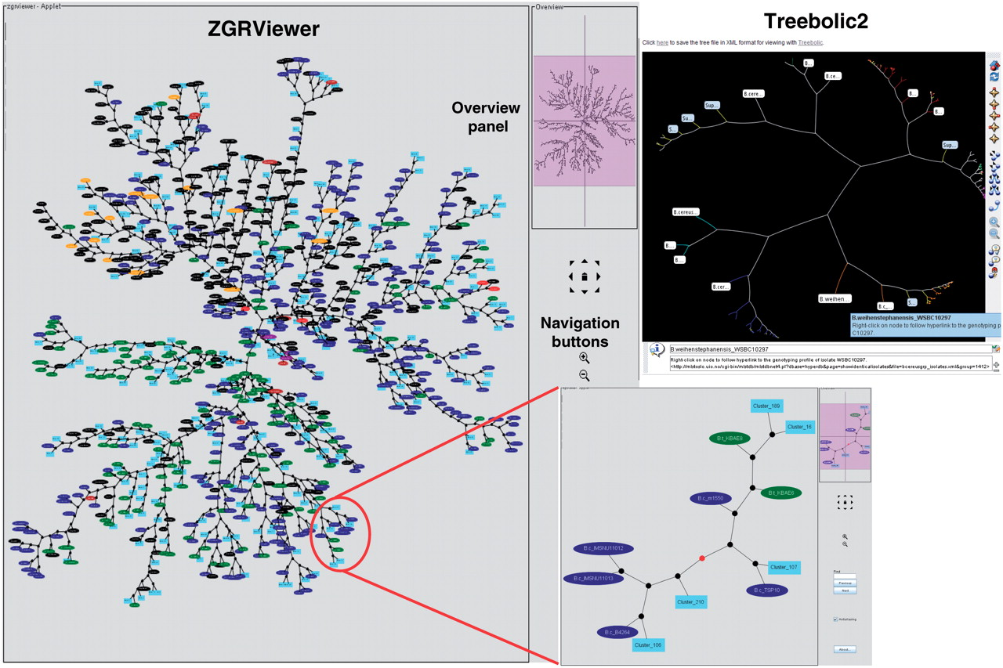
Figure 3. Phylogenetic snapshot of the B. cereus group population based on MLST and AFLP typing data for 2143 isolates. ...
Notes:
Figure 3. Phylogenetic snapshot of the B. cereus group population based on MLST and AFLP typing data for 2143 isolates. The snapshot combines supertree and supercluster information. The supertree is represented as an unrooted network in which the closely related strains belonging to a supercluster have been replaced by a representative isolate. Superclusters are drawn as filled lightblue boxes, while singleton isolates are drawn as ellipses colored by bacterial species (red, B. anthracis; blue, B. cereus; green, B. thuringiensis; brown, B. mycoides; purple, B. pseudomycoides; orange, B. weihenstephanensis; black, uncharacterized B. cereus group isolate). The network can be browsed interactively using the ZGRViewer navigation buttons and mouse functions. Clicking on an internal node loads a new page displaying the subtree including all descendants of that node in the supertree. An example is given in the inset showing the subtree circled in red. The view in the upper right corner shows the display of the supertree in hyperbolic space using Treebolic2.
Unless provided in the caption above, the following copyright applies to the content of this slide: © The Author(s) 2010. Published by Oxford University Press.This is Open Access article distributed under the terms of the Creative Commons Attribution Non-Commercial License (http://creativecommons.org/licenses/by-nc/2.5), which permits unrestricted non-commercial use, distribution, and reproduction in any medium, provided the original work is properly cited.

