Slide 1
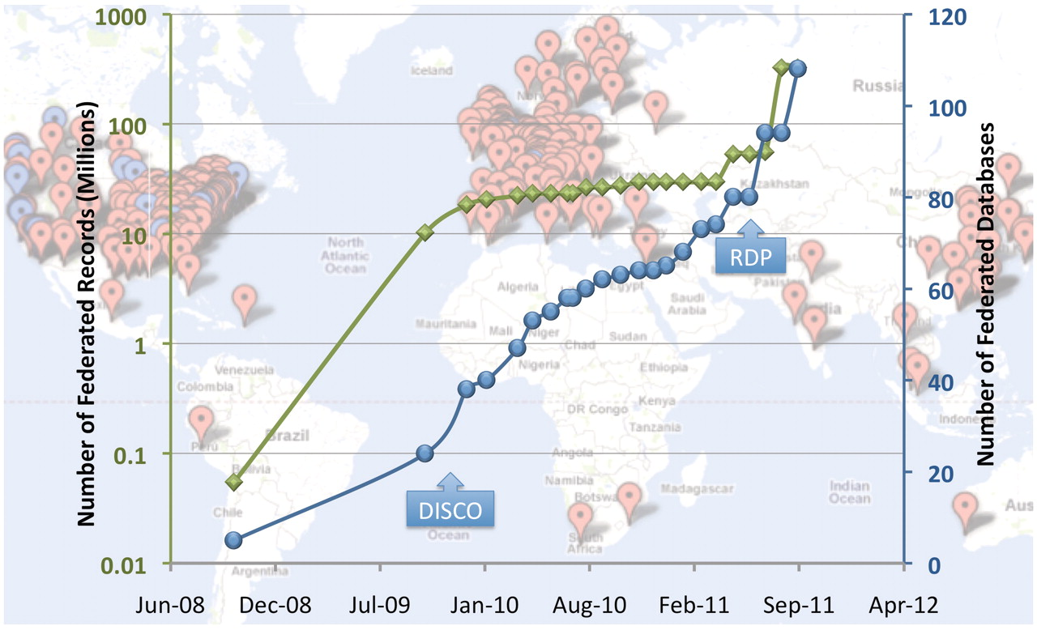
Figure 1. NIF Resource Landscape. Background: each point on the map represents a global location that houses one or ...
Notes:
Figure 1. NIF Resource Landscape. Background: each point on the map represents a global location that houses one or more resources registered with the NIF (via NeuroLex). Red points represent NIF registry entries and blue points represent databases and data sets incorporated into the data federation. Foreground: the blue line represents a plot of the number of federated data sources over time, and the green line represents the number of records in the NIF Data Federation over the same time (note these records come from only the blue dots and that the scale is logarithmic). The DISCO protocols and automated resource crawling were integrated into NIF system function in November 2009 and led to a growth of NIF holdings and in mid 2011, significant enhancements of the DISCO protocols allowing for enhanced automation of data ingestion, as well as the current resource discovery pipeline (RDP) were implemented.
Unless provided in the caption above, the following copyright applies to the content of this slide: © The Author(s) 2012. Published by Oxford University Press.This is an Open Access article distributed under the terms of the Creative Commons Attribution Non-Commercial License (http://creativecommons.org/licenses/by-nc/3.0), which permits unrestricted non-commercial use, distribution, and reproduction in any medium, provided the original work is properly cited.

Slide 2
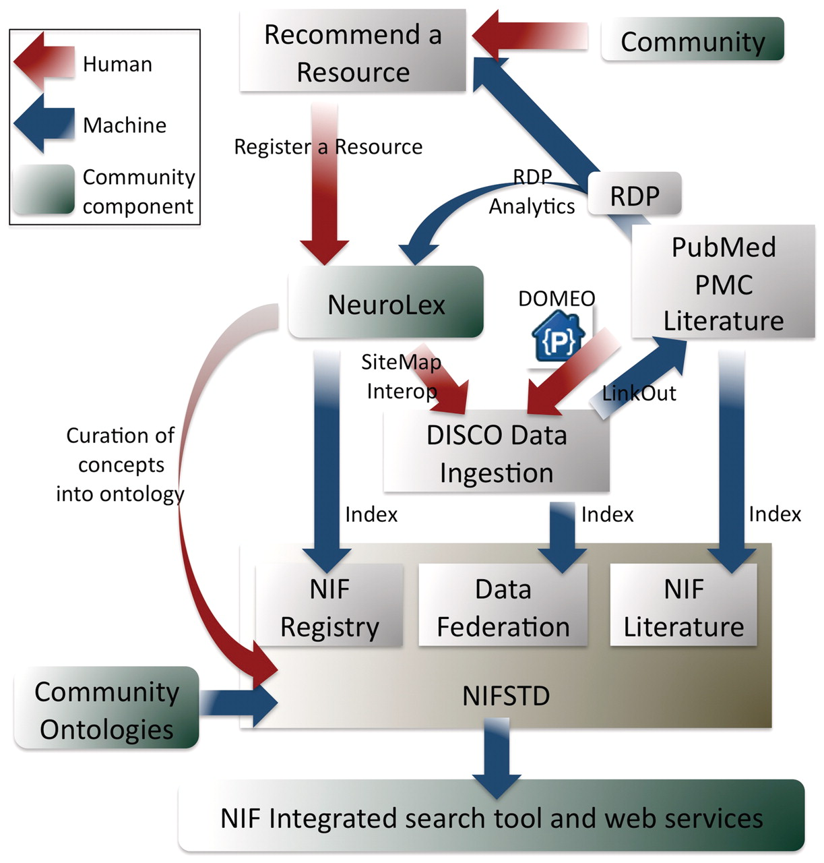
Figure 2. A high level overview of the NIF system. This figure emphasizes where inputs and outputs of the NIF lie as a ...
Notes:
Figure 2. A high level overview of the NIF system. This figure emphasizes where inputs and outputs of the NIF lie as a function of some of NIF's tools. Red arrows represent human steps, blue arrows represent automated steps and green boxes represent places in the system where community interactions are likely. The input of data is done using a suite of tools including NeuroLex (the first step for all data ingestion), DISCO (for deep data registration), LinkOut (linking data to PubMed, PMC PubMed Central literature), DOMEO (for literature annotation) and the RDP automated text-mining resource discovery pipeline that recognizes resources and recommends them to curators for possible inclusion in the NIF Registry. The creation of indices is informed by the ontology, as are the search tools and public web services. Note, all data moves through a process where it is recommended, registered to the NeuroLex, then included in the NIF Registry index and becomes available to DISCO tools for deeper content integration.
Unless provided in the caption above, the following copyright applies to the content of this slide: © The Author(s) 2012. Published by Oxford University Press.This is an Open Access article distributed under the terms of the Creative Commons Attribution Non-Commercial License (http://creativecommons.org/licenses/by-nc/3.0), which permits unrestricted non-commercial use, distribution, and reproduction in any medium, provided the original work is properly cited.

Slide 3
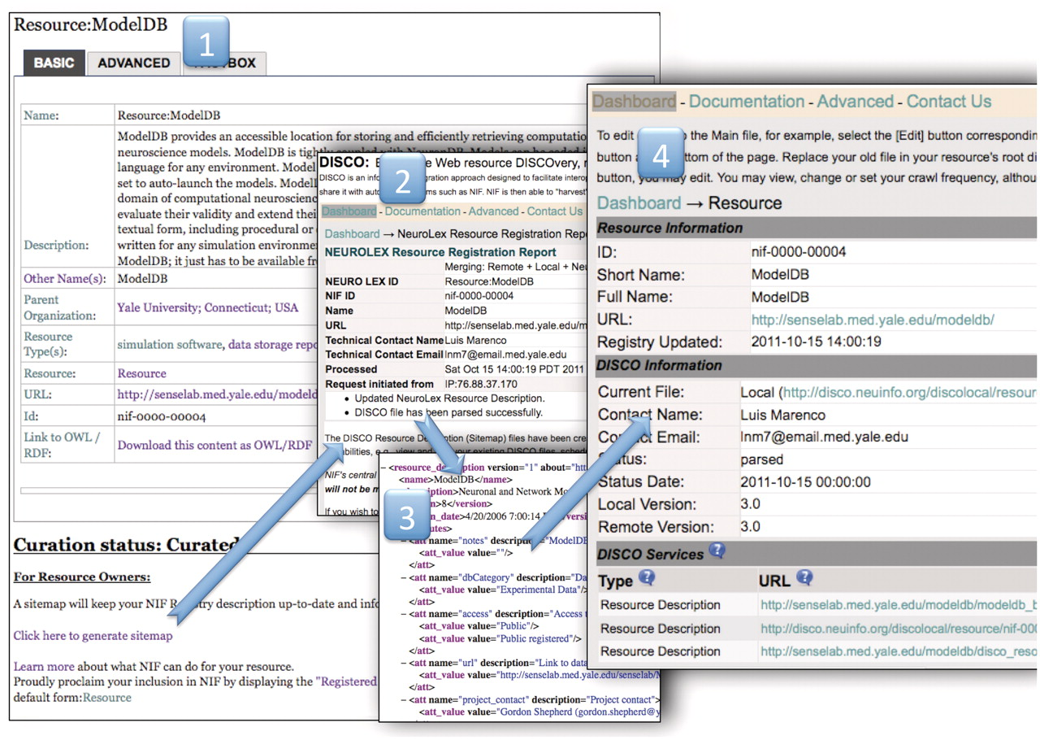
Figure 3. The NIF Registration Pipeline. The NIF registration pipeline starts at a wiki page for each resource (i). ...
Notes:
Figure 3. The NIF Registration Pipeline. The NIF registration pipeline starts at a wiki page for each resource (i). This step shows an example public wiki page for the ModelDB resource. Anyone can nominate a resource, the curators will standardize the entry, the resource owner can change the description by simply hitting the edit button and adding information to the form and the owner can sign up to watch the page so that when any changes are made, he/she is notified. When the description is adequate, the curators will change the curation status to ‘curated’ and the ‘click here to generate sitemap’ link becomes visible. This link activates the DISCO system to generate a sitemap file using the text from the stable version of the resource in the NeuroLex wiki (ii). The event tracking system is activated, generating an email to the resource-provider tracking group in NIF, and instructions prompt the user to download the DISCO interop file (iii) and place it into the root directory of the resource. When this is complete, the DISCO dashboard updates and a new page is generated for the resource (iv) that allows the curators or the resource owner to regenerate, or edit the files that were created, schedule a crawl frequency and add additional files allowing for deeper interoperation with NIF such as including data in the Data Federation.
Unless provided in the caption above, the following copyright applies to the content of this slide: © The Author(s) 2012. Published by Oxford University Press.This is an Open Access article distributed under the terms of the Creative Commons Attribution Non-Commercial License (http://creativecommons.org/licenses/by-nc/3.0), which permits unrestricted non-commercial use, distribution, and reproduction in any medium, provided the original work is properly cited.

