Slide 1
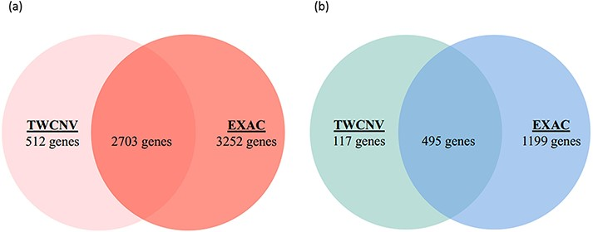
Figure 7. Venn diagrams of significant gene counts from the analysis function (a) Significant CN gains (Red) were ...
Notes:
Figure 7. Venn diagrams of significant gene counts from the analysis function (a) Significant CN gains (Red) were observed in 2703 genes among lung adenocarcinoma patients from both TWCNV and ExAC populations. (b) Significant CN losses (Blue) were observed in 495 genes among lung adenocarcinoma patients from both TWCNV and ExAC populations.
Unless provided in the caption above, the following copyright applies to the content of this slide: © The Author(s) 2021. Published by Oxford University Press.This is an Open Access article distributed under the terms of the Creative Commons Attribution License (http://creativecommons.org/licenses/by/4.0/), which permits unrestricted reuse, distribution, and reproduction in any medium, provided the original work is properly cited.

