Slide 1
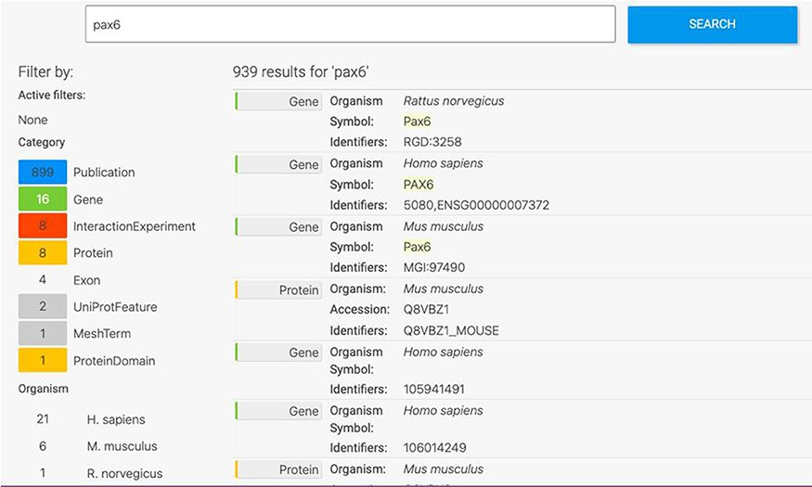
Figure 1. Keyword search. A search for ‘Pax6’ returns a filterable menu of data classes and organisms with the number ...
Notes:
Figure 1. Keyword search. A search for ‘Pax6’ returns a filterable menu of data classes and organisms with the number of entities found in each on the left and individual entities displayed on the right. Each individual entity provides a link to its report page.
Unless provided in the caption above, the following copyright applies to the content of this slide: © The Author(s) 2022. Published by Oxford University Press.This is an Open Access article distributed under the terms of the Creative Commons Attribution-NonCommercial License (https://creativecommons.org/licenses/by-nc/4.0/), which permits non-commercial re-use, distribution, and reproduction in any medium, provided the original work is properly cited. For commercial re-use, please contact journals.permissions@oup.com

