Slide 1
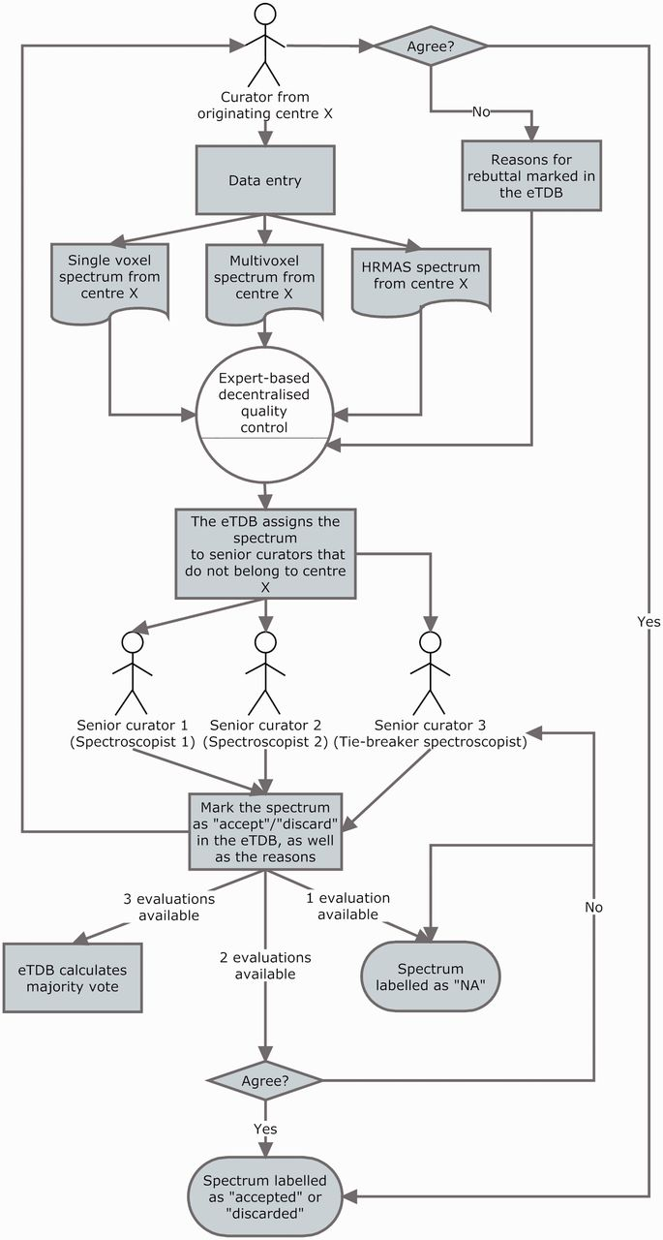
Figure 5 The three-expert system for spectroscopic QC of SV, MV and HRMAS. Two ES decided on the quality of the ...
Notes:
Figure 5 The three-expert system for spectroscopic QC of SV, MV and HRMAS. Two ES decided on the quality of the spectrum based on its empirical examination and a third one, a potential tie-breaker evaluated in case of disagreement. The spectrum could be accepted or discarded, and the instrumental reasons for it could also be stated if deemed necessary, e.g. poor signal-to-noise ratio (SNR), insufficient water suppression or signals from the scalp lipids (12). The system calculated, which was the majority vote and filled in the consensus decision that constituted another searchable meta-data field. It was as well possible that the original spectroscopist rebutted the final consensus decision and then, each of the ES could also change their verdict and state why they had changed their opinion. All these actions had specific meta-data fields. For SV spectra, the fields for ES validation were replicated, because depending on the format, it was possible to have an automatically processed spectrum or not, in which case, a manually processed one had to be entered. For MV data, because there was no automatic processing pipeline available, only expert-based meta-data fields were available. HRMAS validation was performed similarly to MV.
Unless provided in the caption above, the following copyright applies to the content of this slide: © The Author(s) 2012. Published by Oxford University Press.This is an Open Access article distributed under the terms of the Creative Commons Attribution License (http://creativecommons.org/licenses/by-nc/3.0/), which permits non-commercial reuse, distribution, and reproduction in any medium, provided the original work is properly cited. For commercial re-use, please contact journals.permissions@oup.com.

