Slide 1
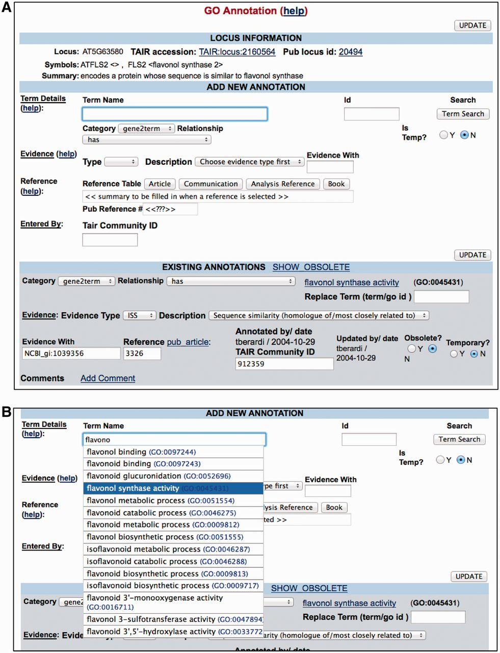
Figure 3 PubSearch GO annotation interface. (A) Top panel Locus Information provides a summary of gene function. The ...
Notes:
Figure 3 PubSearch GO annotation interface. (A) Top panel Locus Information provides a summary of gene function. The ‘Add New Annotation’ section allows curators to compose all essential components required for a GO annotation. Lower panel displays existing annotations. (B) The built-in GO term auto-complete functionality allows curators to select from a list of GO terms as they type. The same interface is also used for PO annotations.
Unless provided in the caption above, the following copyright applies to the content of this slide: © The Author(s) 2012. Published by Oxford University Press.This is an Open Access article distributed under the terms of the Creative Commons Attribution License (http://creativecommons.org/licenses/by-nc/3.0/), which permits non-commercial reuse, distribution, and reproduction in any medium, provided the original work is properly cited. For commercial re-use, please contact journals.permissions@oup.com.

