Slide 1
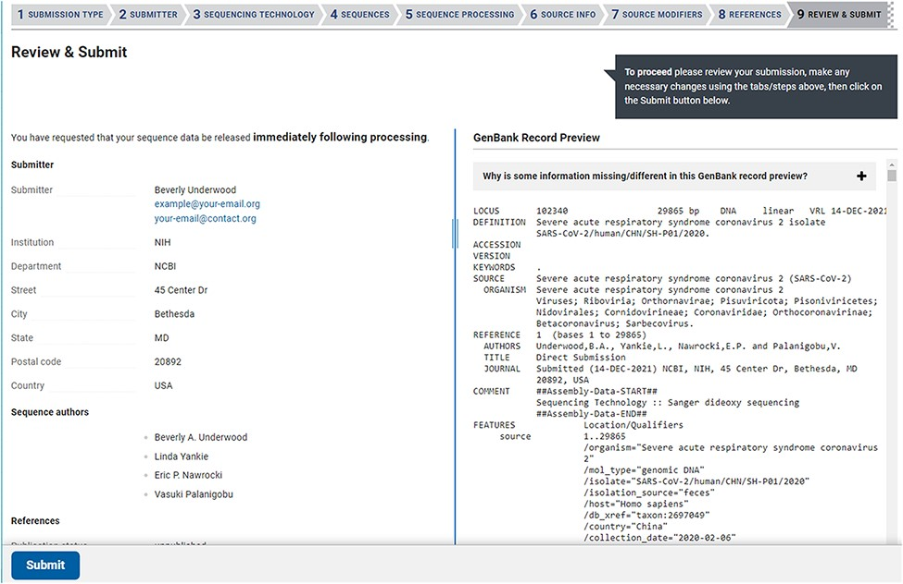
Figure 4. The Review & Submit page in a SARS-CoV-2 web submission. The left side of the page contains a summary of ...
Notes:
Figure 4. The Review & Submit page in a SARS-CoV-2 web submission. The left side of the page contains a summary of information, data files, and pre-submission sequence processing reports. The right side of the page displays a preview of the GenBank flatfiles prior to feature annotation and full submission processing. The preview is a familiar, human-readable format that allows submitters to confirm the author names, publications (if provided), contact information, sequencing technology and source information are correct before submitting.
Unless provided in the caption above, the following copyright applies to the content of this slide: Published by Oxford University Press 2022. This work is written by (a) US Government employee(s) and is in the public domain in the US.This work is written by (a) US Government employee(s) and is in the public domain in the US.

