Slide 1
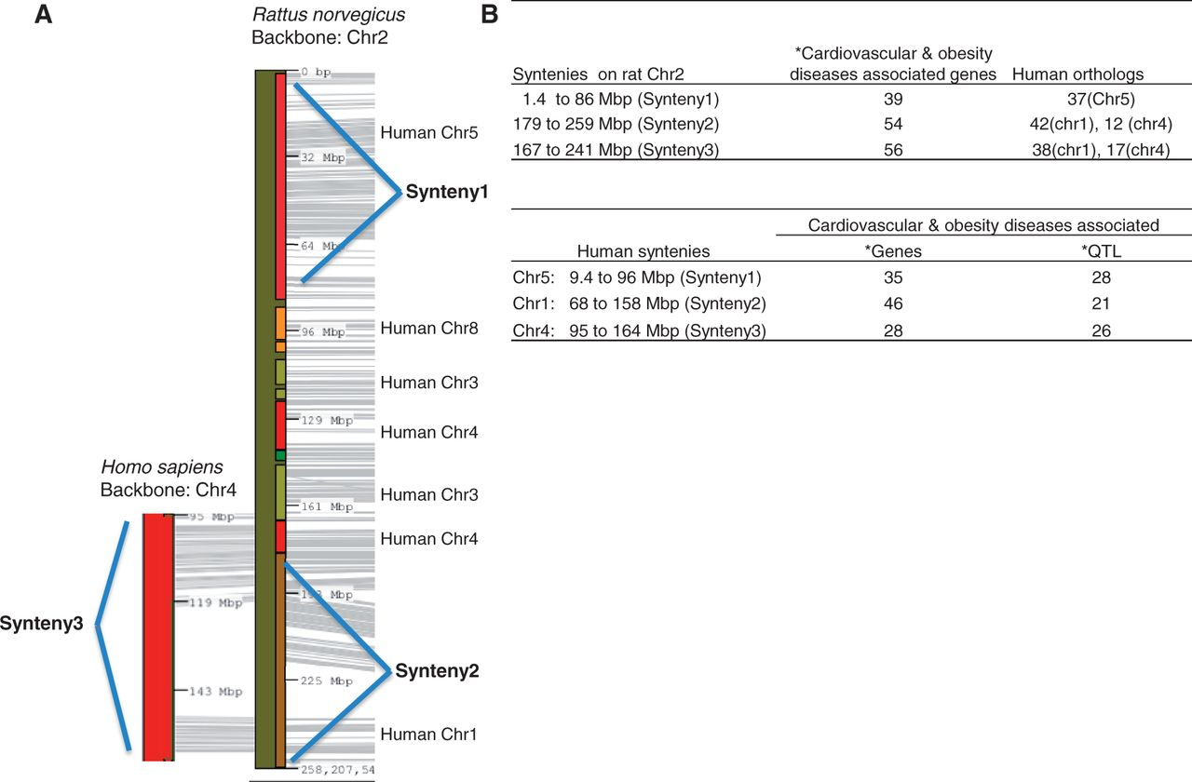
Figure 2. Cardiovascular and obesity diseases association of rat chromosome 2 and the human syntenies. Syntenic mapping ...
Notes:
Figure 2. Cardiovascular and obesity diseases association of rat chromosome 2 and the human syntenies. Syntenic mapping of rat chromosome 2 to the human genome was performed using VCMap (http://animalgenome.org/VCmap/). (A) The two backbone chromosomes are labelled in Mbp. The chromosomal origins of syntenies are labelled to the right. (B) Rat and human syntenies are listed, with corresponding human orthologs for the rat syntenies, and disease-associated genes and QTL. (Asterisk) The cardiovascular and obesity diseases–associated genes (human and rat) and QTL (human) in the synteny were downloaded from ‘Disease Related Tracks’ (cardiovascular diseases and nutritional and metabolic diseases) from genome browsers at RGD. (rat: http://rgd.mcw.edu/fgb2/gbrowse/rgd_904/ and human: http://rgd.mcw.edu/fgb2/gbrowse/human_36_3/).
Unless provided in the caption above, the following copyright applies to the content of this slide: © The Author(s) 2013. Published by Oxford University Press.This is an Open Access article distributed under the terms of the Creative Commons Attribution License (http://creativecommons.org/licenses/by/3.0/), which permits unrestricted reuse, distribution, and reproduction in any medium, provided the original work is properly cited.

