Slide 1
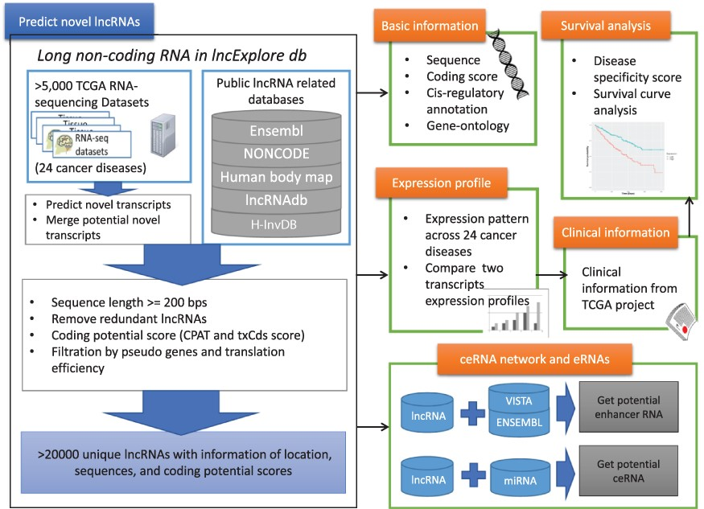
Figure 1. Schematic representation of lncExplore database. The available known lncRNA resources were collected from ...
Notes:
Figure 1. Schematic representation of lncExplore database. The available known lncRNA resources were collected from five public databases (Ensembl, Human body map, NONCODE, H-InvDB and lncRNAdb). We predicted the novel transcripts from RNA-seq datasets. To eliminated false-positive novel lncRNAs, we only collected the transcripts with following characteristics: sequences longer than 200 nucleotides, sequences with low coding potential probability, sequences without potential pseudogenes and sequences with similar translation efficiency as known lncRNAs. The elimination step reduced transcripts into >20 000 ‘unique lncRNA transcripts’ in our database. In lncExplore, the information about lncRNAs includes basic genomic information, gene expression profiles across cancers, predicted molecular annotations (GO, eRNA and ceRNA) and clinical-related information (disease specificity score and survival curve).
Unless provided in the caption above, the following copyright applies to the content of this slide: © The Author(s) 2021. Published by Oxford University Press.This is an Open Access article distributed under the terms of the Creative Commons Attribution License (https://creativecommons.org/licenses/by/4.0/), which permits unrestricted reuse, distribution, and reproduction in any medium, provided the original work is properly cited.

