Slide 1
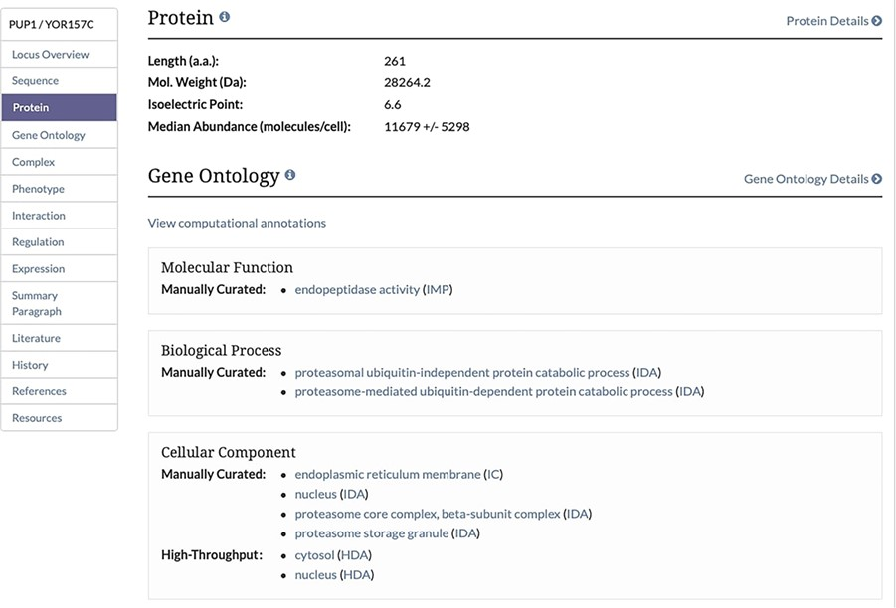
Figure 2 Protein Section of the Locus Summary Page. The protein section of the Locus Summary pages, located between ...
Notes:
Figure 2 Protein Section of the Locus Summary Page. The protein section of the Locus Summary pages, located between the Sequence and Gene Ontology sections, contains the calculated median and MAD for the protein of interest expressed in molecules/cell in addition to basic sequence-derived information (length, molecular weight and isoelectric point). Median was calculated based on all values for a given protein from untreated cells, and MAD was calculated using the same values. When the median value was generated based on a single value, a MAD could not be calculated.
Unless provided in the caption above, the following copyright applies to the content of this slide: © The Author(s) 2020. Published by Oxford University Press.This is an Open Access article distributed under the terms of the Creative Commons Attribution License (http://creativecommons.org/licenses/by/4.0/), which permits unrestricted reuse, distribution, and reproduction in any medium, provided the original work is properly cited.

