Slide 1
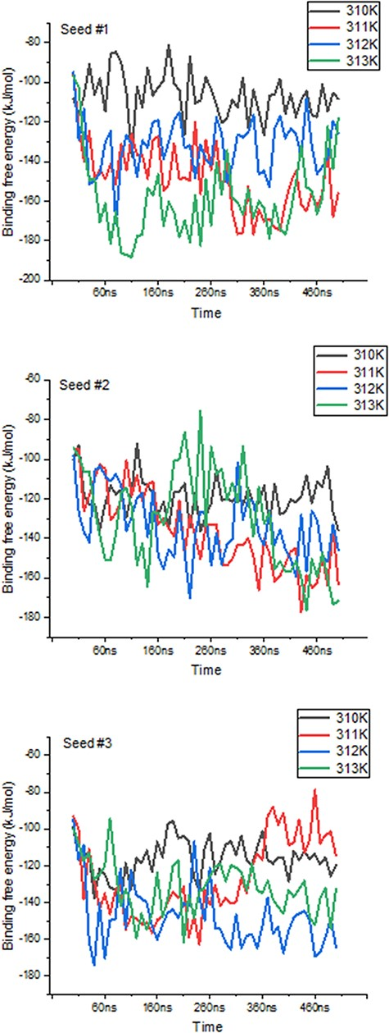
Figure 5. Variations in binding free energies between PD-1 and PD-L2 under different temperatures. Values obtained ...
Notes:
Figure 5. Variations in binding free energies between PD-1 and PD-L2 under different temperatures. Values obtained every 10 ns throughout the 500 ns-long simulations, for each seed and temperature point.
Unless provided in the caption above, the following copyright applies to the content of this slide: © The Author(s) 2024. Published by Oxford University Press.This is an Open Access article distributed under the terms of the Creative Commons Attribution License (https://creativecommons.org/licenses/by/4.0/), which permits unrestricted reuse, distribution, and reproduction in any medium, provided the original work is properly cited.

