Slide 1
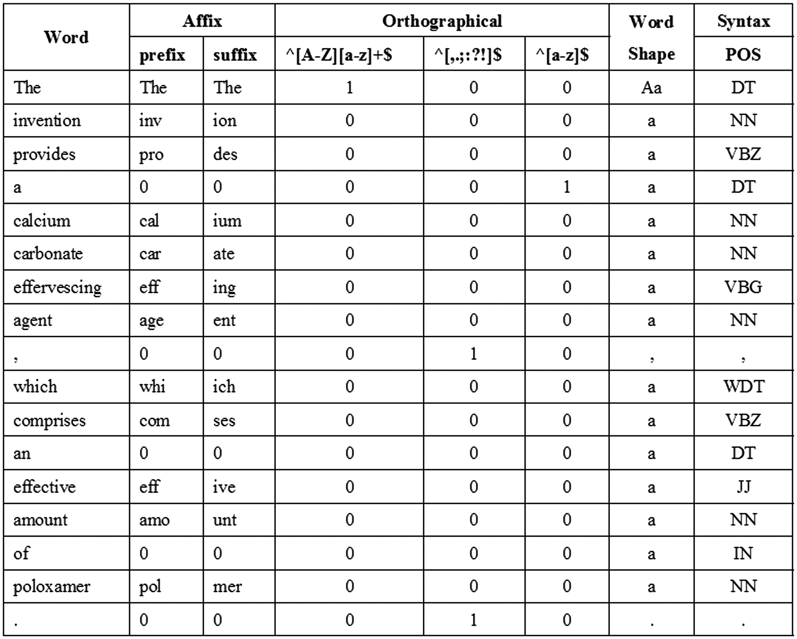
Figure 3 An example of the baseline features.
Notes:
Figure 3 An example of the baseline features.
Unless provided in the caption above, the following copyright applies to the content of this slide: © The Author(s) 2016. Published by Oxford University Press. This is an Open Access article distributed under the terms of the Creative Commons Attribution License ( http://creativecommons.org/licenses/by/4.0/ ), which permits unrestricted reuse, distribution, and reproduction in any medium, provided the original work is properly cited.

Slide 2
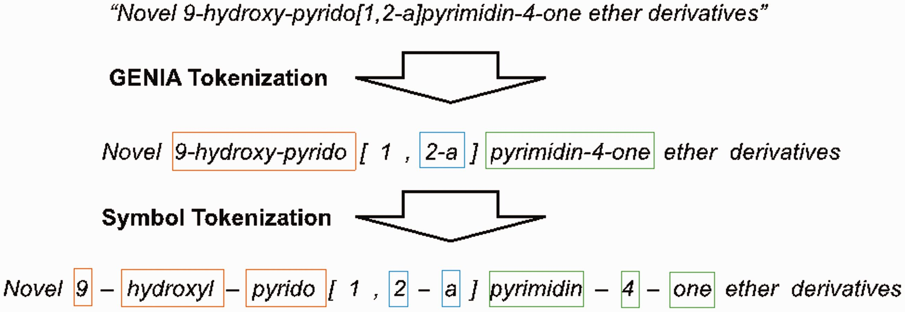
Figure 2 An example of tokenization.
Notes:
Figure 2 An example of tokenization.
Unless provided in the caption above, the following copyright applies to the content of this slide: © The Author(s) 2016. Published by Oxford University Press. This is an Open Access article distributed under the terms of the Creative Commons Attribution License ( http://creativecommons.org/licenses/by/4.0/ ), which permits unrestricted reuse, distribution, and reproduction in any medium, provided the original work is properly cited.

Slide 3
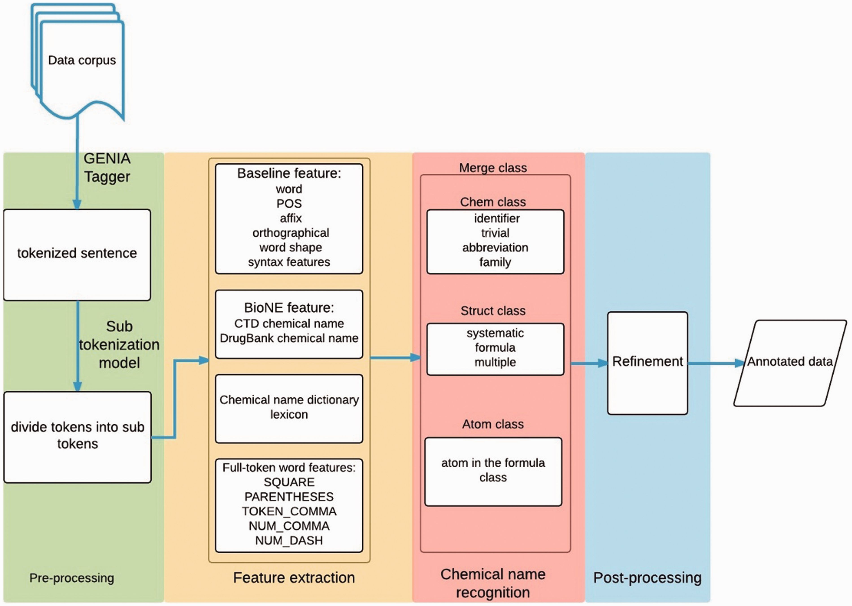
Figure 1 The workflow of our system.
Notes:
Figure 1 The workflow of our system.
Unless provided in the caption above, the following copyright applies to the content of this slide: © The Author(s) 2016. Published by Oxford University Press. This is an Open Access article distributed under the terms of the Creative Commons Attribution License ( http://creativecommons.org/licenses/by/4.0/ ), which permits unrestricted reuse, distribution, and reproduction in any medium, provided the original work is properly cited.

Slide 4
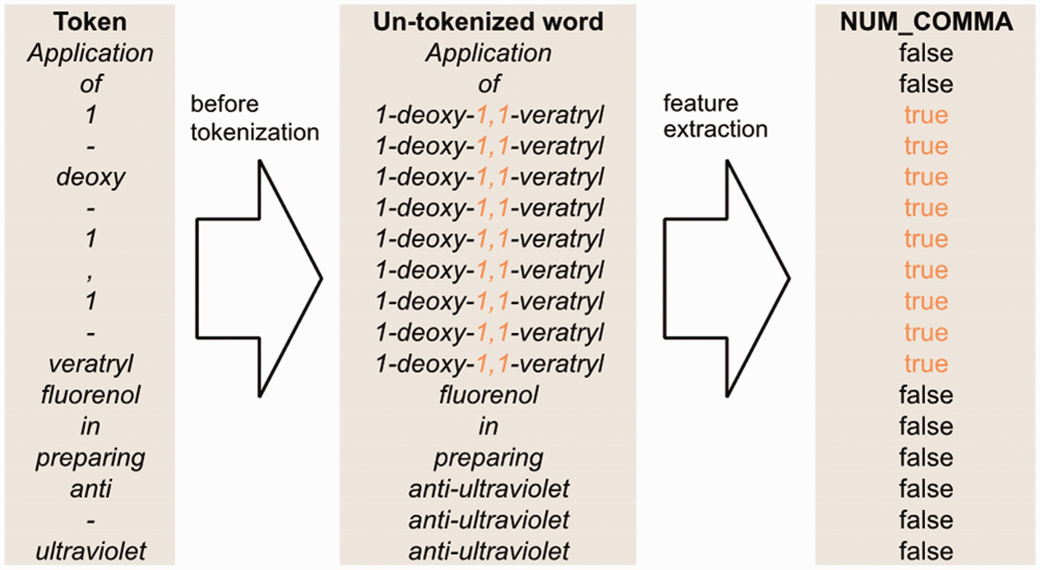
Figure 4 An example of un-tokenized word orthographical features for the sentence ‘Application of 1-deoxy-1,1-veratryl ...
Notes:
Figure 4 An example of un-tokenized word orthographical features for the sentence ‘Application of 1-deoxy-1,1-veratryl fluorenol in preparing anti-ultraviolet’.
Unless provided in the caption above, the following copyright applies to the content of this slide: © The Author(s) 2016. Published by Oxford University Press. This is an Open Access article distributed under the terms of the Creative Commons Attribution License ( http://creativecommons.org/licenses/by/4.0/ ), which permits unrestricted reuse, distribution, and reproduction in any medium, provided the original work is properly cited.

Slide 5
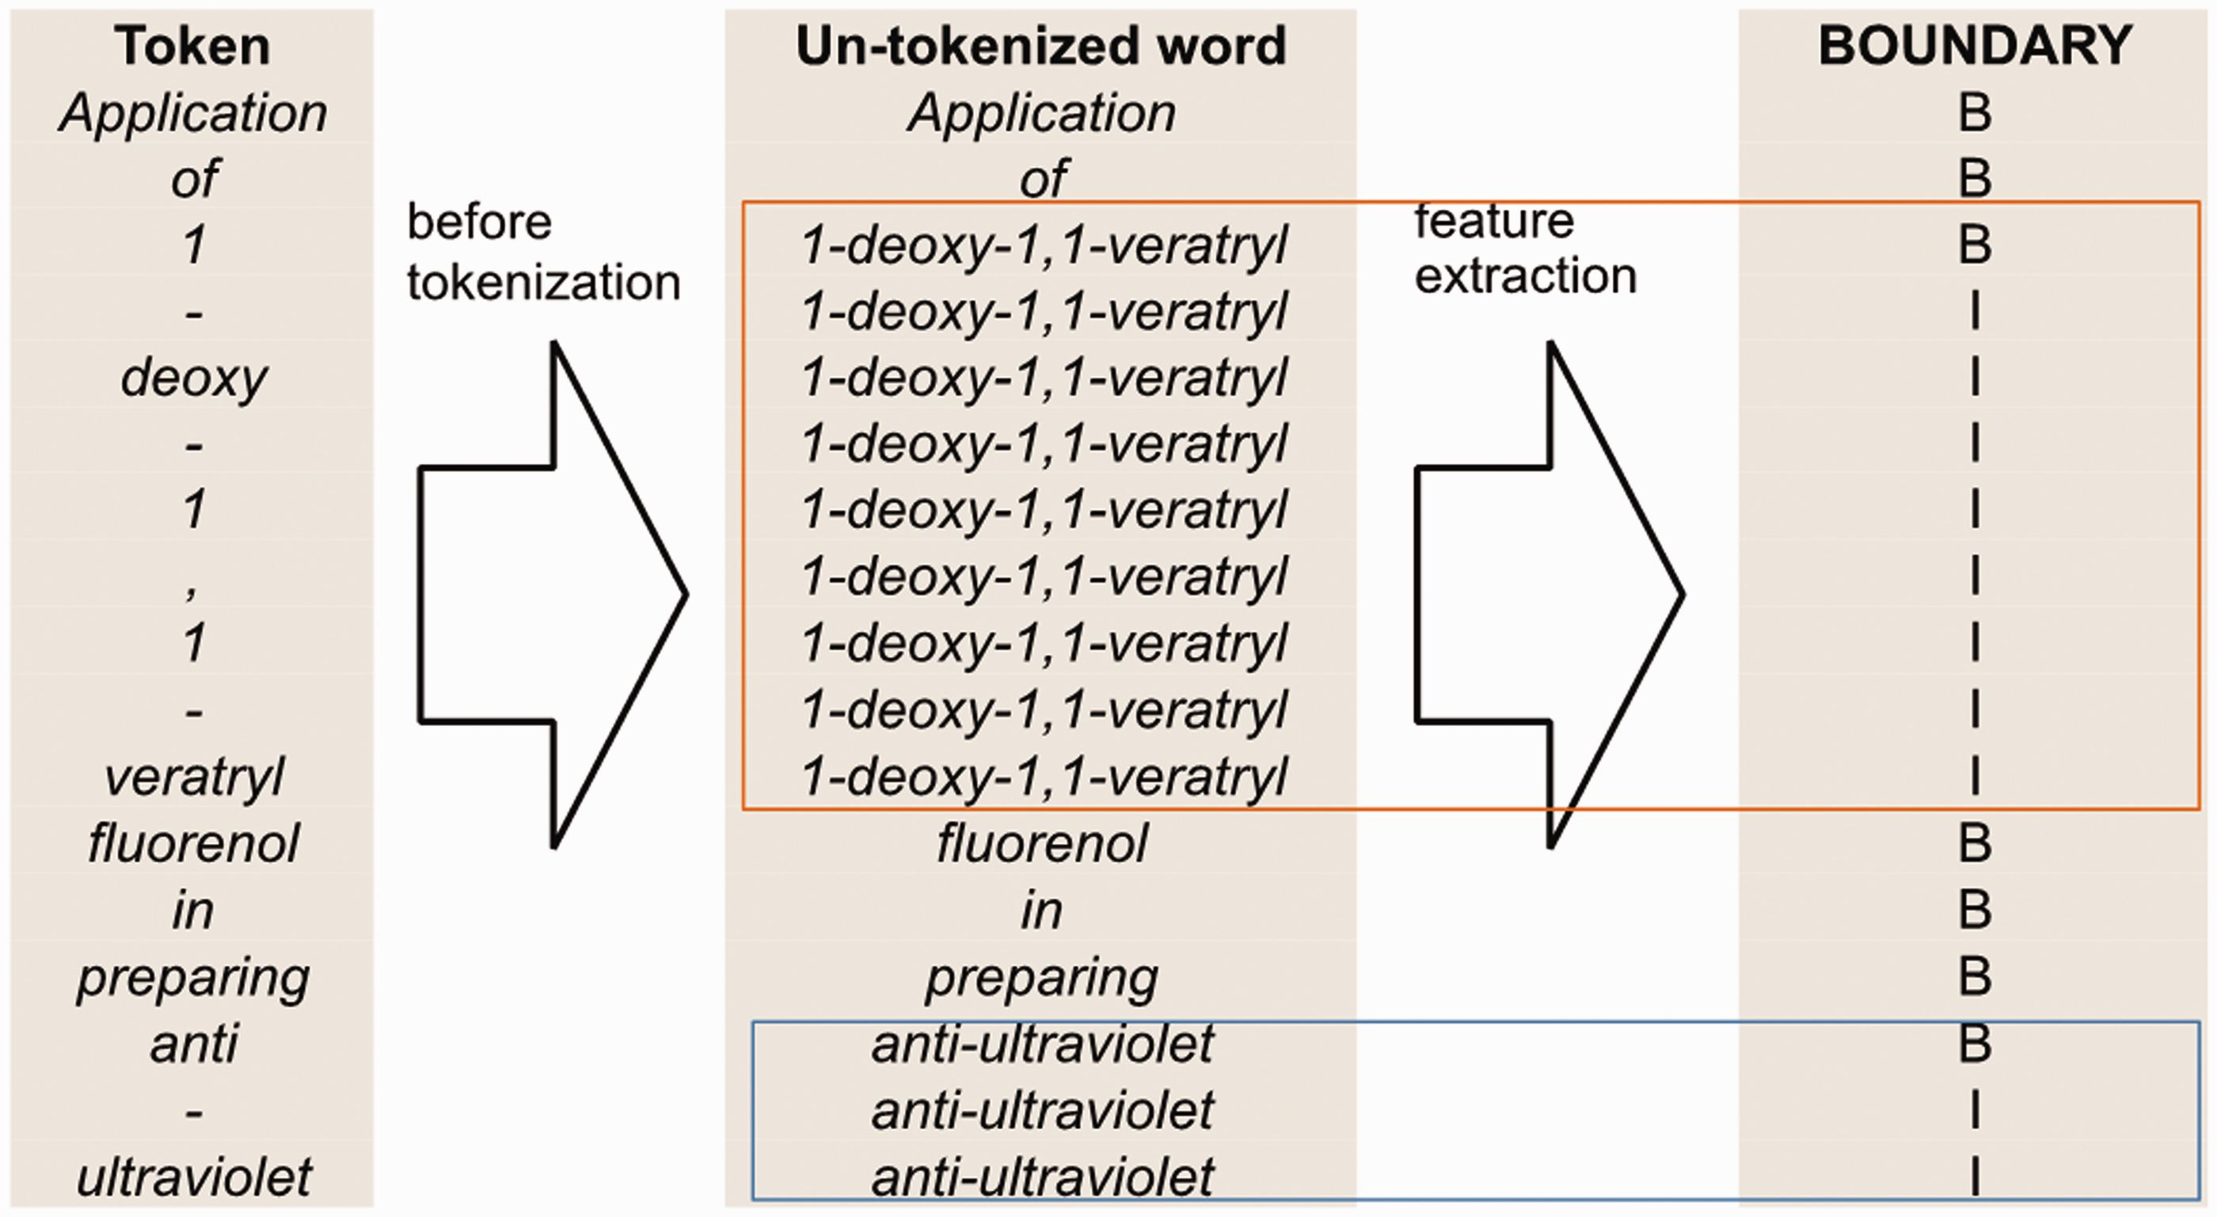
Figure 5 An example of boundary feature for the sentence ‘Application of 1-deoxy-1,1-veratryl fluorenol in preparing ...
Notes:
Figure 5 An example of boundary feature for the sentence ‘Application of 1-deoxy-1,1-veratryl fluorenol in preparing anti-ultraviolet’.
Unless provided in the caption above, the following copyright applies to the content of this slide: © The Author(s) 2016. Published by Oxford University Press. This is an Open Access article distributed under the terms of the Creative Commons Attribution License ( http://creativecommons.org/licenses/by/4.0/ ), which permits unrestricted reuse, distribution, and reproduction in any medium, provided the original work is properly cited.

Slide 6
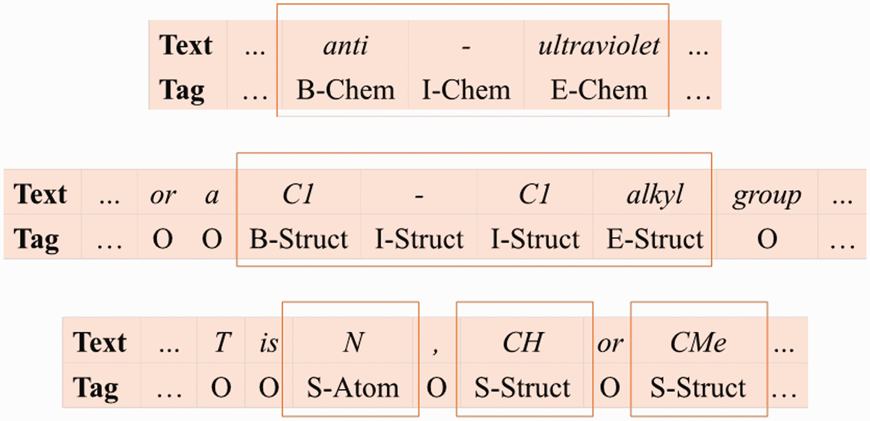
Figure 6 Examples of our label set.
Notes:
Figure 6 Examples of our label set.
Unless provided in the caption above, the following copyright applies to the content of this slide: © The Author(s) 2016. Published by Oxford University Press. This is an Open Access article distributed under the terms of the Creative Commons Attribution License ( http://creativecommons.org/licenses/by/4.0/ ), which permits unrestricted reuse, distribution, and reproduction in any medium, provided the original work is properly cited.

