Slide 1
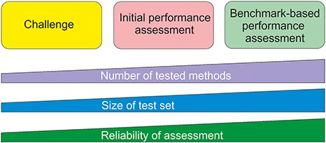
Figure 1 Types of method performance tests. The boxes indicate the three major test settings and the graphs below show ...
Notes:
Figure 1 Types of method performance tests. The boxes indicate the three major test settings and the graphs below show how the amounts of certain properties vary along test setup. The figure is adapted from (71).
Unless provided in the caption above, the following copyright applies to the content of this slide: © The Author(s) 2020. Published by Oxford University Press.This is an Open Access article distributed under the terms of the Creative Commons Attribution License (http://creativecommons.org/licenses/by/4.0/), which permits unrestricted reuse, distribution, and reproduction in any medium, provided the original work is properly cited.

