Slide 1
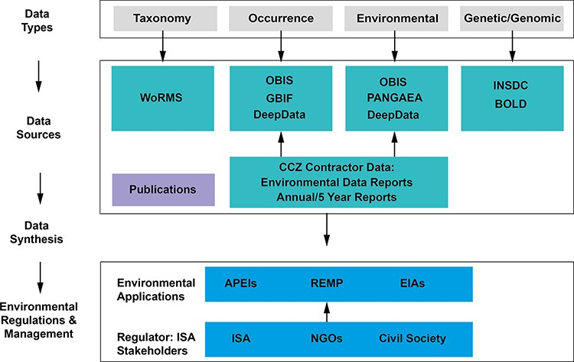
Figure 1. The Clarion-Clipperton Zone biodiversity data landscape, showing relevant key data types: taxonomy, ...
Notes:
Figure 1. The Clarion-Clipperton Zone biodiversity data landscape, showing relevant key data types: taxonomy, occurrence, environmental and genetic/genomic data; key data sources: databases, publications and contractor data; and how these data, once synthesized in publications and meta-analyses, could contribute to environmental management applications, with input by the regulator, the ISA and wider stakeholders. Key databases as listed: WoRMS, OBIS, GBIF, PANGAEA (Data Publisher for Earth & Environmental Science), INSDC and BOLD (Barcode Of Life Data System). Environmental applications: APEIs, REMP and EIAs (environmental impact assessments).
Unless provided in the caption above, the following copyright applies to the content of this slide: © The Author(s) 2023. Published by Oxford University Press.This is an Open Access article distributed under the terms of the Creative Commons Attribution License (https://creativecommons.org/licenses/by/4.0/), which permits unrestricted reuse, distribution, and reproduction in any medium, provided the original work is properly cited.

