Slide 1
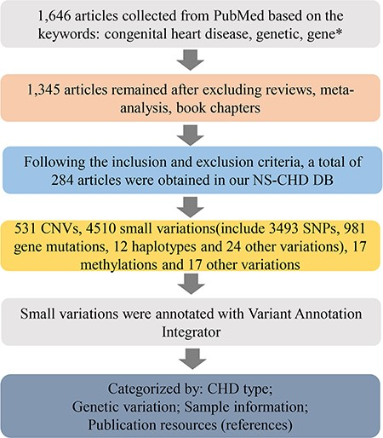
Figure 1 The schematic flow of the NS-CHD data collection and construction. After a series of standard selections, ...
Notes:
Figure 1 The schematic flow of the NS-CHD data collection and construction. After a series of standard selections, there were 284 articles selected from PubMed and incorporated into our database construction.
Unless provided in the caption above, the following copyright applies to the content of this slide: © The Author(s) 2020. Published by Oxford University Press.This is an Open Access article distributed under the terms of the Creative Commons Attribution License (http://creativecommons.org/licenses/by/4.0/), which permits unrestricted reuse, distribution, and reproduction in any medium, provided the original work is properly cited.

Slide 2
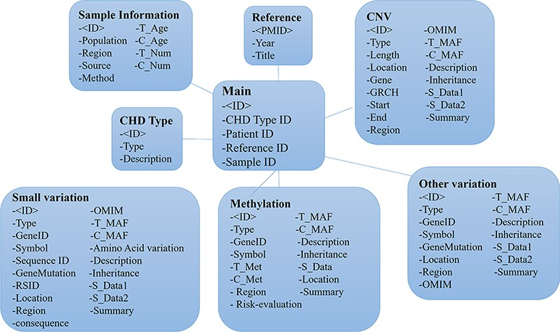
Figure 2 The entity relationship diagram of the CHDGKB.
Notes:
Figure 2 The entity relationship diagram of the CHDGKB.
Unless provided in the caption above, the following copyright applies to the content of this slide: © The Author(s) 2020. Published by Oxford University Press.This is an Open Access article distributed under the terms of the Creative Commons Attribution License (http://creativecommons.org/licenses/by/4.0/), which permits unrestricted reuse, distribution, and reproduction in any medium, provided the original work is properly cited.

Slide 3
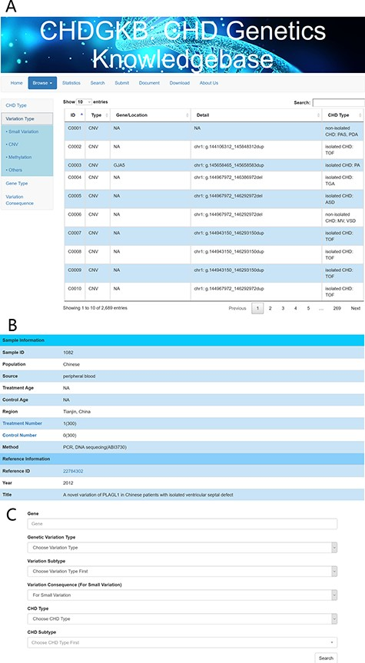
Figure 3 An example of the search interface with CHD subtype and precise query. Detailed information about the genetic ...
Notes:
Figure 3 An example of the search interface with CHD subtype and precise query. Detailed information about the genetic variations can be found in the NS-CHD database. [The search interfaces are depicted in Figure 3A, with links to the original publications (Figure 3B). Figure 3C show the interface for search results using key words, e.g. variations with GATA4].
Unless provided in the caption above, the following copyright applies to the content of this slide: © The Author(s) 2020. Published by Oxford University Press.This is an Open Access article distributed under the terms of the Creative Commons Attribution License (http://creativecommons.org/licenses/by/4.0/), which permits unrestricted reuse, distribution, and reproduction in any medium, provided the original work is properly cited.

Slide 4
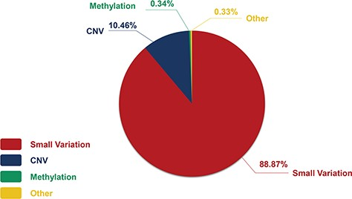
Figure 4 The constitution of genetic variations in the CHDGKB.
Notes:
Figure 4 The constitution of genetic variations in the CHDGKB.
Unless provided in the caption above, the following copyright applies to the content of this slide: © The Author(s) 2020. Published by Oxford University Press.This is an Open Access article distributed under the terms of the Creative Commons Attribution License (http://creativecommons.org/licenses/by/4.0/), which permits unrestricted reuse, distribution, and reproduction in any medium, provided the original work is properly cited.

Slide 5
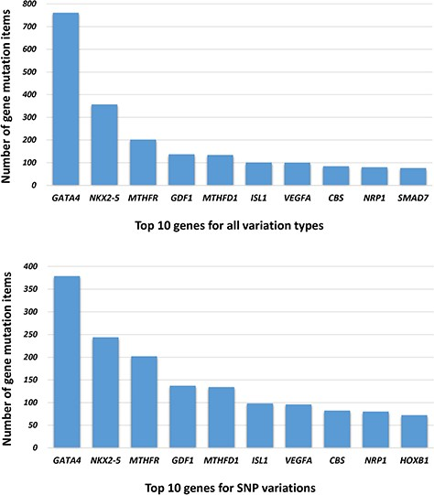
Figure 5 The top 10 genes associated with NS-CHD in the CHDGKB. (Figure 5A shows the top 10 genes with all variations ...
Notes:
Figure 5 The top 10 genes associated with NS-CHD in the CHDGKB. (Figure 5A shows the top 10 genes with all variations for NS-CHD; Figure 5B shows the top 10 genes associated with SNP variation.)
Unless provided in the caption above, the following copyright applies to the content of this slide: © The Author(s) 2020. Published by Oxford University Press.This is an Open Access article distributed under the terms of the Creative Commons Attribution License (http://creativecommons.org/licenses/by/4.0/), which permits unrestricted reuse, distribution, and reproduction in any medium, provided the original work is properly cited.

Slide 6
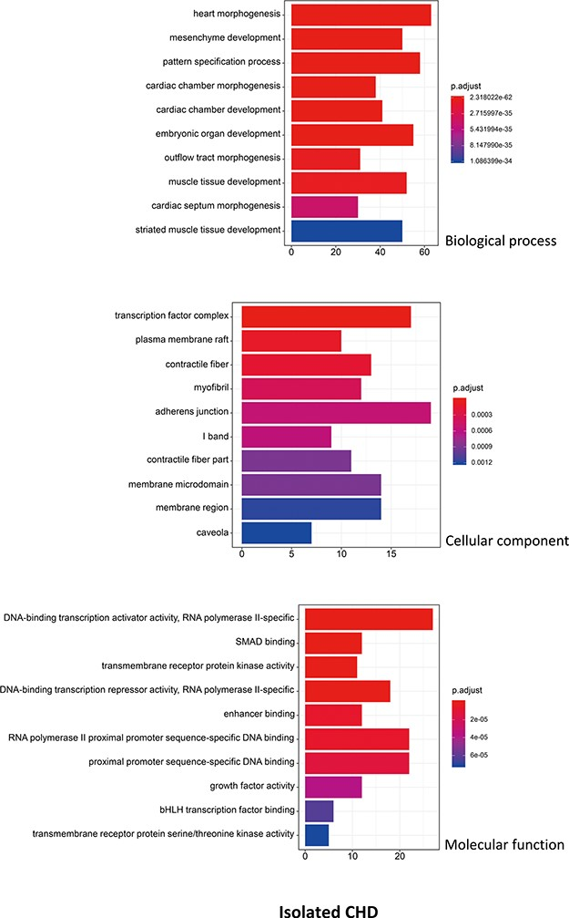
Figure 6 The top 10 significant enriched GO terms for isolated CHD. The statistical significance level (p.adjust, ...
Notes:
Figure 6 The top 10 significant enriched GO terms for isolated CHD. The statistical significance level (p.adjust, adjusted P-value) was depicted as different color.(X-axis indicated number of enriched genes; Y-axis indicated GO terms.)
Unless provided in the caption above, the following copyright applies to the content of this slide: © The Author(s) 2020. Published by Oxford University Press.This is an Open Access article distributed under the terms of the Creative Commons Attribution License (http://creativecommons.org/licenses/by/4.0/), which permits unrestricted reuse, distribution, and reproduction in any medium, provided the original work is properly cited.

Slide 7
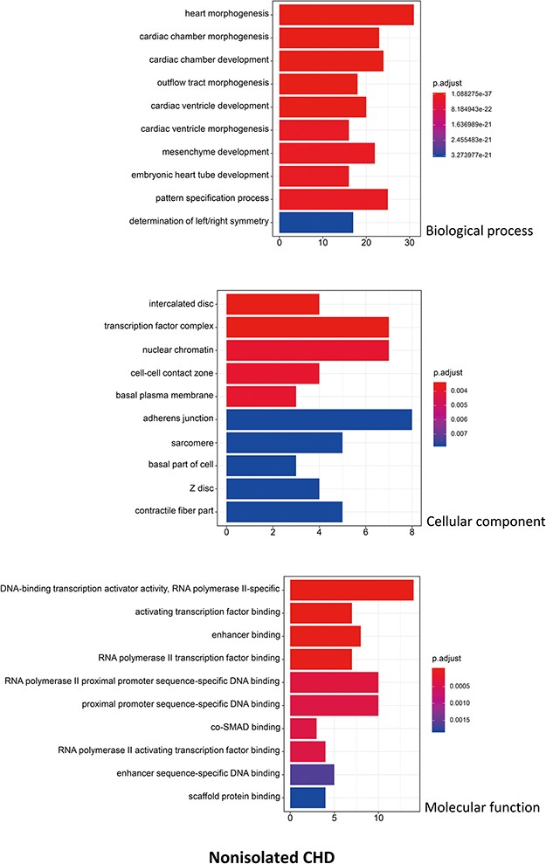
Figure 7 The top 10 significant enriched GO terms for non-isolated CHD. The statistical significance level (p.adjust, ...
Notes:
Figure 7 The top 10 significant enriched GO terms for non-isolated CHD. The statistical significance level (p.adjust, adjusted P-value) was depicted as different color. (X-axis indicated number of enriched genes; Y-axis indicated GO terms.)
Unless provided in the caption above, the following copyright applies to the content of this slide: © The Author(s) 2020. Published by Oxford University Press.This is an Open Access article distributed under the terms of the Creative Commons Attribution License (http://creativecommons.org/licenses/by/4.0/), which permits unrestricted reuse, distribution, and reproduction in any medium, provided the original work is properly cited.

Slide 8
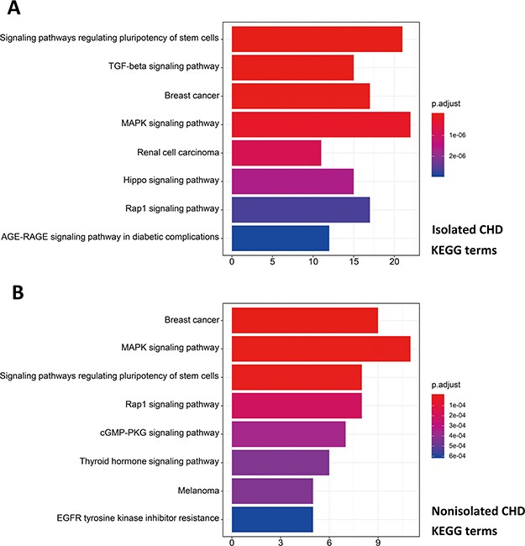
Figure 8 Pathway enrichment analysis for genetic variations of NS-CHD. The statistical significance level (p.adjust, ...
Notes:
Figure 8 Pathway enrichment analysis for genetic variations of NS-CHD. The statistical significance level (p.adjust, adjusted P-value) was depicted as different color. (Figure 8A, the top eight significant KEGG terms for isolated CHD; Figure 8B, the top eight significant KEGG terms for non-isolated CHD. X-axis indicated number of enriched genes; Y-axis indicated enriched pathways.)
Unless provided in the caption above, the following copyright applies to the content of this slide: © The Author(s) 2020. Published by Oxford University Press.This is an Open Access article distributed under the terms of the Creative Commons Attribution License (http://creativecommons.org/licenses/by/4.0/), which permits unrestricted reuse, distribution, and reproduction in any medium, provided the original work is properly cited.

