Slide 1
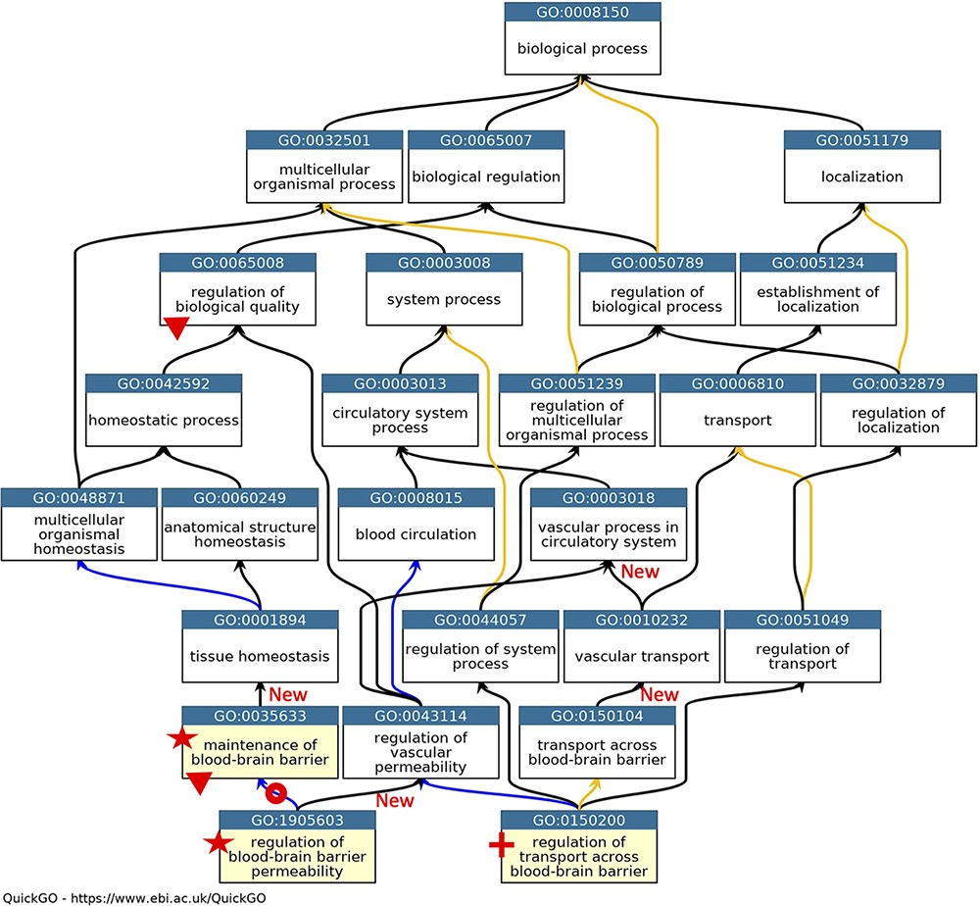
Figure 1. GO describing permeability of the BBB. A subset of the GO terms describing the processes occurring at the ...
Notes:
Figure 1. GO describing permeability of the BBB. A subset of the GO terms describing the processes occurring at the BBB. GO terms are listed in separate nodes and the descendant relationships are indicated by black, blue and yellow arrows, for ‘is_a’, ‘part_of’ and ‘regulates’ relations, respectively. The GO term identifiers and names are included in each node. The yellow highlighted nodes indicate either a new GO term or a revised term name. The new GO term, GO:0150200 ‘regulation of transport across blood-brain barrier’, is indicated by a red cross; the new relations associated with this new term are not individually highlighted. A red star indicates the two terms with changed GO term names: GO:0035633 renamed as ‘maintenance of blood-brain barrier’ rather than ‘maintenance of permeability of blood-brain barrier’ and GO:1905603 renamed as ‘regulation of blood-brain barrier permeability’ rather than ‘regulation of maintenance of permeability of blood-brain barrier’. The red doughnut indicates a change in the relation ‘regulates’ to ‘part_of’ between GO:0035633 ‘maintenance of blood-brain barrier’ and GO:1905603 ‘regulation of blood-brain barrier permeability’. A red triangle indicates GO terms which have had descendant relations removed, GO:0035633 ‘maintenance of blood-brain barrier’ was removed as a child term from GO:0065008 ‘regulation of biological quality’; two terms describing positive and negative regulation of BBB permeability (GO:1905605 and GO:1905604) were removed as direct descendants of GO:0035633 ‘maintenance of blood-brain barrier’. New ‘is_a’ relations are indicated by ‘New’. Screenshot of the GO taken from QuickGO (11).
Unless provided in the caption above, the following copyright applies to the content of this slide: © The Author(s) 2021. Published by Oxford University Press.This is an Open Access article distributed under the terms of the Creative Commons Attribution License (https://creativecommons.org/licenses/by/4.0/), which permits unrestricted reuse, distribution, and reproduction in any medium, provided the original work is properly cited.

