Slide 1
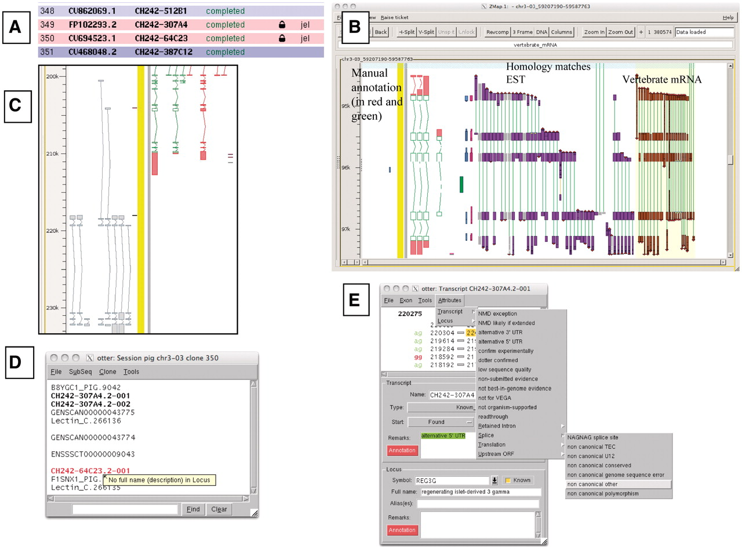
Figure 1. A selection of different views of Otterlace and ZMap. (A) Assembly sequence chooser showing user’s email ...
Notes:
Figure 1. A selection of different views of Otterlace and ZMap. (A) Assembly sequence chooser showing user’s email displayed on locked clones. (B) ZMap view of the results of pipeline analysis, namely EST (in purple) and vertebrate mRNA (in brown) homology matches together with manually annotated transcripts (in red and green). (C) Manual annotation shown as ‘greyed out’, non-editable transcripts where they extend past the genomic region that has been opened. (D) Internal QC displaying a ‘tool tip’. (E) Transcript editing window showing a non-consensus splice site that has been highlighted in red, and a selection of attributes available at the transcript level (green shaded text).
Unless provided in the caption above, the following copyright applies to the content of this slide: © The Author(s) 2012. Published by Oxford University Press.This is an Open Access article distributed under the terms of the Creative Commons Attribution Non-Commercial License (http://creativecommons.org/licenses/by-nc/3.0), which permits unrestricted non-commercial use, distribution, and reproduction in any medium, provided the original work is properly cited.

