Slide 1
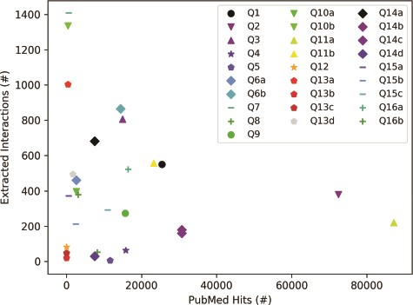
Figure 5 Influence of query category and term choice (the legend corresponds to query numbers in Table 3) on the ...
Notes:
Figure 5 Influence of query category and term choice (the legend corresponds to query numbers in Table 3) on the number of papers found in PubMed and on the number of interactions extracted from the top 200 papers (except Q12, Q13b and Q13c, where PubMed returned less than 200 hits). Results obtained for the same query topic category, but different term aliases, or different example terms, are grouped together with the same marker shape and similar color.
Unless provided in the caption above, the following copyright applies to the content of this slide: © The Author(s) 2020. Published by Oxford University Press.This is an Open Access article distributed under the terms of the Creative Commons Attribution License (http://creativecommons.org/licenses/by/4.0/), which permits unrestricted reuse, distribution, and reproduction in any medium, provided the original work is properly cited.

