Slide 1
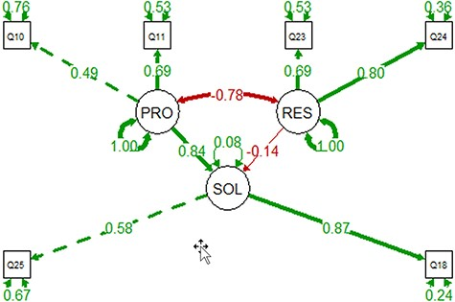
Figure 18. The PRO-SOL-RES model constructed with the 91 observations. Circles are for latent variables, and boxes are ...
Notes:
Figure 18. The PRO-SOL-RES model constructed with the 91 observations. Circles are for latent variables, and boxes are for measured variables. Self-directing, double-arrowed links show the residuals. Double-arrowed links between two variables indicate correlation, where single-arrowed links show causal relationships. Positive correlations are shown in green, and negative in red. The model shows that increased awareness of the problems can reduce resistance and increase adoption.
Unless provided in the caption above, the following copyright applies to the content of this slide: © The Author(s) 2022. Published by Oxford University Press.This is an Open Access article distributed under the terms of the Creative Commons Attribution License (https://creativecommons.org/licenses/by/4.0/), which permits unrestricted reuse, distribution, and reproduction in any medium, provided the original work is properly cited.

