Slide 1
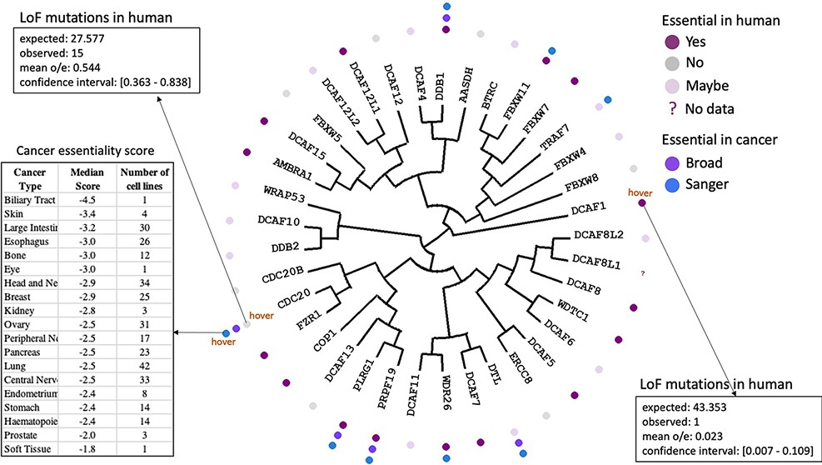
Figure 3. Essentiality in cancer and in healthy individuals. Cancer dependency data derived from CRISPR knockout ...
Notes:
Figure 3. Essentiality in cancer and in healthy individuals. Cancer dependency data derived from CRISPR knockout screens at the Broad and Wellcome Sanger Institutes (20, 21) is mapped next to each protein name in the dendogram. Hovering over icons provides details on essentiality score and number of cell lines representing each cancer type. The essentiality of each gene in healthy individuals derived from observed versus expected LoF mutations (12) is also projected on the tree.
Unless provided in the caption above, the following copyright applies to the content of this slide: © The Author(s) 2022. Published by Oxford University Press.This is an Open Access article distributed under the terms of the Creative Commons Attribution-NonCommercial License (https://creativecommons.org/licenses/by-nc/4.0/), which permits non-commercial re-use, distribution, and reproduction in any medium, provided the original work is properly cited. For commercial re-use, please contact journals.permissions@oup.com

