Slide 1
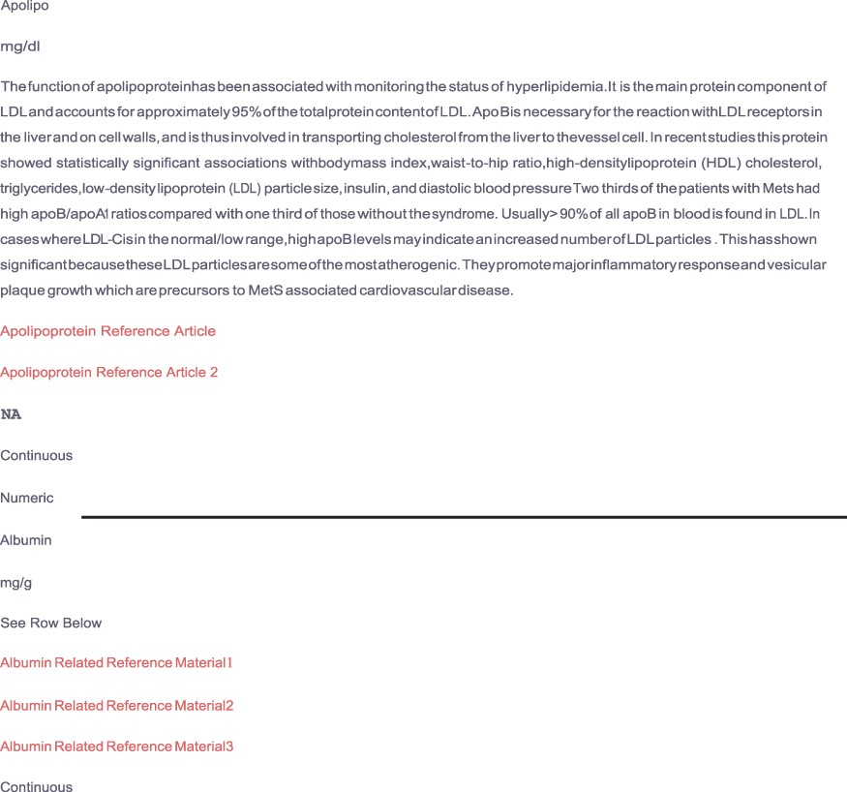
Figure 6. Depicts supplemental material provided by the MetSRR database. The live links allow users to access journal ...
Notes:
Figure 6. Depicts supplemental material provided by the MetSRR database. The live links allow users to access journal articles supporting the inclusion of selected variables.
Unless provided in the caption above, the following copyright applies to the content of this slide: © The Author(s) 2020. Published by Oxford University Press.This is an Open Access article distributed under the terms of the Creative Commons Attribution License (http://creativecommons.org/licenses/by/4.0/), which permits unrestricted reuse, distribution, and reproduction in any medium, provided the original work is properly cited.

