Slide 1
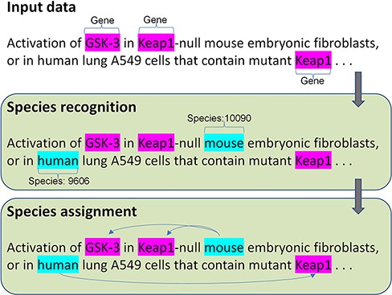
The architecture of the species recognition and assignment.
Notes:
The architecture of the species recognition and assignment.
Unless provided in the caption above, the following copyright applies to the content of this slide: Published by Oxford University Press 2022. This work is written by (a) US Government employee(s) and is in the public domain in the US.This work is written by (a) US Government employee(s) and is in the public domain in the US.

