Slide 1
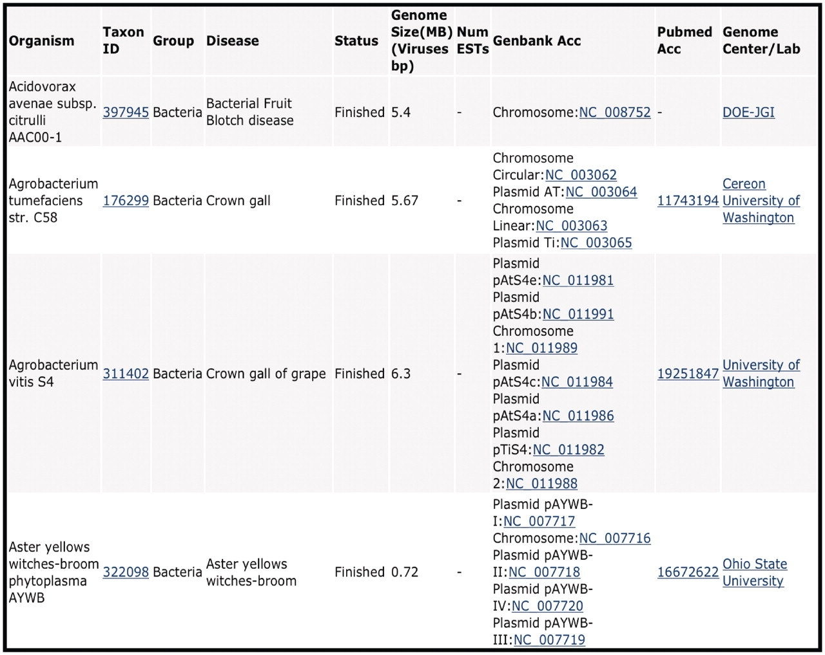
Figure 1. CPGR Warehouse. Output derived from filtering the CPGR Warehouse for bacterial genome projects. The output ...
Notes:
Figure 1. CPGR Warehouse. Output derived from filtering the CPGR Warehouse for bacterial genome projects. The output has been alphabetized based on the organism name and only the first four genome projects are listed. The organism name including strain designation, NCBI Taxon ID (http://www.ncbi.nlm.nih.gov/taxonomy), warehouse group, disease, genome status, genome size, number of ESTs (none in this example as these are genome projects), GenBank accession numbers hyperlinked to GenBank http://www.ncbi.nlm.nih.gov/genbank/), Pubmed accession numbers hyperlinked to Pubmed (http://www.ncbi.nlm.nih.gov/pubmed) and the Genome Center or laboratory that completed the work are provided in the output.
Unless provided in the caption above, the following copyright applies to the content of this slide: © The Author(s) 2011. Published by Oxford University Press.This is an Open Access article distributed under the terms of the Creative Commons Attribution Non-Commercial License (http://creativecommons.org/licenses/by-nc/3.0), which permits unrestricted non-commercial use, distribution, and reproduction in any medium, provided the original work is properly cited.

