Slide 1
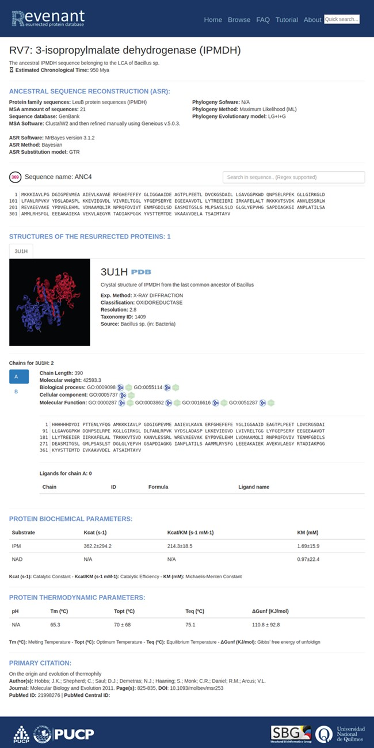
Figure 4 Main entry page. Each entry starts with a title followed by a brief explanation of the biological relevance ...
Notes:
Figure 4 Main entry page. Each entry starts with a title followed by a brief explanation of the biological relevance of the resurrected protein. Additionally, each entry has fields regarding ancestral sequence reconstruction, information about their structures, biochemical and biophysical parameters and, finally, the primary citation.
Unless provided in the caption above, the following copyright applies to the content of this slide: © The Author(s) 2020. Published by Oxford University Press.This is an Open Access article distributed under the terms of the Creative Commons Attribution License (http://creativecommons.org/licenses/by/4.0/), which permits unrestricted reuse, distribution, and reproduction in any medium, provided the original work is properly cited.

