Slide 1
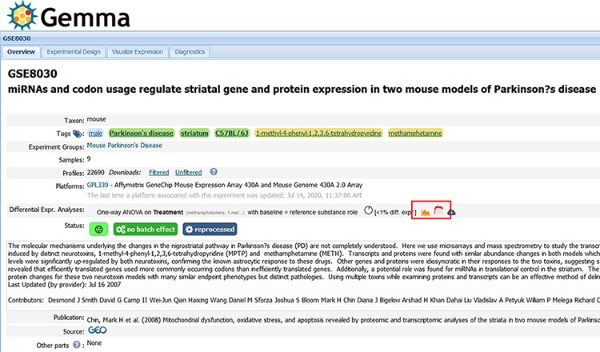
Figure 9. Snapshot of Gemma’s dataset page for GSE8030 [https://tinyurl.com/Gemma-GSE8030, (61)]; see main text for ...
Notes:
Figure 9. Snapshot of Gemma’s dataset page for GSE8030 [https://tinyurl.com/Gemma-GSE8030, (61)]; see main text for description. The red box indicates the ‘Differential Expression’ buttons for accessing the details shown in Figure 10C.
Unless provided in the caption above, the following copyright applies to the content of this slide: © The Author(s) 2021. Published by Oxford University Press.This is an Open Access article distributed under the terms of the Creative Commons Attribution License (http://creativecommons.org/licenses/by/4.0/), which permits unrestricted reuse, distribution, and reproduction in any medium, provided the original work is properly cited.

